Slide 1
Professor Onn Min Kon
BTS MDR-TB Clinical Advice Service

Slide 2
Contents
The Service in brief
Service usage figures
Virtual MDT figures
How to use the Service
MDR-TB Data Dashboards
Contact us

Slide 3
The BTS MDR-TB Clinical Advice Service
This new and improved service was launched in January 2018
Cases can be jointly managed by clinicians
Clinicians receive treatment advice on a case by case basis
Monthly virtual MDTs with a panel of MDR-TB experts
Rapid advice given in advance of monthly MDTs
Apply for ratification of bedaquiline/delamanid applications

Slide 4
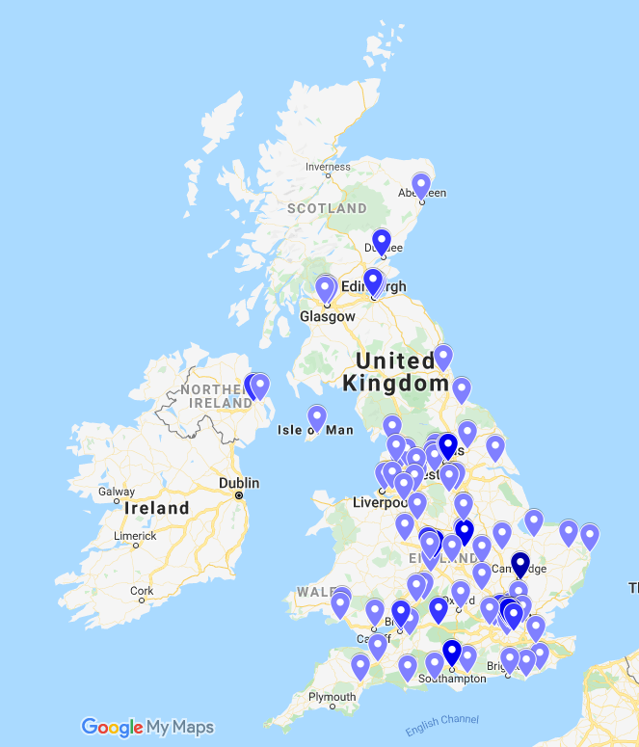
Service use since January 2018
266 registered clinicians across 100 sites
Sites registered across the UK
181 cases submitted to date
Advice given from a panel of 38 Clinical Service Advisers, including specialists in:
.
  Respiratory medicine
  Infectious diseases
  Paediatrics
  Thoracic surgery
  Pharmacy
  TB nursing
  Public Health
  Microbiology
Map of registered clinicians – November 2019

Slide 5
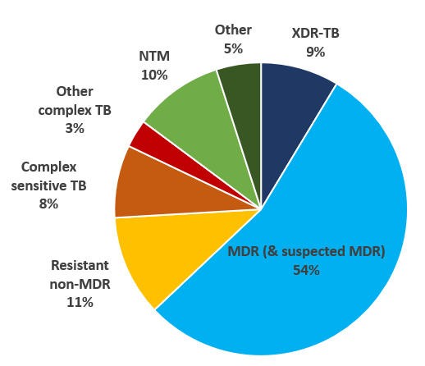
Virtual MDT meetings since January 2018
23 virtual MDTs held to date
162 cases discussed
Clinicians may dial in if they are able
On average,10 Clinical Service Advisers from a range of disciplines present for each MDT
Cases discussed at vMDT – to November 2019

Slide 6
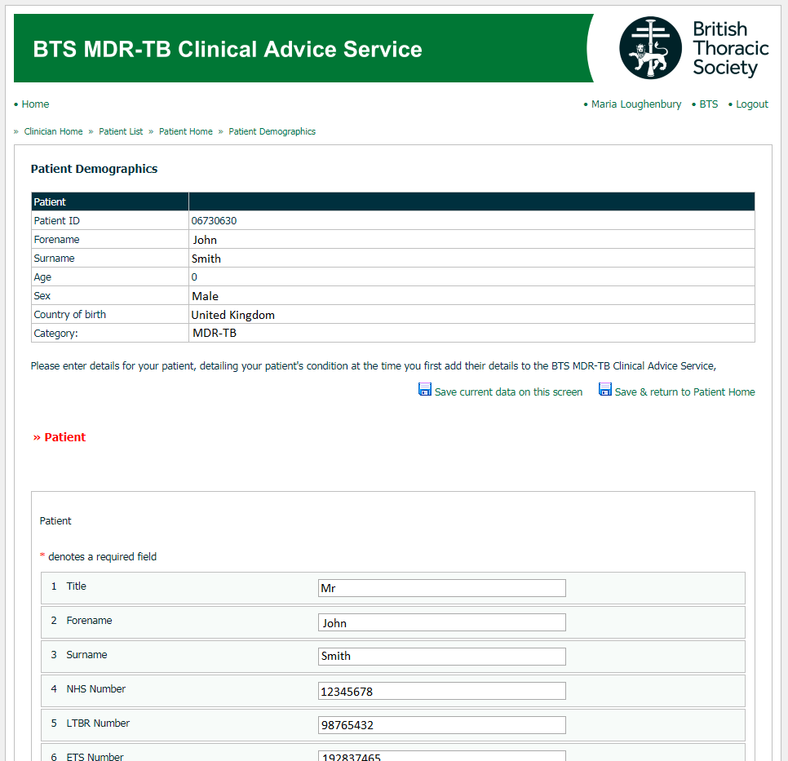
Using the Service – Adding a case
Clinicians sign up for the Service at:
mdrtb.brit-thoracic.org.uk
.
Patient consent must be obtained prior to posting.
.
Information is entered into simple online forms which ask for key information on patient demographics and clinical information.

Slide 7
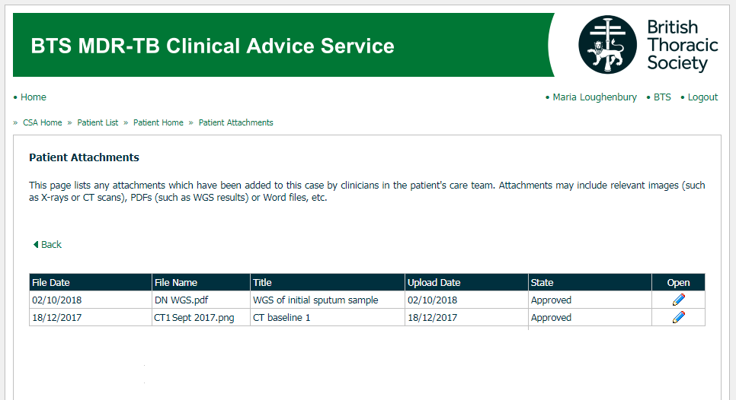
Using the Service – Attachments
Clinicians are able to upload attachments to their cases online.
Uploading WGS reports means the microbiologists on our panel of advisers can give greater insight into cases. Reports may be uploaded as a simple PDF.
Clinicians can also add CT/X-ray images to their cases.

Slide 8
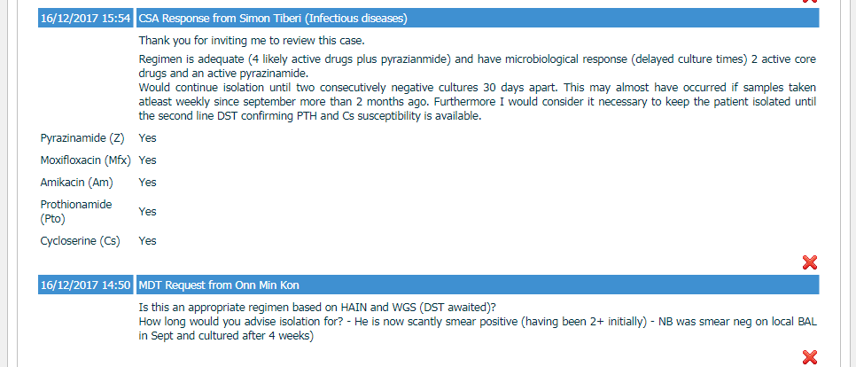
Using the Service – Receiving advice
When clinicians post a case online they also enter a short question indicating what specific advice they would like e.g. drugs, treatment duration, etc.
.
Any responses from advisers – including MDT responses – appear alongside this question.
.
Clinicians receive an automated email notification when any advice is posted to their case.

Slide 9
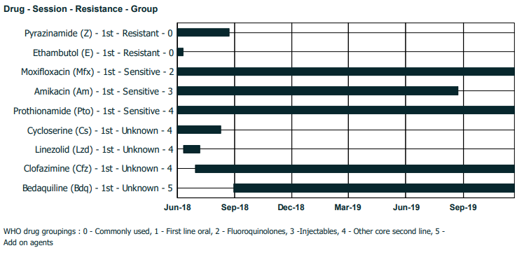
Using the Service – Drug-o-grams
In July 2019 the drug-o-gram chart was launched as part of the case summary report.
This chart is available to clinicians and advisers, acting as a visual representation of drug treatment to date (akin to a Gantt chart).

Slide 10
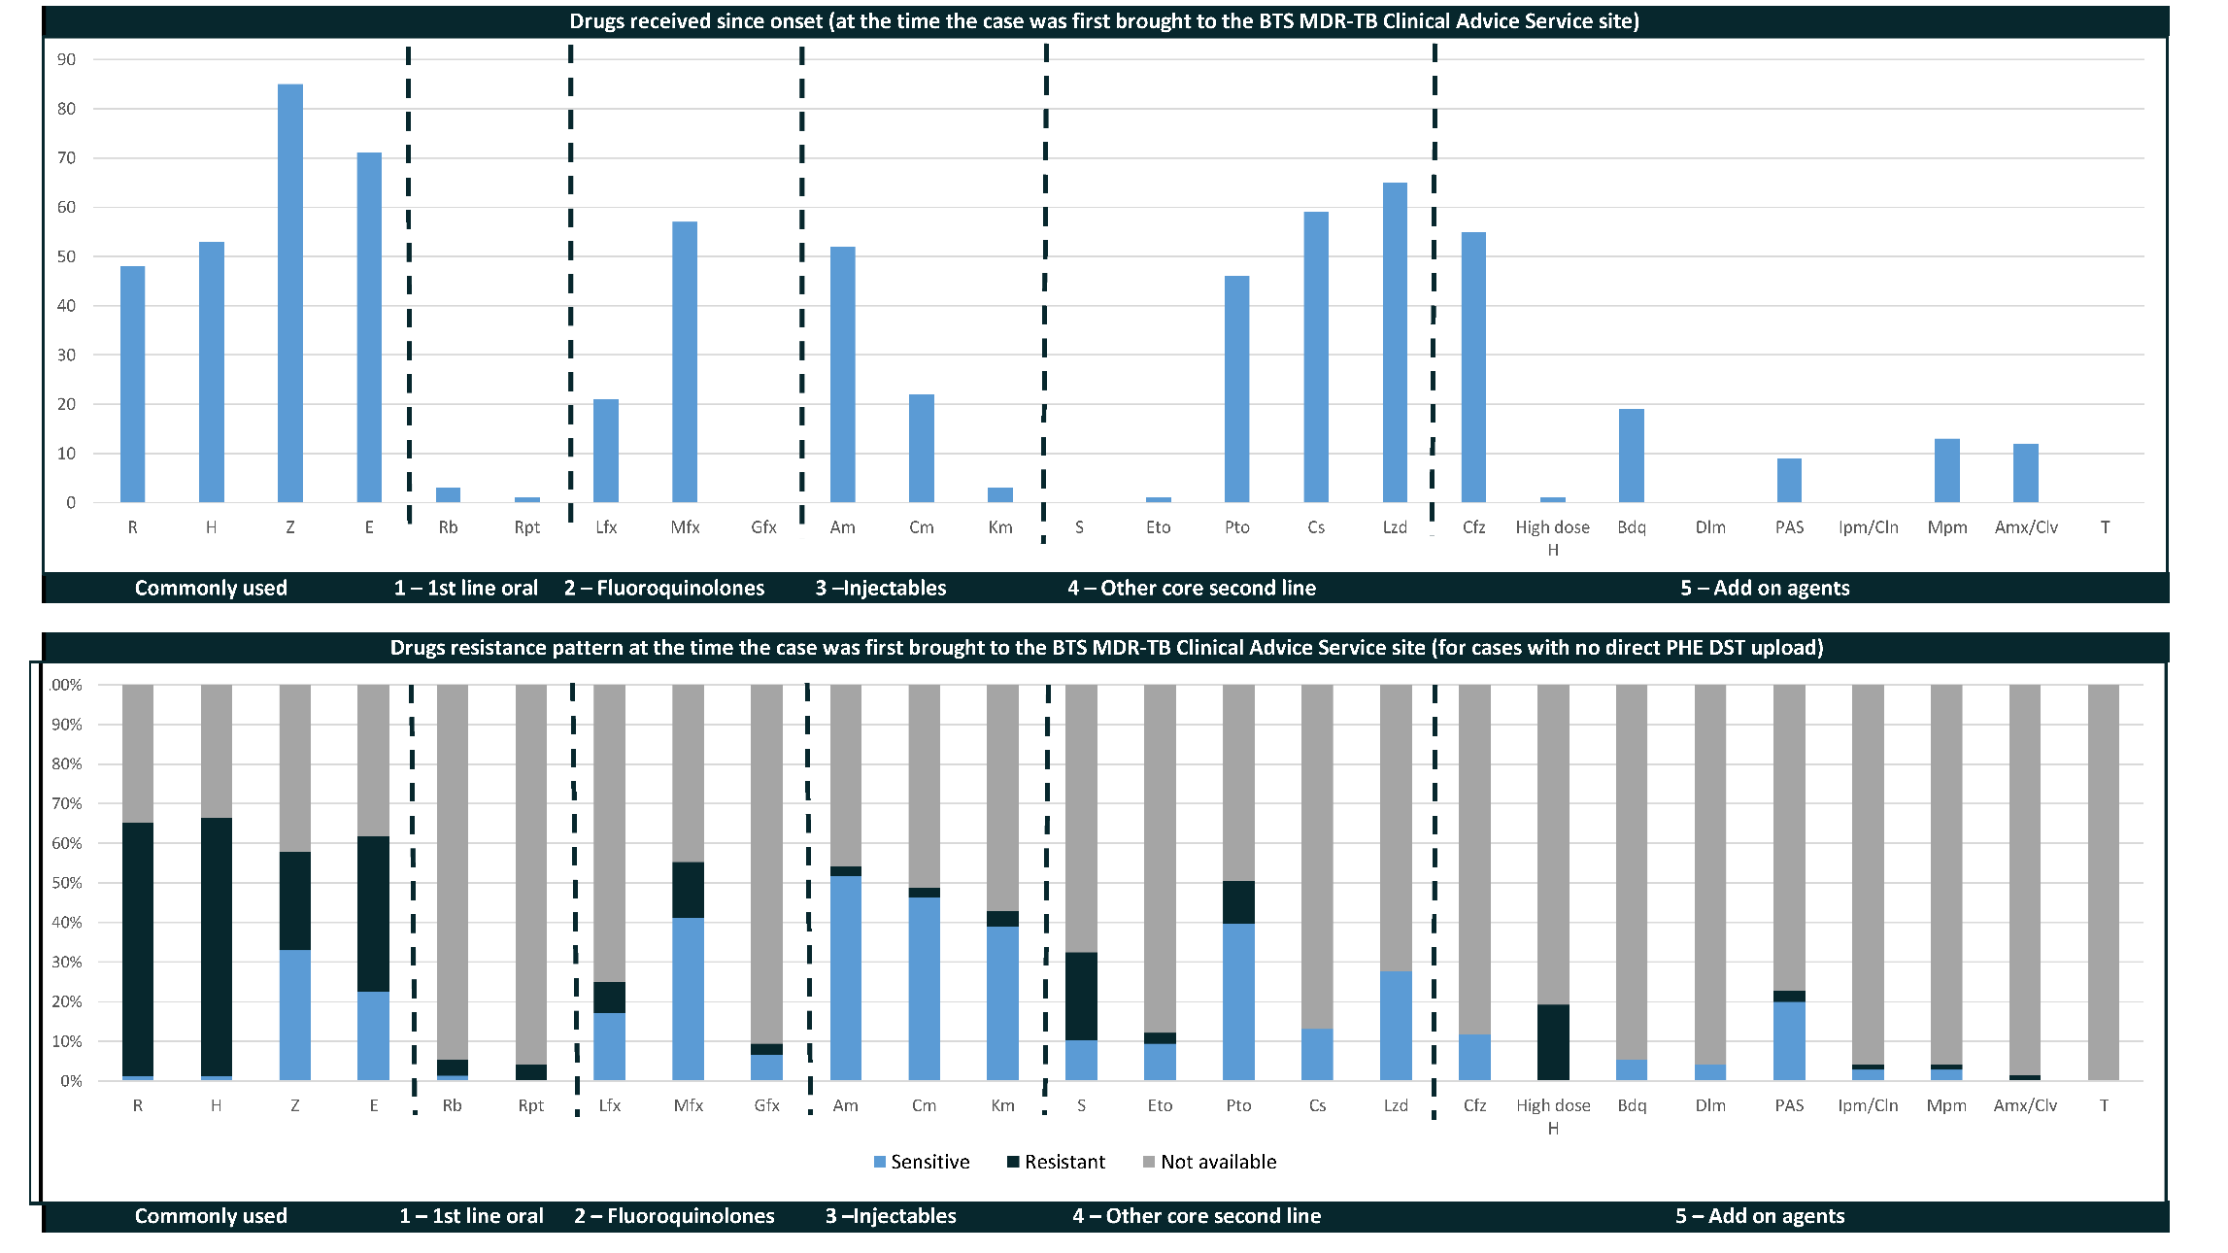
MDR-TB Data Dashboards

Slide 11
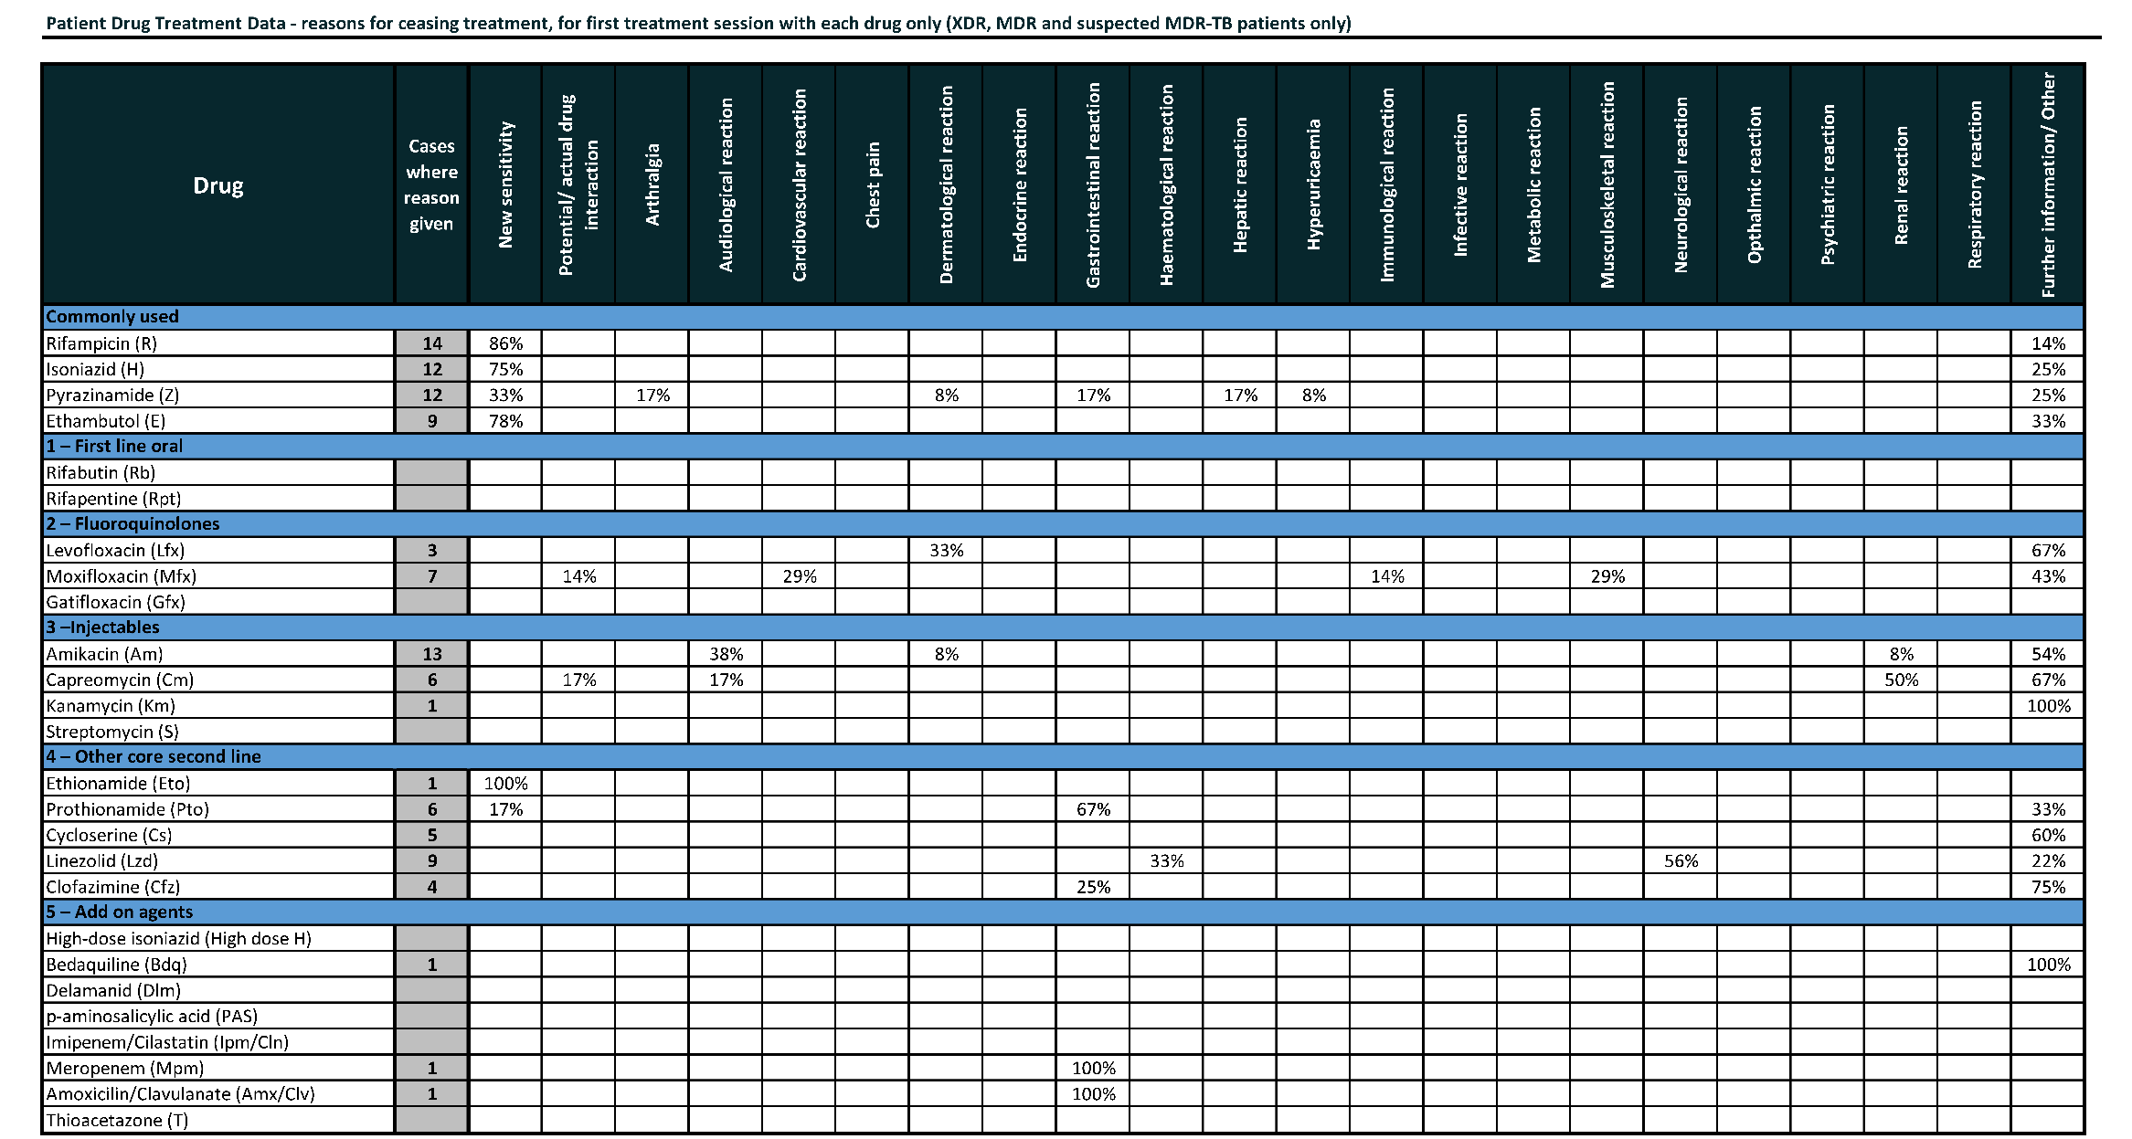
MDR-TB Data Dashboards

Slide 12
Contact us
mdrtb@brit-thoracic.org.uk

