Slide 1
Thoracic Ultrasound Practical Training – Supporting material
Collated by Andrew Stanton and Eihab Bedawi, BTS Thoracic Ultrasound Working group, June 2022, with thanks to Oxford Pleural Unit for selected images

Slide 2
TUS Practical training – supporting material
This material is intended as an optional adjunct to the practical training component of the primary TUS operator pathway. Depending on the patient mix recruited for face-to-face training, it may help demonstrate certain pathology where not available.
Faculty can use as much or as little as is felt appropriate for time available
Slides have some explanatory notes, but they are intentionally kept to a minimum to allow faculty to discuss potential associated clinical scenarios and reasons for / against intervention in certain situations
Videos are best viewed without enlarging to avoid loss of resolution
Examples are provided of:
  Echogenic effusion
  Varying degrees of septation
  Small effusions
  Pleural thickening
  Nodularity /pleural tumour

Slide 3
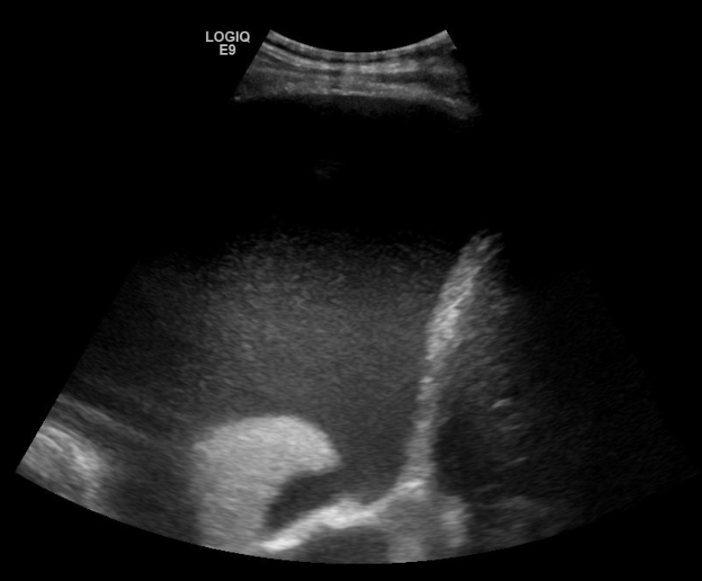
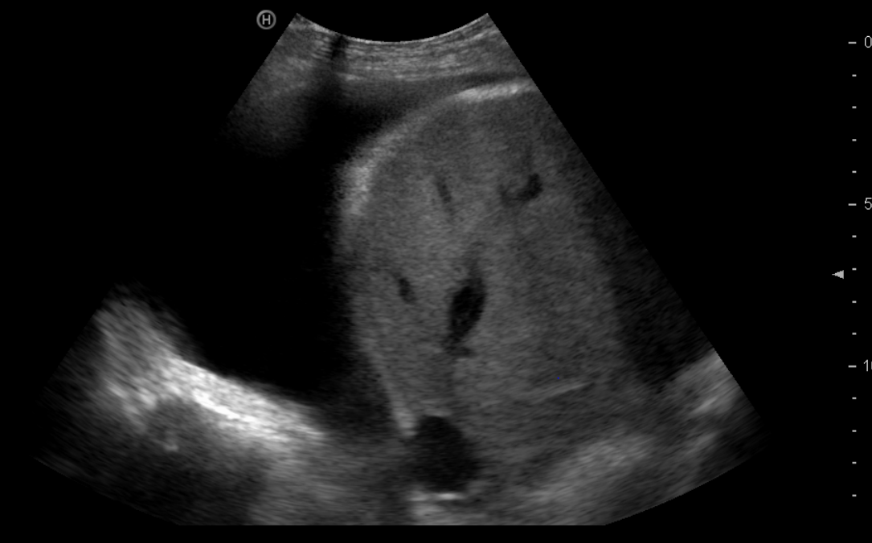
Anechoic/ Non-echogenic
Hyperechoic/ Echogenic
Notes:
LEFT – liver, normal dome-shaped diaphragm, anechoic pleural fluid
RIGHT – echogenic fluid, flattened diaphragm, atelectatic lung

Slide 4
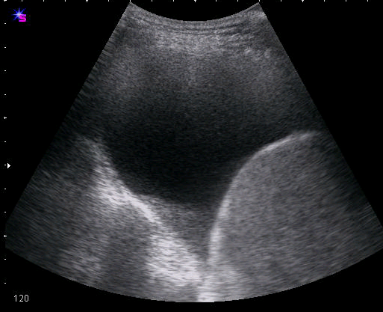
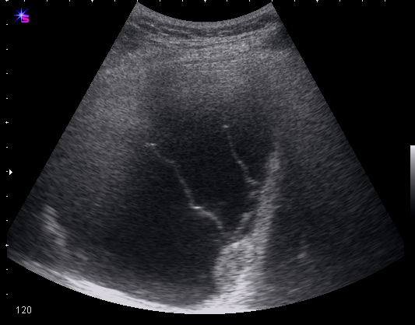
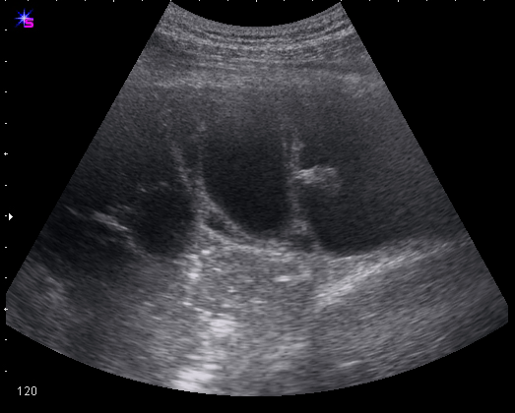
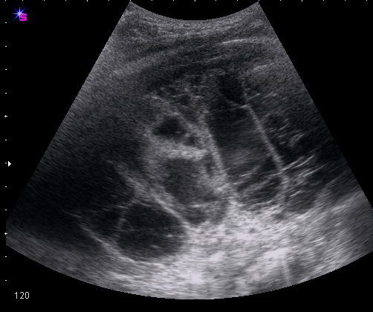
Septation assessment
None
Mild
Moderate
Severe
Notes:
A septation is the sonographic description of a fibrin strand. In the early phase of their development, septations are thin and mobile in appearance and progress to thick and fixed mature adhesions.
How to quantify?
No of septations visible through vertical plane
Mild – 1-2
Moderate 3-4
Severe >/=5

Slide 5
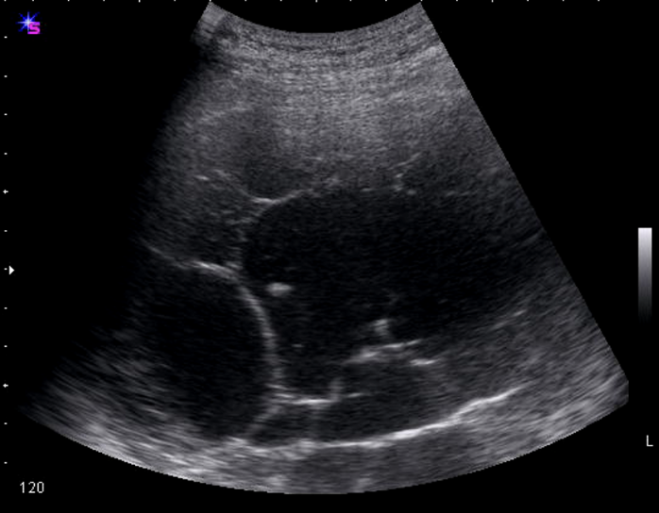
Septations 1
Notes:
Moderately septated, echogenic effusion

Slide 6
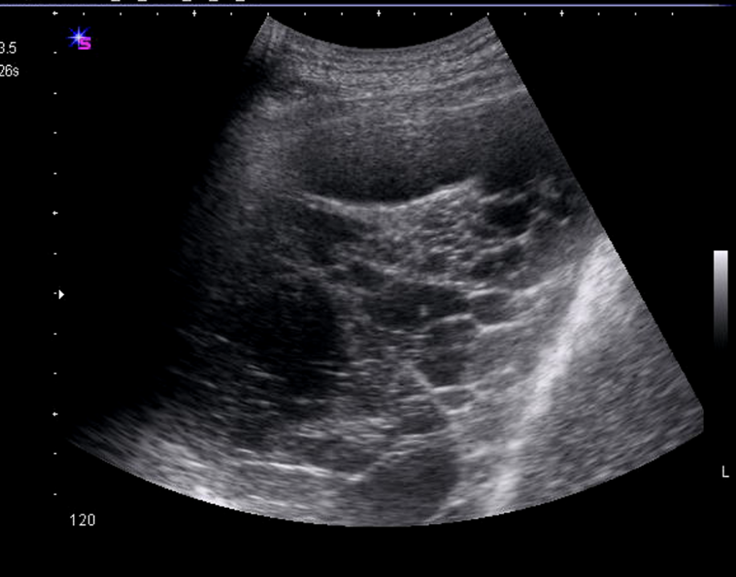
Septations 2
Notes:
Severely septated effusion, highly organised in places

Slide 7
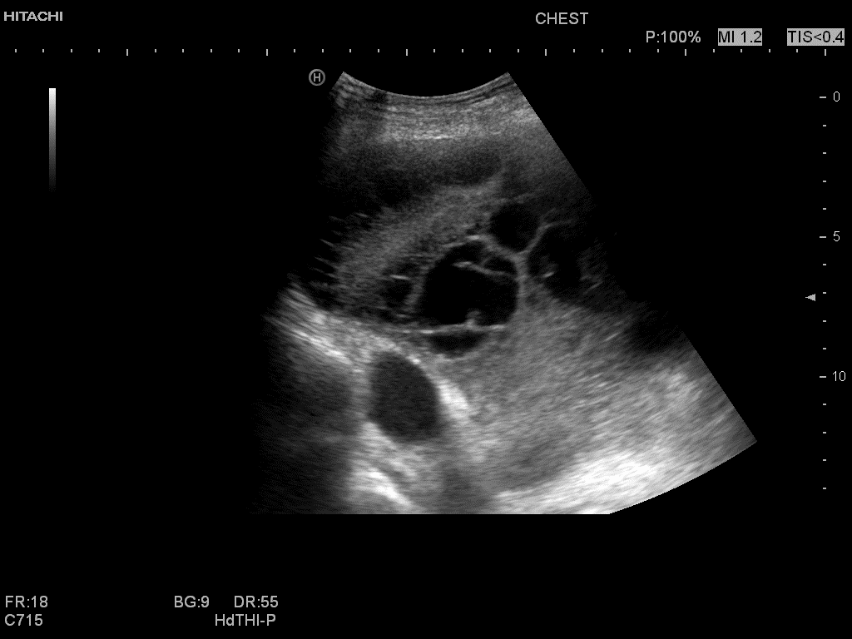
Septations 3
Notes:
Severely septated/ superficically organised collection forming clear locules (with septations within) and distal consolidated lung with a thick mature adhesion

Slide 8
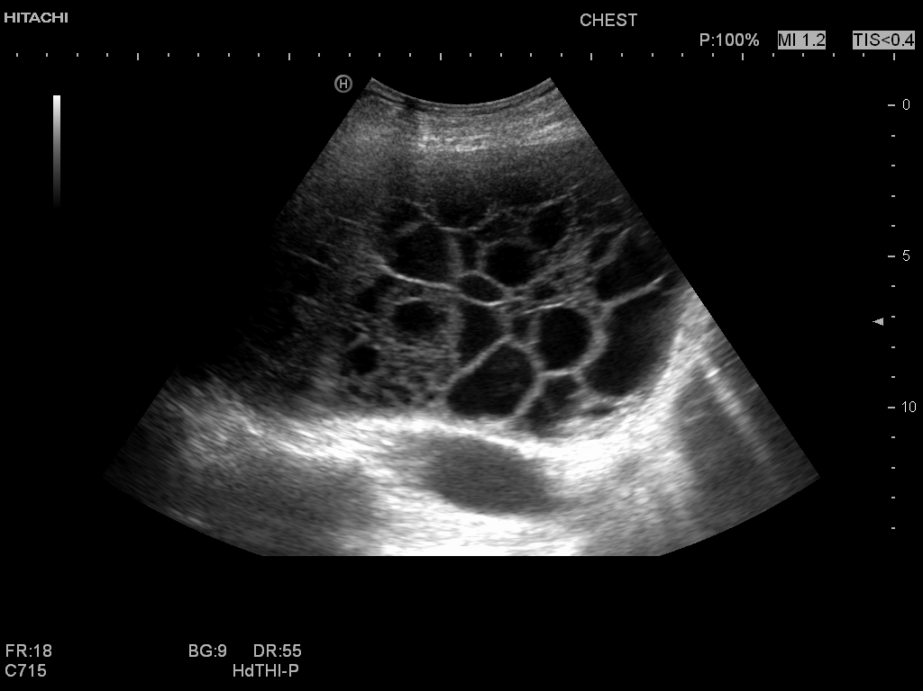
Septations 4
Notes:
When septations form enclosed webs such as this they are commonly referred to as locules – this would be described as a heavily loculated collection

Slide 9
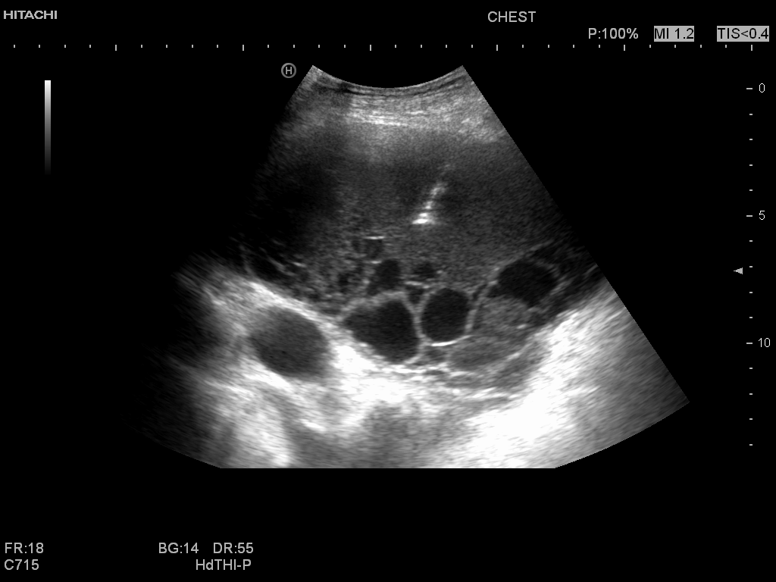
Septations 5
Notes:
Example of a fibrin ‘sheet’ in a very mature infected collection. A spinal needle was inserted right down to the distal locule to aspirate fluid and insert a chest tube.

Slide 10
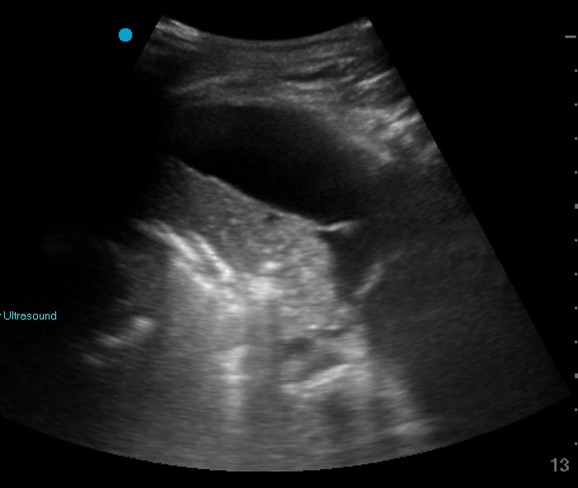
Safe to aspirate? 1
Notes:
Anechoic fluid overlying consolidated lung.
Answer: Depending on clinical context and expertise of operator it may be…

Slide 11
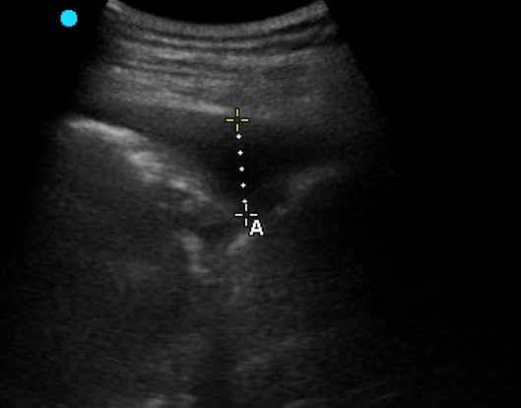
Safe to aspirate? 2
Notes:
Answer: Too small, static image but example of where remembering ultrasound is a dynamic tool and this does not take into account normal movement of lung / diaphragm in and out of the needle trajectory with respiration

Slide 12
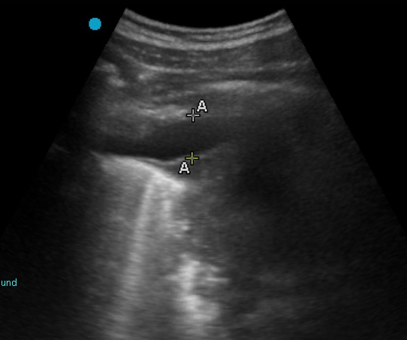
Safe to aspirate? 3
Notes:
Answer: Very high risk

Slide 13
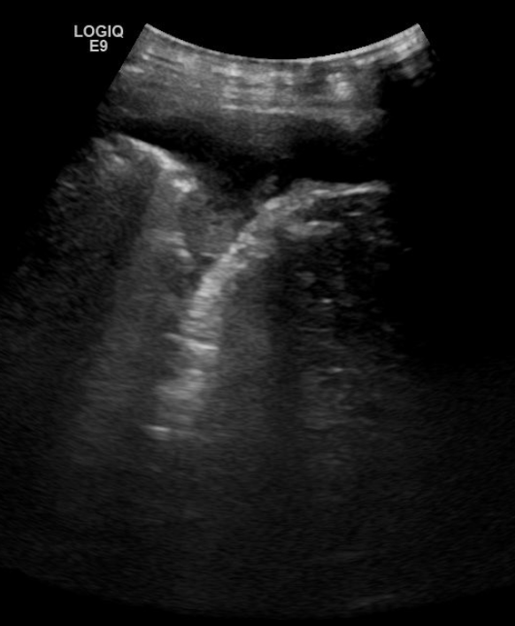
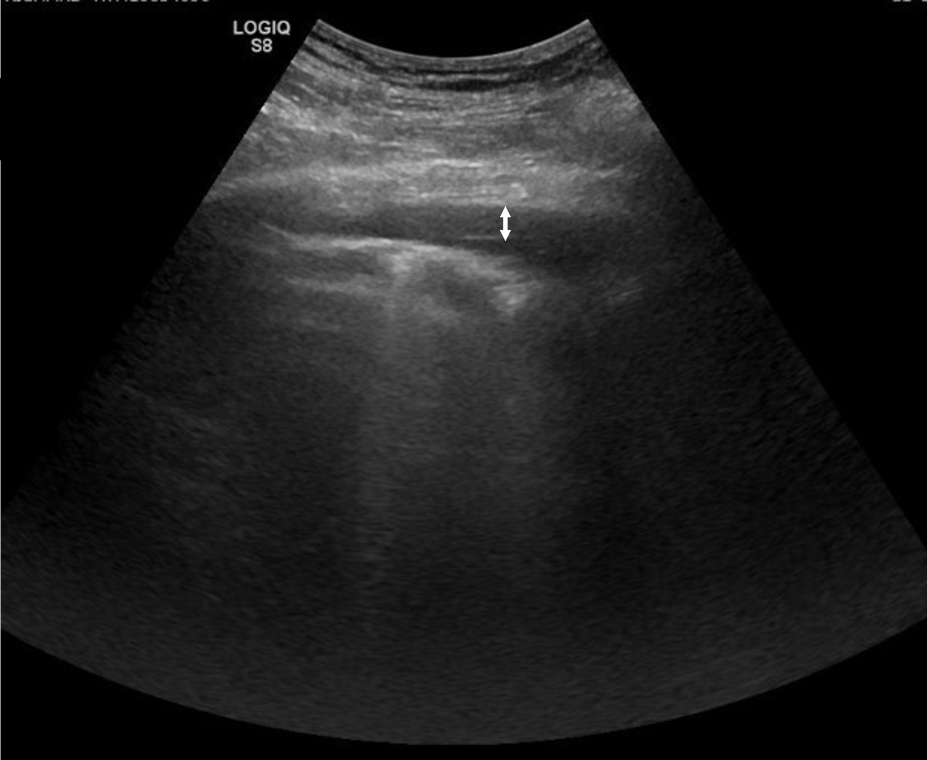
Pleural thickening
Notes:
Parietal pleural thickening
LEFT – irregular, craggy and more concerening for a malignant process
RIGHT – more smooth and benign in appearance

Slide 14
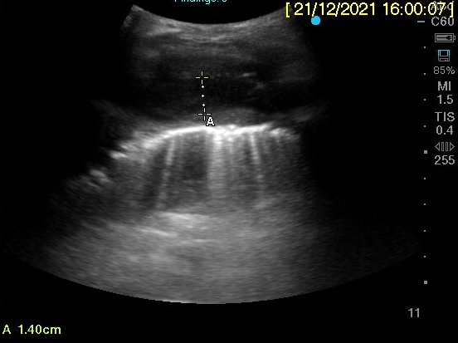
Pleural thickening
Notes:
Small effusion with parietal thickening above calipers and visceral thickening below, lots of B lines in underlying lung

Slide 15
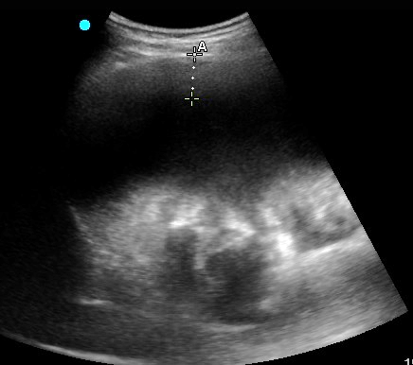
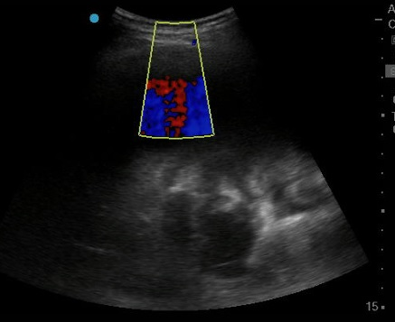
“Fluid colour sign”
Notes:
Pleural thickening (poorly defined without doppler- grey density noted by calipers). Becomes clearer with doppler as fluid colour sign can be seen immediately distal to pleural thickening representing pleural effusion
Tip: Remember to set focal point correctly!

Slide 16
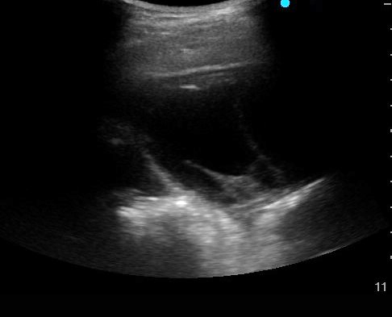
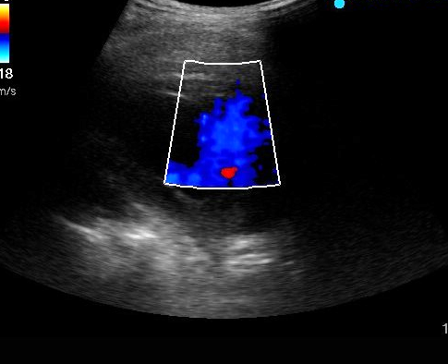
“Fluid colour sign”
TUS7.jpg
Notes:
LEFT: Thin area of parietal pleural thickening
RIGHT: fluid colour sign – showing random ‘flow’ of effusion due to absence of blood vessels

Slide 17
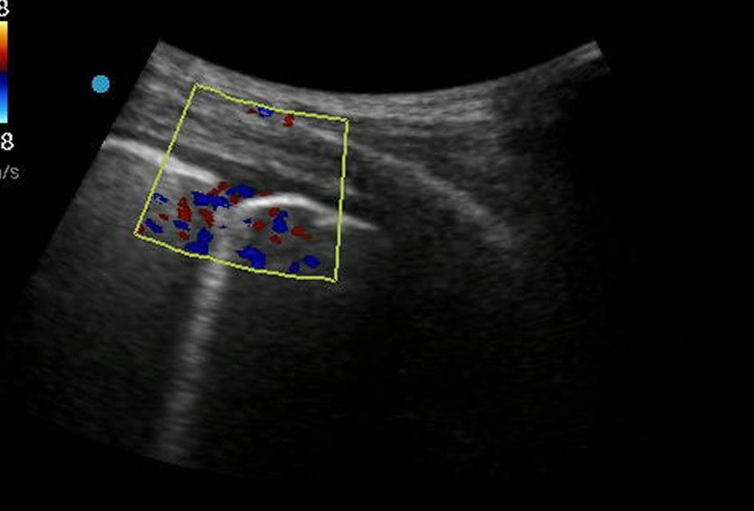
Notes:
Thickening in absence of fluid, may be hard to tell but its a sliver of greyness rather than black, no doppler signal

Slide 18
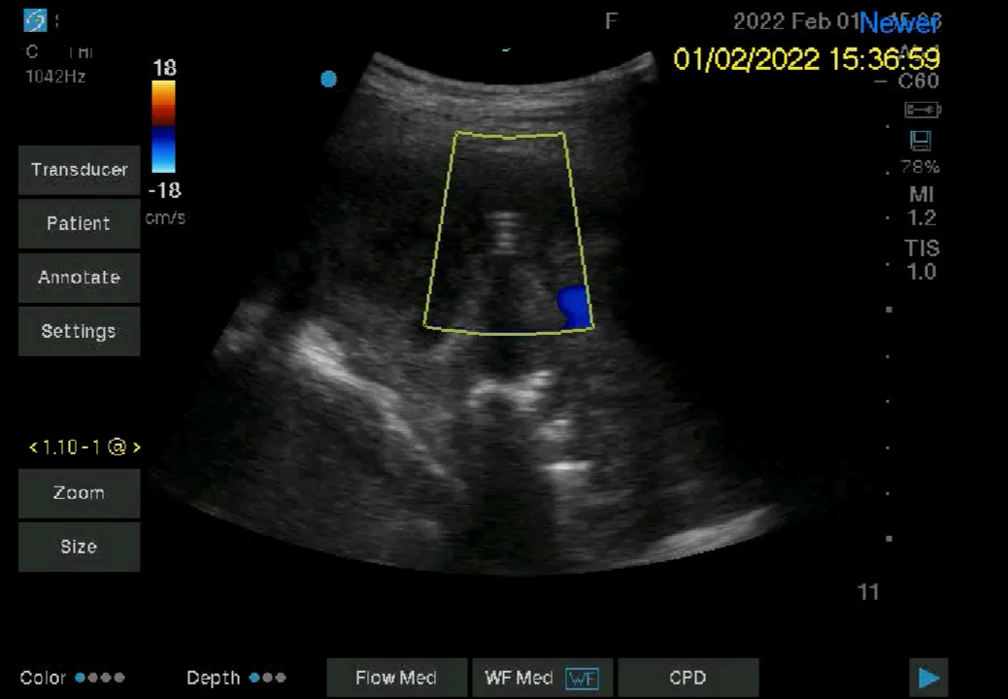
Notes:
Very organized collection with thickening above IPC in middle of frame, doppler on shows minimal fluid

Slide 19
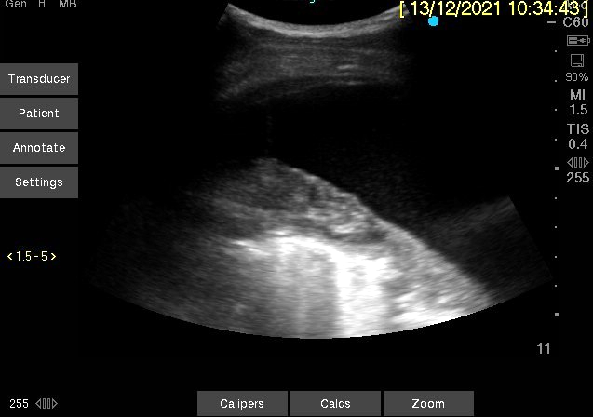
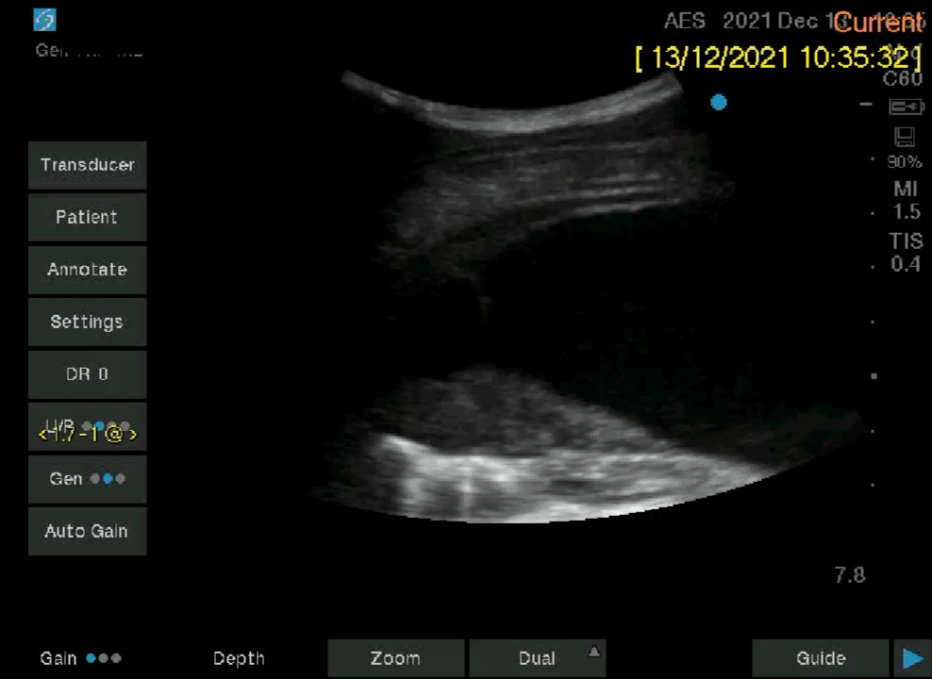
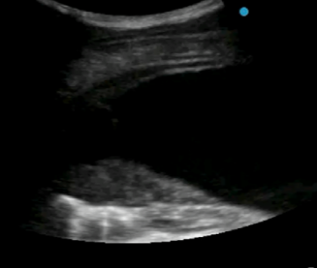
Parietal thickening
Visceral plural tumour
Lung edge with distal artefacts
Notes:
Very thin layer of parietal thickening with anechoic pleural effusion, better seen in corresponding video clip
There is also visceral pleural tumour above lung edge (see additional image with legend) with underlying lung appearances hard to interpret (? Atelectasis ? Consolidation, ultrasound air bronchograms not clearly seen)

Slide 20
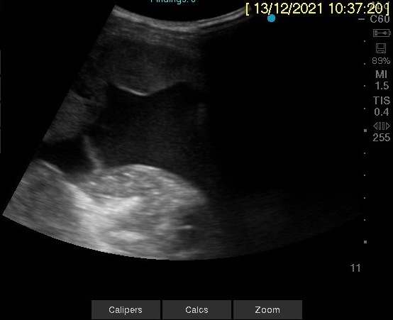
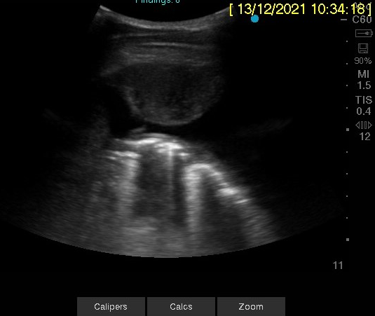
Pleural tumour 1
Notes:
Young patient with sarcoma

Slide 21
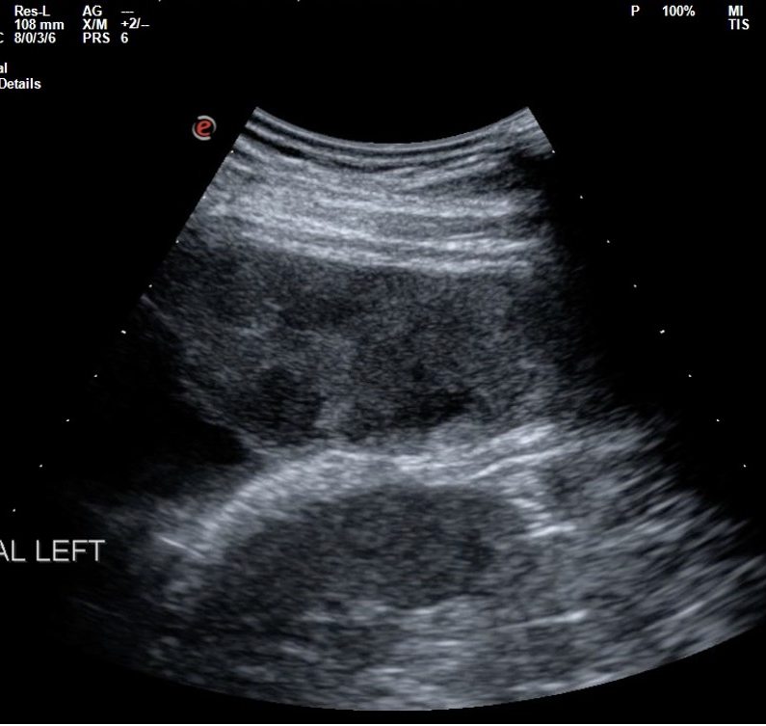
Pleural tumour 2
Notes:
Mixed density pleural tumour from myxofibrosarcoma

Slide 22
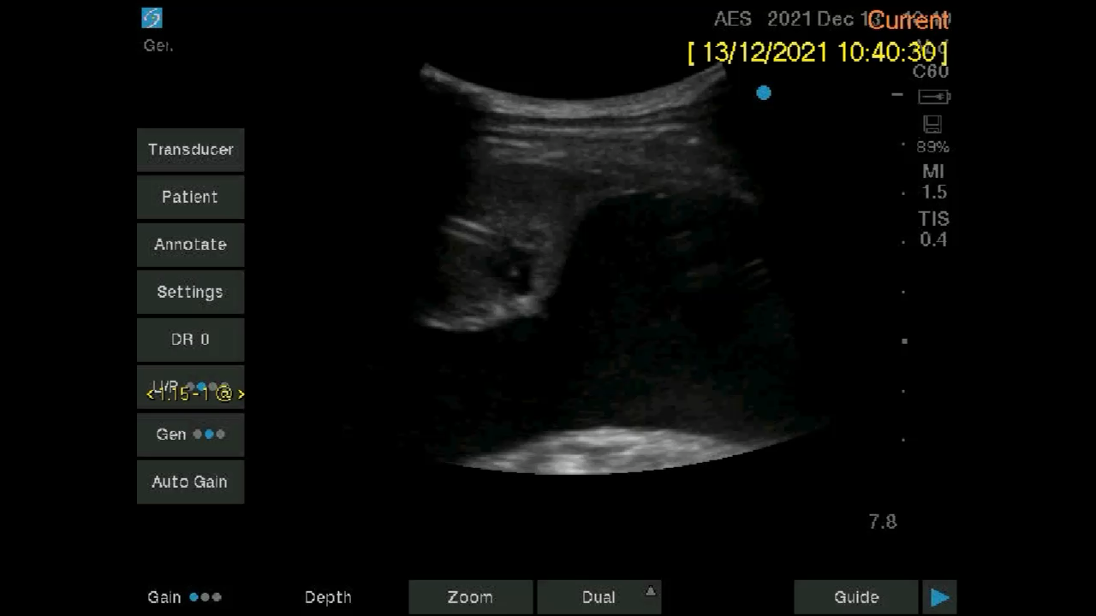
Pleural tumour 3
Notes:
Pleural tumour with IPC in situ (and embedded in tumour…)

Slide 23
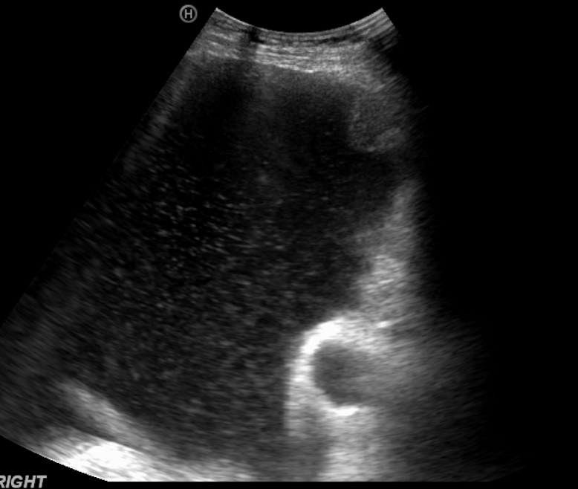
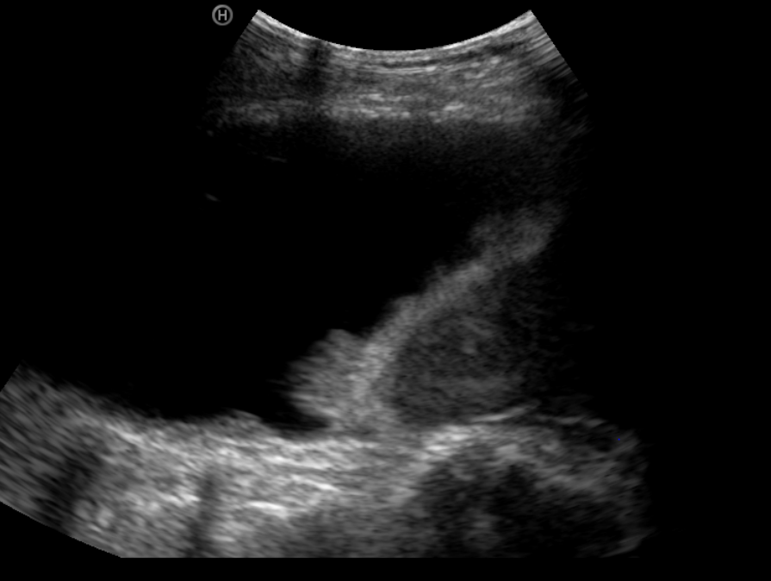
Nodularity 1
Notes:
LEFT – echogenic effusion with visible ‘swirling’ in the presence of costophrenic nodule
RIGHT - Diaphragm tumour nodules

Slide 24
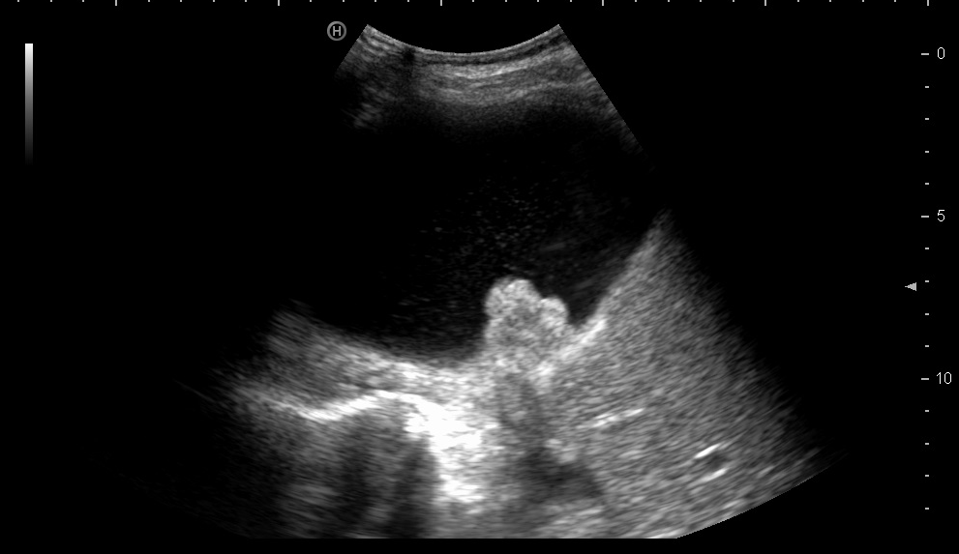
Nodularity 2
Notes:
Large diaphragmatic nodule sampled at thoracoscopy

Slide 25
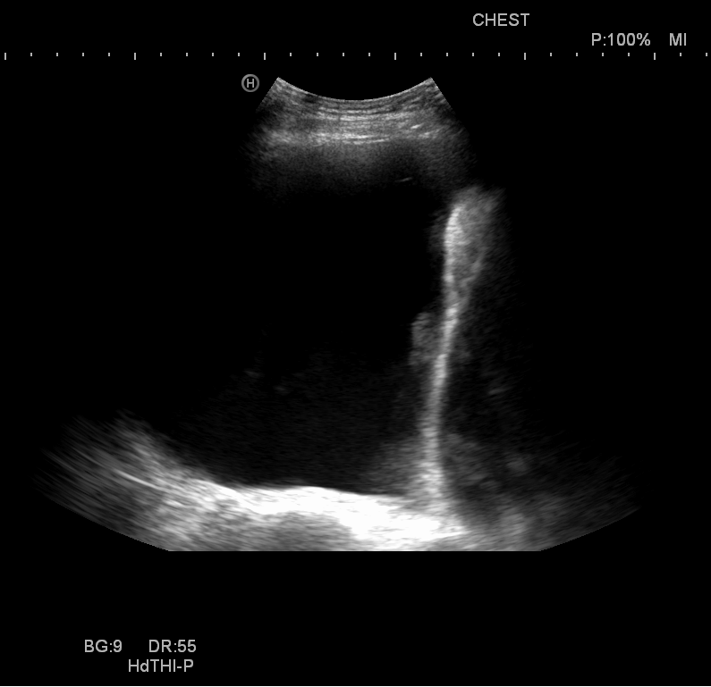
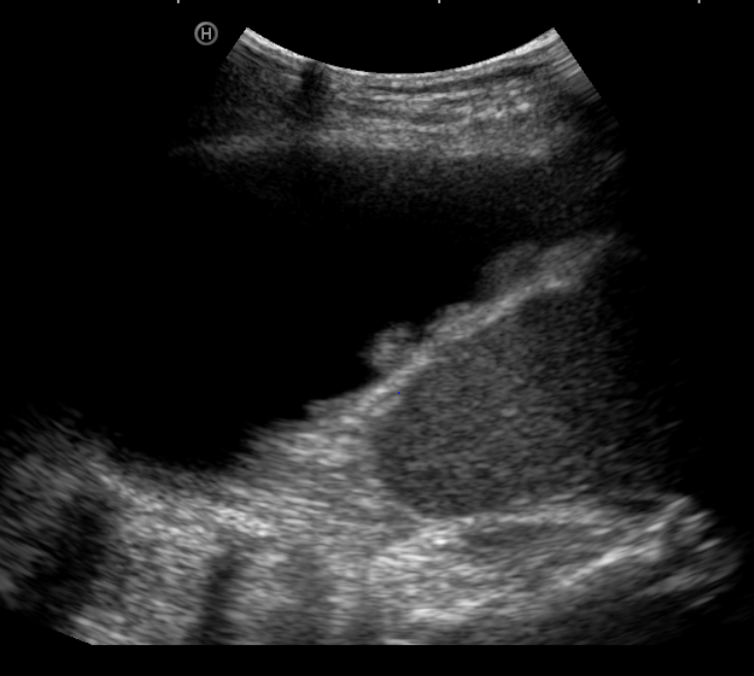
Nodularity 3
Notes:
Diaphragm nodularity including very flattened diaphragm from large effusion on right

