Slide 1
British Thoracic Society
Tobacco Specialist Advisory Group
December 2014
(updated March 2016)
Stopping Smoking
What health professionals should know and how to encourage smokers to quit

Slide 2
Objectives
To outline the effects of smoking on health
To be aware of different approaches to smoking cessation
To be aware of the need for support during quit attempts and to recognise the role of local stop smoking services
To understand the basics of Nicotine Replacement Therapy (NRT) and other medications in helping quit attempts
Notes:
Aim: to ensure that all NHS staff directly involved with patient care meet a basic set of core competencies to enable them to identify and support smokers who want to stop smoking.
This talk is mostly aimed at staff in secondary care and will be relevant for doctors, pharmacists, nurses, (including ward nurses, theatre nurses, outpatient nurses, nurse specialists in all areas) allied health professionals and health care assistants.

Slide 3
Key points
Smoking still kills thousands of people each year
Most smokers want to stop
All NHS staff should be able to…
  ASK: all patients if they smoke
  ADVISE: the best way to stop
  ACT: by providing referral to local stop smoking services and/or drug treatment
Notes:
A key aspect of tackling smoking cessation is the ‘3 A’s’ approach, which encourages health workers to address smoking with all their patients.
Brief chats between people who smoke and health care professionals about quitting can be very effective. These can be personalised, ie linked to their presenting health condition, or given opportunistically to improve their overall health – but the key thing is to ASK about smoking, give some BRIEF ADVICE, and then ACT by providing support, usually referral to a dedicated stop smoking service.

Slide 4
Overview
Knowledge
Skills
Attitudes
(Specialty specific advice)
(Additional competencies for prescribers)
Notes:
The aims of this presentation are to cover the core knowledge, skills and attitudes needed by all healthcare professionals to deliver good, brief, individual advice on stopping smoking.
Additional slides at the end of the presentation may be useful for specialty-specific advice (slides 38-46) and should help health professionals who are able to prescribe (slides 47-60).
A summary slide (slide 61) can be used at the end of the presentation.

Slide 5
Knowledge
Effects of smoking on health
Implications of addiction to nicotine
Cessation strategies available to help smokers to quit
Local smoking cessation services available
Notes:
This talk covers briefly the effects of smoking on health, the implications of addiction to nicotine - the main reason that most smokers smoke - plus smoking cessation strategies that are proven to help people to stop successfully.
Presenters should also be aware of local services available, and these may vary from area to area.

Slide 6
Effects of smoking on health
Smoking causes 80,000 deaths per year in the UK
17% of all deaths in adults ≥35 are due to smoking
Smoking causes:
  > 1/3 respiratory deaths
  > 1/4 cancer deaths
  1/7 cardiovascular deaths
  Half of all smokers will be killed by their addiction
References:
ASH (2015) Smoking Statistics; Smoking and disease
BTS (2016) Tobacco position statement
Doll (1994) Mortality in relation to smoking [British Doctors Study]. BMJ
Notes:
There are around 10 million adult smokers in the UK – about a sixth of the total UK population.
For some time, it has been said that smoking causes 100,000 deaths per year in the UK. Recent estimates put this closer to 80,000 deaths, which is still over 9 deaths per hour
Smoking is the leading cause of preventable death and disease in the UK – more than obesity, alcohol, illicit drugs, road traffic accidents and HIV infection combined.
In 2013, 17% of deaths of adults aged 35 and over in England were estimated to be attributable to smoking.
Smoking causes:
35% of all respiratory deaths
27% of all cancer deaths
13% of all circulatory disease deaths
Half of smokers die from their smoking – ref Doll 1994 British Doctors Study (BMJ). After age 35, you lose 3 months of life expectancy for each year of continued smoking.
References:
ASH factsheet ‘Smoking statistics’ November 2015.
ASH factsheet ‘Smoking and disease’ June 2015.
Doll et al (1994) Mortality in relation to smoking: 50 years’ observations on male British doctors. BMJ. 309(6959):901-11.. doi:10.1136/bmj.38142.554479.AE
Jha et al (2013) 21st century hazards of smoking and benefits of cessation on the United States. NEJM. 368:341-50

Slide 7
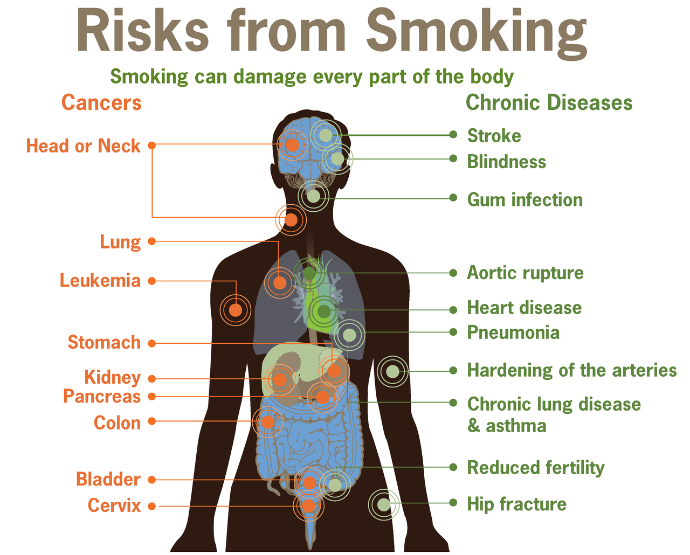
Notes:
Most significant illness caused by smoking are lung cancer, COPD and heart disease, but it also contributes to many other cancers, increases risk of pneumonia, can cause stroke, macular degeneration, osteoporosis, infertility and more.
Image from CDC Vital Signs document, 2010

Slide 8
Effects of smoking on health
Risks of passive smoking
  12,000 deaths a year due to second-hand smoke
  Passive smoking causes
    40 sudden infant deaths
    22,000 new cases of wheeze and asthma
    20,000 lower respiratory tract infections
  Active maternal smoking causes:
    5,000 miscarriages
    2,200 premature births per year
Reference: Royal College of Physicians (2010) Passive Smoking and children
Notes:
Reference: Royal College of Physicians (2010), Passive smoking and children.
Deaths in UK, per year.
Active maternal smoking = passive smoking to fetus.

Slide 9
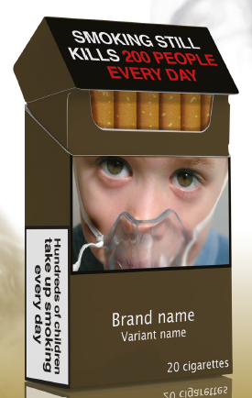
Effects of smoking on health
UK White Paper 1998:
‘If people chose to stop smoking, they would live longer. Smoking kills.’
Smoking cost the NHS £2.7 billion in 2006-07
Smoking costs the social care system around £1 billion
Reference:
Healthy Lives, Healthy People (2011)
ASH (2014) The Costs of Smoking to the Social Care System in England
Image: ASH, 2015
Notes:
The UK Government White Paper from 1998 emphasised the dangers of smoking clearly in a preface by the then Prime Minister, Tony Blair:
‘If people chose to stop smoking, they would live longer. Smoking kills.’
This paper aimed to establish a downward trend in smoking, by funding smoking cessation services, stopping tobacco sponsorship, and banning poster and print advertising.
Subsequent efforts such as the ban on smoking in public places have been major drivers in reducing smoking prevalence.
However, smoking still causes much harm and costs the UK a considerable amount. It is estimated smoking cost the NHS £2.7 billion in 2006-07, and a 2014 report showed an additional cost to the social care system of £1 billion, due to the increased care needs of smokers.
Smoking Still Kills, a report published by ASH in 2015, encouraged the government to publish a new tobacco control plan, committed to tackling inequalities, and with a long-term vision to end the smoking epidemic. The report set targets to reduce smoking in the UK adult population to 13% by 2020 and 9% by 2025.
References:
Smoking Kills (1998), UK Government White Paper
Healthy Lives, Healthy People: A Tobacco Control Plan for England (2011) UK Government
ASH report (2014), The Costs of Smoking to the Social Care System in England
ASH (2015) Smoking Still Kills.

Slide 10
Benefits of stopping smoking
Stopping smoking before age 30 reduces mortality risk to that of a non-smoker.
Stopping smoking at any age gives extra years of life.
Stopping smoking slows decline in lung function.
Health benefits of stopping smoking start immediately.
Reference:
Doll (1994) Mortality in relation to smoking [British Doctors Study]. BMJ
Notes:
Stopping smoking early can reverse the ‘risk’ of smoking – stopping before age 30 reduces mortality risk to that of a non-smoker - but stopping at any age gives extra years of life.
Stopping smoking will also slow down the decline in lung function that happens to us all as we get older, maintaining quality of life for as long as possible.
Stopping smoking will result in immediate health benefits.
The following slides illustrate some of these points.

Slide 11
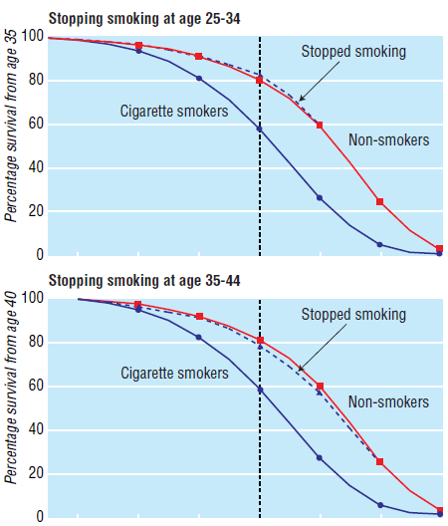

Effects on survival of stopping smoking cigarettes at age 25-34 (effect from age 35) and age 35-44 (effect from age 40) – ref Doll 2004, BMJ
Notes:
- Stopping smoking at a young age increases survival to that of non-smokers.
This graph from Richard Doll and the British Doctors Study shows the survival in smokers compared to non-smokers and those who stopped stopping.
In both graphs, the blue line shows the mortality of cigarette smokers – at the start of the graph, 100% were alive, and at the straight dotted line (age 70) 60% were still alive.
The red line shows the mortality of non-smokers – at age 70, 80% were still alive.
The curved blue dotted line shows those who stopped smoking, at age 25-34 (top graph) and age 35-44 (bottom graph), and demonstrates that survival is relatively similar to non-smokers – almost identical in the earlier age group.
Therefore stopping smoking at a young age increases survival to that of non-smokers, and it is crucial that we target young smokers to get them to stop.
Reference:
Doll et al (1994) Mortality in relation to smoking: 50 years’ observations on male British doctors. BMJ. 309(6959):901-11.. doi:10.1136/bmj.38142.554479.AE

Slide 12
Benefits of stopping smoking
 | Men |  | Women
 | Life expectancy | Extra years compared to smokers | Life expectancy | Extra years compared to smokers
Smoked until death | 69.3 |  | 73.8
Never smoked | 78.2 | 8.9 | 81.2 | 7.4
Quit age 35 | 76.2 | 6.9 | 79.9 | 6.1
Quit age 45 | 74.9 | 5.6 | 79.4 | 5.6
Quit age 55 | 72.7 | 3.4 | 78.0 | 4.2
Quit age 65 | 70.7 | 1.4 | 76.5 | 2.7
Reference: Taylor 2002, Am J Public Health
Notes:
Key message – stopping at any age gives extra years of life
This table highlights the extra years of life gained by smokers who are able to stop.
According to this US data, male smokers had a life expectancy of 69 years, compared to never smokers having a life expectancy of 78 years.
Quitting at any age increased the life expectancy, albeit by a lesser amount for those stopping later.
For female smokers, the life expectancy for never smokers was 81 years compared to 74 years for lifelong smokers, but again, quitting at any age extended life expectancy.
The key message is that stopping at any age gives extra years of life.
Reference:
Taylor et al (2002) Benefits of Smoking Cessation for Longevity. Am J Public Health. 92:990-996

Slide 13
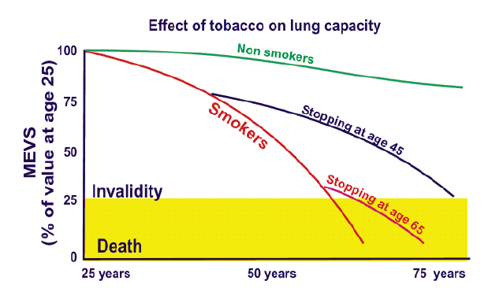
Effect of smoking continuation or discontinuation on the decrease in FEV1 over time
FEV1
Reference:
BTS Case for Change document, 2013
Adapted from Fletcher and Peto, BMJ, 1977
Notes:
Stopping smoking reduces decline in lung function – disability due to breathlessness will then occur at a later age.
Airflow obstruction is the consequence of diseases that narrow the airway, and usually measured as a ‘forced expiratory volume in 1 second’ (FEV₁).
In nearly every population studied world-wide, cigarette smoking is the dominant factor for the prevalence of airway obstruction. Numerous studies have reported the correlation between cigarette smoking and the decline in lung function.
This graph shows the decline in (FEV₁) among smokers, as compared to non-smokers and those who stopped at earlier ages.
The decline in lung function is steepest in smokers, resulting in progressive lung damage, leading to symptoms attributable to COPD and eventually death.
When a smoker quits, the rate of decline slows and with sustained abstinence, the rate of decline in former smokers returns to that of someone who has never smoked.
This emphasises the importance of smoking cessation and the fact that it is never too late to quit. Most smokers would be keen to delay the onset of invalidity due to breathlessness.
Reference:
BTS Case for Change (2013) adapted from Fletcher (1977) The natural history of chronic airflow obstruction. BMJ. 1:1645-48

Slide 14
Benefits of stopping smoking
Time | Effect
At 20 minutes… | Reduction in blood pressure and pulse rate, normalisation of temperature of hands and feet
At 48 hours… | Sense of smell and taste noticeably improved
At 2 weeks to 3 months… | Risk of myocardial infarction begins to fall and lungs begin to improve
At 3 weeks to 3 months… | Decrease in respiratory symptoms (cough and breathlessness)
At 1 year… | Excess risk of MI and stroke decreased to less than half that of a smoker
At 10 years… | Risk of death from lung cancer declined to almost half for an average smoker.
At 15 years… | Risk of heart disease now that of a never-smoker
Reference: BTS Case for Change, 2013
Notes:
There are immediate benefits from stopping smoking – within 20 minutes, physiological parameters such as blood pressure and pulse rate should return to normal.
Quitters may notice improved smell and taste within 2 days. Respiratory symptoms should improve from 3 weeks to 3 years (note some smokers may be prompted to quit by progressive decline in chest symptoms, and therefore mistakenly attribute this decline to their quit attempt).
- Cardiovascular risk is halved at 1 year post-quitting, and back to baseline at 15 years.
Reference:
- BTS Case for Change (2013)

Slide 15
Why is quitting difficult? Nicotine
Smoking
Cycle of addiction
Cravings
Nicotine
Notes:
Most smokers want to quit. Continuing smoking is due to addiction to nicotine. Cigarettes deliver nicotine to brain very effectively.
Withdrawal from nicotine usually leads to nicotine cravings - smokers need more nicotine to satisfy cravings, therefore continue to smoke, leading to a cycle of addiction.
Other withdrawal symptoms include restlessness, depression, poor concentration, increased appetite, irritability, disturbed sleep.
Markers of nicotine addiction include time till first cigarette in the morning (14% of UK smokers reported lighting up within 5 minutes of waking in 2010) and amount smoked per day.
Reference:
- ASH fact sheet 2013: Nicotine and Addiction

Slide 16
Components of a cigarette
Hydrogen cyanide
Formaldehyde
Nicotine
Chromium
Nitrosamines
Carbon monoxide
Tar
Arsenic
Cadmium
Benzene
Nitric oxide
Notes:
Nicotine is the substance in tobacco that causes addiction.
Tobacco smoke also releases over 5000 chemicals when it burns – many of which are known to be carcinogenic. Some are listed here.
Tar is a mixture of lots of chemicals – this is what stains smokers teeth and fingers.
Arsenic is used in wood preservatives – has been associated with cancer and cardiovascular disease.
Benzene is an industrial solvent that is know to cause cancer, particularly leukaemia.
Cadmium is used in batteries, and causes damage to the kidneys and lungs.
Nitric oxide helps dilate the airways and therefore helps the lungs to absorb more nicotine, contributing to nicotine addiction.
Carbon monoxide is found in car exhausts. It lowers the bloods ability to transport oxygen around the body.
Nitrosamines are found in heavy quantities in tobacco, and cause several cancers.
Chromium is used to manufacture dyes, paints and alloys. It can cause lung cancer.
Formaldehyde is used in mortuaries and paint manufacturing. It causes cancer and lung disease.
Hydrogen cyanide is a poisonous gas that causes headache, dizziness, nausea and vomiting in small amounts, but can cause arrhythmias and seizures in large quantities.
References:
Various online sources including http://quitsmoking.about.com/od/chemicalsinsmoke/, accessed March 2016; http://www.lung.org/stop-smoking/smoking-facts/whats-in-a-cigarette.html, acccessed March 2016; and more
Chen et al (2011) Arsenic exposure from drinking water and mortality from cardiovascular disease in Bangladesh: prospective cohort study. BMJ; 342. doi:http://dx.doi.org/10.1136/bmj.d2431
Korte et al (2000) The contribution of benzene to smoking-induced leukaemia. Environ Health Perspect. 108(4):333-9
Hendrick (2004) Smoking, cadmium and emphysema. Thorax. 59:184-5
Vleeming et al (2002) The role of nitric oxide in cigarette smoking and nicotine addiction. Nicotine Tob Res. 2002 Aug;4(3):341-8.
Bernhard et al (2005) Metals in Cigarette Smoke. IUBMB Life. 57(12):805-809
Godish (1989( Formaldehyde exposures from tobacco smoke: a review. Am J Public Health. 79(8):1044-5
Cigarette image from Microsoft ClipArt.

Slide 17
Why do we need to help smokers quit?
Smoking still common (1/6 of UK population)
Increasing proportion of female smokers
More common in socially deprived areas
Stopping smoking:
  Treats person and reduces future risks
  Prevents second-hand transmission to others
  Reduces chance of children taking up smoking
Almost 70% of smokers want to stop
Few smokers can stop with willpower alone
Notes:
One-sixth of UK population = 10 million people
Most smokers do actually want to quit, so health professionals are 'pushing at an open door' when advising patients to stop smoking.
In 2008, 67% of current smokers in Great Britain wanted to quit smoking. In 2010, 69% smokers in the USA wanted to stop. Health professionals shouldn’t be afraid to raise the issue.
However, stopping smoking without support is difficult - many patients will have tried and failed, so it is important to be positive about the chances of success in the future.
References:
Lader (2009) Opinions Survey Report No. 40 – Smoking-related behaviour and attitudes, 2008/09. Office of National Statistics. http://www.ons.gov.uk/ons/rel/lifestyles/smoking-related-behaviour-and-attitudes/2008-09/smoking-related-behaviour-and-attitudes--2008-09.pdf
Malarcher et al (2011) Quitting Smoking Among Adults – United States, 2001-2010. CDC Morbidity and Mortality Weekly Report, referencing National Health Interview Survey, US, 2010. From http://www.cdc.gov/mmwr/preview/mmwrhtml/mm6044a2.htm?s_cid=mm6044a2_w#tab1

Slide 18
How to help smokers quit
Brief advice alone
More intensive advice
Referral to smoking cessation advisor
Individual counselling
Motivational interviewing
Group support
Pharmacotherapy
  Nicotine replacement therapy (NRT)
  Medications: Bupropion (Zyban) and Varenicline (Champix)
Notes:
A Cochrane review from 2013 showed that even brief simple advice from a physician can increase quit rates – therefore health professionals have influence.
More intensive advice can double quit rates.
Smoking cessation advice in hospital can be very effective: patients have often been admitted for a smoking-related reason and are therefore receptive to advice, family may be keen to provide additional encouragement (and will not provide temptation by smoking nearby), they are in an environment where quitting will be easy (smoke-free site), and pharmacotherapy is easily available.
Intensive interventions (as provided by smoking cessation advisors) typically include scheduled face-to-face meetings between the smoker, either alone or in a group, and a counsellor trained to provide stop smoking support. Discussions may include information, practical advice about goal-setting, self-monitoring and dealing with the barriers to stopping smoking as well as encouragement. Intensive behavioural support also includes anticipating and dealing with the challenges of stopping. Established and effective behaviour-change techniques should be used. Support is typically offered weekly for at least the first 4 weeks of a quit attempt (that is, for 4 weeks after the quit date) or 4 weeks after discharge from hospital (where a quit attempt may have started before discharge).
Novel interventions such as text reminders or interactive websites may help enhance quit rates.
All intensive support is normally given alongside pharmacotherapy.
NRT is available in several forms: patches, gum, lozenges, microtabs, inhalators, nasal spray.
References:
BTS Case for Change and Recommendations for Hospital Stop-smoking Services documents.
NICE (2013) Smoking cessation in secondary care: acute, maternity and mental health services. NICE public health guidance 48
Mussener et al (2016) Effectiveness of short message service text based smoking cessation intervention among university students: a randomised trial. JAMA Internal Medicine. Doi: 10.1001/jamainternmed.2015.8260
Brown et al (2014) Internet-based intervention for smoking cessation (StopAdvisor) in people with low and high socioeconomic status: a randomised controlled trial. Lancet Respiratory Medicine. 2:997-1006.

Slide 19
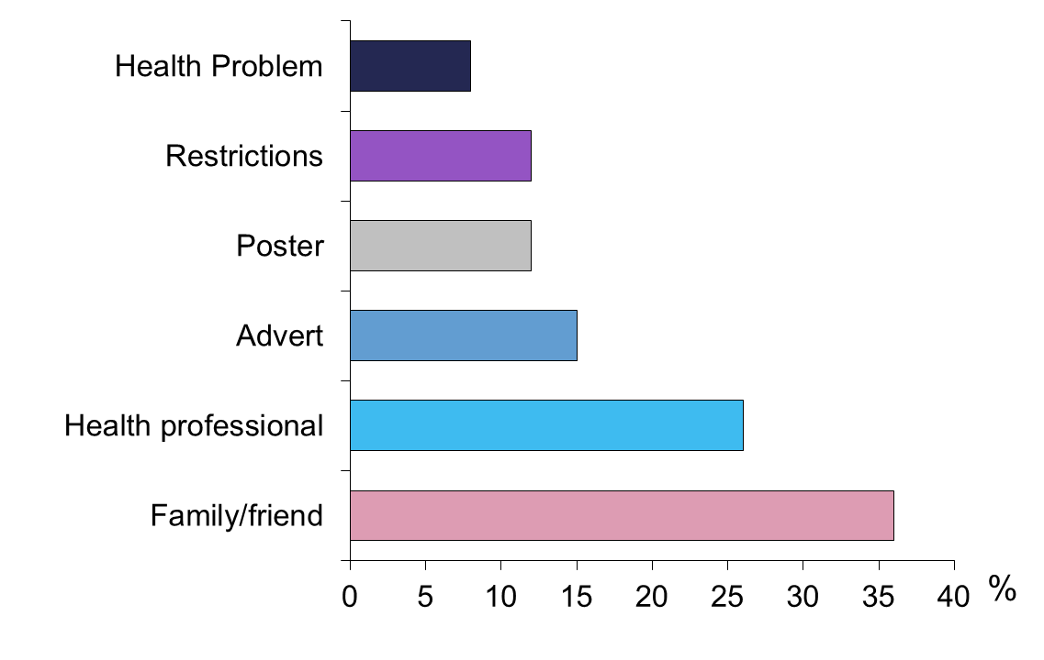
The role of the healthcare professional
Of nearly 700 smokers hoping to stop, what prompted their attempt to quit?
Notes:
Slide 49 - The role of the health care professional - what prompted an attempt to stop smoking?
Objective : To demonstrate the important role health care professionals play in helping and encouraging smokers to quit
Reference:
- West (1997) Getting Serious About Stopping Smoking: A Report for No Smoking Day

Slide 20
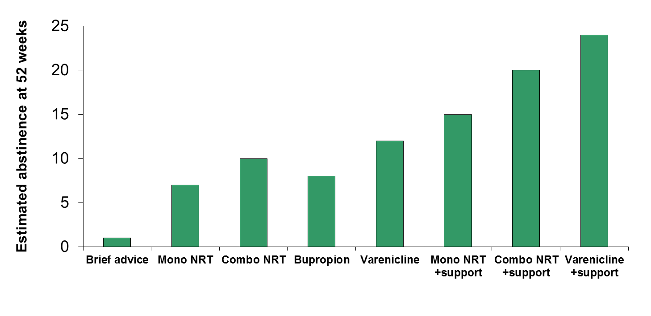
Effectiveness of smoking cessation
‘Support’ = specialist individual behavioural support
Reference: West R, Owen L (2012) Estimates of 52-week continuous abstinence rates following selected smoking cessation interventions in England. www.smokinginengland.info Version 2
Notes:
NRT and medications increase the chance of quitting. Combination NRT (for example, patch plus gum) seems to be more effective than NRT in a single format.
Specialist individualized behavioural support combined with NRT increases rates further.
Some evidence suggests varenicline may be more effective than NRT (Kotz, 2014) whereas others have suggested there is no difference between the two (Baker, 2016)
Group support may enhance quit rates even more.
Be aware of your local stop smoking service and what support it can offer. Choice of medication may depend on patient factors, eg concerns about side effects or compliance.
References:
West R, Owen L (2012) Estimates of 52-week continuous abstinence rates following selected smoking cessation interventions in England. www.smokinginengland.info Version 2
Kotz et al (2014) Prospective cohort study of the effectiveness of varenicline versus nicotine replacement therapy for smoking cessation in the ‘real world’. BMC Public Health. 14:1163.
Baker et al (2016) Effects of nicotine patch vs varenicline vs combination nicotine replacement therapy on smoking cessation at 26 weeks: a randomised controlled trial. JAMA. 315(4): 371-379
Hartmann-Boyce and Aveyard (2016) Drugs for smoking cessation. BMJ. 352:i571 doi: 10.1136/bmj.i571.

Slide 21
Harm reduction
Harm reduction – a way to reduce the negative consequence of substance use by substituting a less harmful alternative
NICE advocates harm reduction for those who:
  May not be able (or want to) stop smoking in one step
  May want to stop smoking, without giving up nicotine
  May not be ready to stop, but want to reduce the amount of smoking
Helps people cut down prior to stopping or reduce the amount smoked
Notes:
Harm reduction is established in many areas of public health, for example methodone prescribing for heroin addiction, and needle-exchange programmes for iv drug users
The concept is applicable to smoking cessation: while it is nicotine that causes addiction to cigarettes, it is the tar and other substances that cause most of the adverse health effects - therefore using alternatives such as nicotine replacement therapy can reduce the harm associated with nicotine addiction.
NICE endorsed harm reduction in 2013, and encourages stop smoking services to consider this approach for smokers who are unable to consider stopping smoking in one step. This includes cutting down prior to stopping smoking, and reducing the amount smoked.
Previously it was ‘stop completely or not at all’, and stop smoking services still emphasise the ‘not a puff’ rule in those wanting to stop smoking – but NICE now supports helping others who aren’t ready to reduce the amount smoked, in the hope that this will make a successful quit attempt more likely in the future. This may include long-term use of NRT.
Reference:
- NICE guidance. Tobacco: harm-reduction approaches to smoking (PH45) - 2013

Slide 22
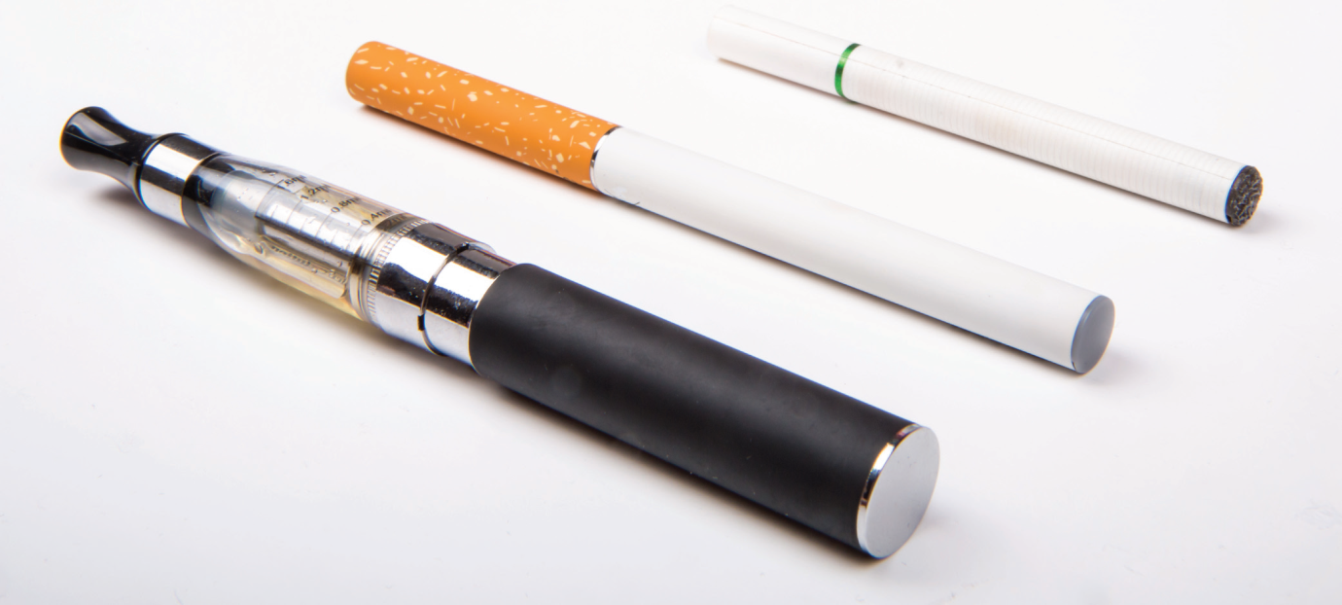
E-cigarettes
Rapid increase in popularity – 2.6 million users in UK
  1/3 are ex-smokers
  2/3 are current smokers
Source: ASH Briefing, Feb 2016
Notes:
E-cigarettes are a form of harm reduction.
Also known as vapourisers or electronic nicotine delivery systems (ENDS), these are battery-powered devices that deliver nicotine to the user by heating a nicotine-containing solution.
The solution usually contains propylene glycol or glycerine, and may contain added flavourings. Earlier ‘first generation’ versions were disposable and looked more like traditional cigarettes; newer ‘second generation’ versions are now more popular and have refillable containers for the nicotine solution.
Reference and image source:
ASH briefing, Feb 2016

Slide 23
E-cigarettes: the two sides of the argument
Arguments supporting e-cigarette use | Arguments against e-cigarette use
Acceptable to smokers, more popular than other forms of NRT | Wide uptake and marketing campaigns may encourage young people to start smoking
Considerably less harmful than traditional cigarettes | Risks not clear, lack of regulation means contents not well defined
Some evidence that they can support smoking cessation | Limited evidence they can support smoking cessation
Allows smokers to get nicotine relief in ‘smoke-free’ areas | Use in ‘smoke-free’ areas could re-normalise smoking
Notes:
E-cigarettes have been controversial, with strong arguments being put forward for and against their widespread use, with senior figures on both sides of the debate.
The Royal College of Physicians and ASH (Action on Smoking and Health) are two groups that are supportive of harm reduction strategies and have taken the view that e-cigarettes may be a valuable tool in helping smokers to reduce the harm from tobacco use. They argue that effective regulation and prevention of marketing to young people may allow e-cigarettes to have a role in helping smokers cut down or quit. Their popularity and acceptability to smokers mean they may be more effective than other measures.
Other organisation, such as the World Health Organisation and the Federation of International Respiratory Societies, have taken a more cautious and critical approach and advised restriction until more studies are available proving lack of harm and benefits in smoking cessation. Concerns include marketing resembling that previously used by the tobacco industry, appealing flavourings targeting young people, and the lack of regulation leading to concerns about safety.
Public Health England commissioned a report in 2015 that concluded that e-cigarettes were significantly less harmful than smoking. This was based on several concepts, including the fact that most chemicals causing smoking-related disease were absent from e-cigarettes, and an expert review that rated them as having 95% less harm than conventional cigarettes. Press attention following this report included speculation that doctors would be able to prescribe e-cigarettes to patients to help them stop smoking. The National Centre for Smoking Cessation and Training has also produced guidance encouraging stop smoking services to support smokers who choose to use e-cigarettes to quit.
There is some evidence that e-cigarettes can help smokers quit. A Cochrane review described two randomised controlled trials that together showed around 9% of smokers had quit at one year using e-cigarettes, vs 4% using placebo e-cigarettes. A ‘real world’ study using online survey data showed e-cigarette users were 50% more likely to remain abstinent for at least a few months than those buying NRT or quitting unaided. On the other hand, a recent systematic review in the Lancet reached the other conclusion: that e-cigarettes were associated with less quitting among smokers – limitations of this study included the large number of observational studies, varying definitions for smoking cessation, and variations in study quality. Clearly more evidence is needed, although all studies note the fact that the rapidly changing nature of devices mean that evidence can quickly become out-of-date as products leave and enter the market.
References:
McNeil et al (2015) E-cigarettes: an evidence update. A report commissioned by Public Health England.
RCP statement on e-cigarettes – June 2014. https://www.rcplondon.ac.uk/press-releases/rcp-statement-e-cigarettes
ASH briefing on e-cigarettes – Feb 2016. http://ash.org.uk/files/documents/ASH_715.pdf
WHO Framework on Tobacco Control Report on Electronic Nicotine Delivery Systems – July 2014. http://apps.who.int/gb/fctc/PDF/cop6/FCTC_COP6_10-en.pdf?ua=1
Schraufnagel et al (2014) Electronic cigarettes: A position statement of the Forum of International Respiratory Societies. AJRCCM. 190(6): 611-618. http://www.atsjournals.org/doi/abs/10.1164/rccm.201407-1198PP#.VCLV3fldV48
McEwen and McRobbie (2016) Electronic Cigarettes – A briefing for stop smoking services. National Centre for Smoking Cessation and Training. http://www.ncsct.co.uk/usr/pub/Electronic%20cigarettes.%20A%20briefing%20for%20stop%20smoking%20services.pdf
McRobbie et al (2014) – Electronic cigarettes for smoking cessation and reduction (Cochrane Review).
Brown et al (2014) Addiction – Real-world effectiveness of e-cigarettes when used to aid smoking cessation: a cross-sectional population study.
Kalkhoran and Glantz (2016) E-cigarettes and smoking cessation in real-world and clinical settings: a systematic review and meta-analysis. Lancet Respiratory Medicine. 4:116-28.

Slide 24
E-cigarettes – where do they fit in?
E-cigarettes are the most popular stop smoking aid
Stop smoking services are the most effective method of helping smokers quit
  Smokers who have tried other methods without success should be encouraged to try e-cigarettes to help them quit, with behavioural support from local stop smoking services
  Around 16-22,000 smokers were helped to quit by using e-cigarettes in 2014
References:
Public Health England, 2015
NCSCT E-cigarette briefing, 2016
West, Addiction, 2016
Notes:
Although stop smoking services can only supply and recommend licensed nicotine containing products (ie NRT), Public Health England (and consequently the National Centre for Smoking Cessation and Training) now advise that services should be open to supporting those who choose to use e-cigarettes.
The debate surrounding e-cigarettes is very active and will likely develop during the lifetime of these slides. Current guidance is that healthcare professionals should recommend licensed nicotine replacement products until more research is available regarding e-cigarettes.
A recent analysis concluded that e-cigarettes helped 16,000-22,000 smokers in England to quit in 2014… (see West, Addiction)
References:
McEwen and McRobbie (2016) Electronic Cigarettes – A briefing for stop smoking services. National Centre for Smoking Cessation and Training. http://www.ncsct.co.uk/usr/pub/Electronic%20cigarettes.%20A%20briefing%20for%20stop%20smoking%20services.pdf
McNeil et al (2015) E-cigarettes: an evidence update. A report commissioned by Public Health England.
West et al (2016) Estimating the population impact of e-cigarettes on smoking cessation in England. Addiction. DOI: 10.1111/add.13343. http://onlinelibrary.wiley.com/doi/10.1111/add.13343/abstract

Slide 25
Skills
Identifying all smokers
Delivering brief opportunistic smoking cessation advice to all smokers
Assessment of a patient’s commitment to quit
Referring to local specialist smoking cessation services
Notes:
This slide summarises the core skills that health professionals should have in order to deliver good smoking cessation advice to as many smokers as possible.

Slide 26
What we should be doing –
Very Brief Advice
ASK – all patients if they smoke
ADVISE – the best way to stop
ACT – provide a referral or offer behavioural support and drug treatment
‘The best way to quit is a combination of support and treatment, that is available via the NHS’
Visit www.ncsct.co.uk to complete a short course on how to deliver Very Brief Advice
Notes:
Very Brief Advice, is an approach advocated by the UK National Centre for Smoking Cessation and Training.
Previously a 5 As approach was recommended: Ask (and record smoking status), Advise (all smokers to quit), Assess (an individual’s willingness to quit), Assist (by offering help to quit), Arrange (follow-up to increase chances of quitting).
Standard practice was to advise a smoker to stop (and why), as well as assessing whether they wanted to stop.
VBA takes a simpler approach with 3 ‘A’s’: the main change is that smokers are advised on the best way to stop, rather than being advised to stop...
The approach is quick (less than 30 seconds) and avoids some of the awkwardness that can occur when bringing up smoking status.
The idea is that VBA is delivered quickly and frequently, and a more detailed approach is kept for dedicated smoking cessation sessions.
Reference:
- UK National Centre for Smoking Cessation and Training – www.ncsct.co.uk

Slide 27
1. ASK smoking status
All patients should be asked their smoking status – ‘Current, Ex- or Never Smoker’
This should be clearly documented
Consider use of a proforma or a stamp
‘Are you still smoking?’
‘Do you smoke?’
‘I know you recent gave up smoking – are you still off the cigarettes?’
Notes:
First step remains to ASK patients about their smoking status.
Patients expect this to be addressed by health professionals, and may think it isn’t a problem if it isn’t brought up.
It is important to establish current smoking status (and check it is the same as before) and record this in the records.
Asking how much someone smokes isn’t crucial – all smokers need to stop, and addressing the amount smoked can be left for a dedicated session with a stop smoking advisor.
Asking if someone wants to stop is also no longer recommended – it can sometimes put the person on the defensive, arguing why they can’t stop, and may generate extra debate that should probably take place in the dedicated smoking cessation session. Delivering advice may prompt the smoker to quit even if that hadn’t thought of it before.
[At this point, you could discuss how smoking status is recorded in your patients, and whether health care professionals in the group have access to this information]

Slide 28
2. ADVISE – on best way to quit
Offering support to help smokers quit is more effective than simply telling them to stop
‘The best way to stop smoking is with the combination of treatment and support that is available on the NHS – is that something that would interest you?’
‘With the right support and treatment, it can be much easier to stop, and stay stopped’
Notes:
The traditional approach has been to advise smokers to stop.
Recent evidence has suggested that the offer of support – either a referral or a prescription - works better. Compared to ‘no advice’, the odds of quitting are 68% higher if stop smoking medication is offered, and 217% higher with an offer of support.
Before: ‘The best thing you can do for your health is stop smoking, and I advise you to stop as soon as possible’
Now: ‘The best way to stop smoking is with the combination of treatment and support that is available on the NHS’
All smokers know they should stop, and that it is bad for their health, but they don’t know how to stop – so better to simply do this.
When there is a clinical problem however, it is reasonable to link the smoking to their individual health:
‘Your asthma / angina / circulation will certainly get worse if you carry on smoking’
‘Your inhalers / chemotherapy will not work as well if you continue to smoke’
‘Your breathing tests / x-rays already show some smoking-related damage’
It is important that patients appreciate the effects of continued smoking in terms of their own disease and their medication – personalised advice will have more relevance.
References:
Aveyard et al (2012). Brief opportunistic smoking cessation interventions: a systematic review and meta-analysis to compare advice to quit and offer of assistance. Addiction. 107(6):1066-73.
UK National Centre for Smoking Cessation and Training – www.ncsct.co.uk

Slide 29
3. ACT – by providing support
Provide a referral to a dedicated stop smoking advisor
OR
Provide a prescription
    NRT
    Bupropion
    Varenicline
Give ‘common sense’ behavioural support
‘Give this number a ring, and you speak to one to the team and make an appointment’
Notes:
If willing to quit – seize opportunity, and either refer to smoking cessation service, or provide support and prescribe NRT / medication.
Dedicated stop smoking services can be in-house (in the hospital or GP practice) or at a local service.
Alternatively, you can provide a prescription – supply two weeks at a time so you can assess compliance / side-effects / motivation soon.
If patient not interested in stopping – use a non-judgmental approach, offer to help if they change their mind, re-visit at a later date, reassure them that support will be available when they are ready.
‘That’s fine, when you are ready, let me know’.

Slide 30
Understanding smoking behaviour
Health effects of nicotine / smoke
Withdrawal syndrome
Address misconceptions around quitting:
Smoking helps me deal with stress’
‘I’ll put on weight’
‘I’ve switched to roll ups’
‘My chest gets worse when I stop’
Notes:
Smoking is often associated with relaxation, but the feeling of ‘stress relief’ is often situational, or related to relief of withdrawal symptoms.
Smokers do put on weight when they stop – an average of 5-9kg, however this doesn’t take account efforts to reduce weight gain by exercise or dieting. It is important that smokers don’t replace smoking cigarettes with snacking on food, and smokers should be given advice on healthy eating and exercise. Stopping smoking may make exercise easier due to improved lung function. The risks of slight weight gain are far less than continued smoking.
Switching to roll ups (or light cigarettes) is not a healthy option, as the amount of tar and carbon monoxide inhaled does not reduce.
Many patients find their cough gets worse after they quit smoking, as the small hairs (cilia) in the windpipe grow back and start bringing all the ‘gunk’ back to the surface again. This usually settles after 4-6 weeks. Starting smoking again simply kills all the cilia and puts the process back to square one.
Other misconceptions include the fact that women who smoke will have easier deliveries (in fact their babies are smaller, less healthy, more likely to be born prematurely and more likely to spend time on special care baby units).

Slide 31
‘Common sense’ behavioural support
Set a quit date
Tell friends and colleagues
Avoid smokers when quitting
Avoid additional life stresses
Think about gains from quitting
Review past quit attempts
Notes:
All health professionals can offer behavioural support. This takes a little more time than brief advice but is effective on the wards, in outpatients etc.
Tactics can include setting a quit date, and sharing this with friends to get support, as well as avoiding triggers such as other smokers and things that might cause stress and lead to relapse.
Smoking triggers may be things like trips to the pub, stressful situations, after meals, with certain friends – ask the group to discuss different smoking triggers.
Important that prescribers prescribe! – but doctors should also be prepared to deliver simple behavioural support.
Gains include financial (over £50/week for a 20/day habit = nearly £3000/year), physical appearance (hair, smell, breath), personal health, not harming children, etc.

Slide 32
Attitudes
Non-judgemental approach to smokers
Acknowledge role of addiction and importance of support
Most smokers do not choose to smoke but do so because they are addicted to nicotine
Most smokers will not be able to give up without support
Smokers have equal rights to best available treatments
Notes:
It is important to adopt a non-judgemental approach when dealing with people who smoke. Smokers smoke not out of choice but because they are addicted to nicotine. It is important that the role of nicotine is acknowledged, and that patients are aware of the support available to help them quit.
People who have smoking-related illnesses may blame themselves for their conditions – it is important to be clear that you do not perceive their condition to be ‘self-inflicted’ or ‘all their own fault’ as nicotine addiction is extremely powerful and difficult to overcome.

Slide 33
Summary
Health care professionals should understand that most smokers smoke because of addiction to nicotine and not out of choice
Most smokers would like to quit, but the majority will not be able to do so without help
All health care professionals should use the 3 A’s:
  ASK: all patients if they smoke
  ADVISE: the best way to stop
  ACT: by providing referral to local stop smoking services and/or drug treatment

Slide 34
Action Plan
Where and how do you see yourselves giving brief stop smoking advice?
In two minutes:
An outpatient care assistant could advise a patient with COPD about stopping smoking and where to find help
A junior doctor on a ward round could advise a patient with angina, and prescribe drug treatment
A physiotherapist doing a stair assessment with a stroke patient could give brief advice about stopping smoking and the ways to do it
A pre-op nurse could reduce post-operative complications by delivering brief advice to a patient coming for hernia repair, and giving the number for local stop smoking services
All healthcare professionals can refer patients to their local stop smoking service

Slide 35
Useful sources of information
NICE guidance
http://www.nice.org.uk/guidance/lifestyle-and-wellbeing/smoking-and-tobacco
UK National Centre for Smoking Cessation and Training http://www.ncsct.co.uk/
Action on Smoking and Health (ASH)
http://www.ash.org.uk/
NHS Smoke free
http://www.nhs.uk/smokefree
NHS Choices Stop Smoking website http://www.nhs.uk/livewell/smoking/Pages/stopsmokingnewhome.aspx

Slide 36
Useful sources of information
Royal College of Physicians tobacco control group
https://www.rcplondon.ac.uk/topics/tobacco
BTS Smoking Cessation information
https://www.brit-thoracic.org.uk/clinical-information/smoking-cessation/
Smoking Still Kills - ASH
http://www.ash.org.uk/current-policy-issues/smoking-still-kills
Smoking Kills - A White Paper on Tobacco https://www.gov.uk/government/publications/a-white-paper-on-tobacco
Healthy Lives, Healthy People
https://www.gov.uk/government/publications/healthy-lives-healthy-people-our-strategy-for-public-health-in-england

Slide 37
Additional slides
Specialty specific health effects
Additional competencies for prescribers

Slide 38
Effect of smoking on health - Cardiovascular
Smoking causes 14% of deaths from cardiovascular disease
Smokers have a 2-4x increased risk of heart disease and stroke
Smokers are 3-6x more likely to die from aortic aneurysm-related events than non-smokers
Living with a smoker associated with a 2x risk of MI in non-smokers
Within a year of stopping smoking, risk of heart attack halves
Reference: ASH (2013) Smoking, the heart and circulation and others
Notes:
British Heart Foundation website: ‘Stopping smoking is the single best thing you can do for your heart health, and the good news is that the risk to your heart health decreases significantly soon after you stop.’
Refs:
ASH factsheet 2013: Smoking, the heart and circulation
Jefferis et al (2010) Cotinine-assessed second-hand smoke exposure and risk of cardiovascular disease in older adults. Heart. 96:854
Iverson et al (2013) Active and passive smoking and the risk of myocardial infarction in 24,968 men and women during 11 year of follow-up: the Tromsø Study. Eur J Epidemiol. 28:659
Lederle et al (2003) Smokers' relative risk for aortic aneurysm compared with other smoking-related diseases: a systematic review. J Vasc Surg, 38(2):329-34

Slide 39
Effect of smoking on health –
Gastrointestinal
Smoking is a risk factor for:
  Oesophageal cancer
  Gastric cancer
  Pancreatic cancer
  Liver cancer
  Bowel cancer
  Gastro-oesophageal reflux
  Peptic ulcer disease
Notes:
An estimated 66% of oesophageal cancers in the UK are linked to tobacco smoking. Oesophageal adenocarcinoma risk is 85-96% higher in ever-smokers compared with never-smokers. Oesophageal squamous cell carcinoma risk is 4.2x higher in current smokers in Europe compared with never-smokers.
Smoking causes an estimated 22% of stomach cancers in the UK. Stomach cancer risk is 62% higher in male smokers compared with male never-smokers, and 20% higher in female smokers compared with female never-smokers.
An estimated 29% of pancreatic cancers in the UK are linked to tobacco smoking. Pancreatic cancer risk is 2.2 times higher in current smokers compared with never-smokers.
An estimated 23% of liver cancers in the UK are linked to smoking. Hepatocellular carcinoma risk is 51-56% higher in current smokers compared with never-smokers, and risk is almost 10x higher in smokers who also heavily drink alcohol.
An estimated 8% of bowel cancer cases in the UK are linked to tobacco smoking. Bowel cancer risk is 20-21% higher in current cigarette smokers compared with never-smokers.
Refs:
Cancer Research UK
Nilsson et al (2004) Lifestyle related risk factors in the aetiology of gastro-oesophageal reflux. Gut 53:1730
Kato et al (1992) A prospective study of gastric and duodenal ulcer and its relation to smoking, alcohol, and diet. Am J Epidemiol. 135(5):521

Slide 40
Effect of smoking on health –
Oncology
Smoking is associated with poorer survival in small cell lung cancer
Stopping smoking increases survival in early stage lung cancer
Smoking is associated with increased side effects from surgery (including poor wound healing), radiotherapy and chemotherapy
Smokers have increased risk of secondary malignancy
Notes:
In 215 patients undergoing chemo-radiotherapy for early stage small cell lung cancer, former smokers had a median survival of 18 months, vs 13.6 months for continuing smokers (5 yr survival 8.9% vs 4% respectively).
Smoking leads to poorer wound healing and increased risk of post-operative pneumonia in smokers.
Studies have suggested that anthracyclines cause greater cardiotoxicity in smokers, and bleomycin causes more lung fibrosis in smokers.
Head and neck cancer patients undergoing radiotherapy who smoked had longer duration of mucositis than non-smokers, and laryngeal cancer undergoing radiotherapy patients who smoked had poorer voice quality afterwards than non-smokers.
Refs:
Videtic et al (2003) Continued cigarette smoking by patients receiving concurrent chemoradiotherapy for limited-stage small-cell lung cancer is associated with decreased survival. J Clin Oncol. 21(8):1544
Tammemagi et al (2004) Smoking and lung cancer survival: the role of comorbidity and treatment. Chest. 125(1):27
Parsons et al (2010) Influence of smoking cessation after diagnosis of early stage lung cancer on prognosis: systematic review of observational studies with meta-analysis. BMJ. 340:b5569
National Cancer Institute – Smoking in Cancer Care – several refs http://www.cancer.gov/cancertopics/pdq/supportivecare/smokingcessation/HealthProfessional/page3 Accessed Sept 2014

Slide 41
Effect of smoking on health - Rheumatology
Smoking is associated with development, progression and severity of rheumatoid arthritis
Rheumatological conditions are associated with worse cardiovascular risk factors so stopping smoking is important to reduce risk
Stopping smoking is a treatment for Raynaud’s phenomenon
Notes:
Twin studies have shown associations between smoking and susceptibility to RA.
In one cohort, the RR of RA in current vs never male smokers was 3.8, and in ex- vs never male smokers was 2.6. In another larger female cohort, the RR was 1.43 for current vs never and 1.47 for ex- vs never smokers. In this study, both smoking intensity and duration were directly related to risk, with prolonged increased risk after cessation.
Heavy smoking was associated with RA, and markedly so in those without a family history of RA.
Smoking is associated with disease progression in patients with RA. Heavy smoking was associated with rheumatoid nodules and increased radiological joint damage.
In a cross-sectional study, hypertension, overweight, obesity and smoking were more prevalent in rheumatology patients (RA, OA, CTD, PMR, chronic pain syndromes) than in the general population.
Refs:
Di Giuseppe et al (2014) Cigarette smoking and risk of rheumatoid arthritis: a dose-response meta-analysis. Arthritis Research & Therapy. 16:R61
Costenbader et al (2006) Smoking intensity, duration, and cessation, and the risk of rheumatoid arthritis in women. Am J Medicine. 119:503
Heliovaara (1993) Smoking and risk of rheumatoid arthritis. J Rheumatol 20(11):1830
Hutchinson et al (2001) Heavy cigarette smoking is strongly associated with rheumatoid arthritis (RA), particularly in patients without a family history of RA. Ann Rheum Dis. 60:223
Masdottir et al (2000) Smoking, rheumatoid factor isotypes and severity of rheumatoid arthritis. Rheumatology. 39(11):1202
Silman (1996) Cigarette smoking increases the risk of rheumatoid arthritis. Results from a nationwide study of disease-discordant twins. Arthritis and Rheumatism. 39(5):732
Meek (2013) Increased cardiovascular risk factors in different rheumatic diseases compared with the general population. Rheumatology. 52(1):210

Slide 42
Effect of smoking on health –
Diabetes
Smoking is a risk factor for developing type 2 diabetes
Smoking will increase the already higher risk of cardiovascular disease
Diabetic smokers have an increased risk of premature death then diabetic non-smokers
Smoking and diabetes together are associated with increased risk of diabetic complications
Notes:
Refs:
ASH (2015) Smoking and diabetes
Willi (2007) Active smoking and the risk of type 2 diabetes: a systematic review and meta-analysis. JAMA. 298(22):2654-64
Qin (2013) Excess risk of mortality and cardiovascular events associated with smoking among patients with diabetes: Meta-analysis of observational prospective studies. International Journal of Cardiology. 167(2):342-350

Slide 43
Effect of smoking on health –
Paediatrics
Passive smoking harms children
Every year in the UK it causes:
    40 sudden infant deaths
    22,000 new cases of wheeze and asthma
    20,000 lower respiratory tract infections
    120,000 new cases of middle ear disease
    200 cases of meningitis
Resulting in:
    Over 300,000 GP consultations
    9,500 hospital admissions
Reference: RCP (2010) Passive Smoking and Children
Notes:
Salivary cotinine levels show that children are particularly vulnerable to passive smoking, and most exposure occurs in the home.
In households where both parents smoke, 88% had someone smoking inside the house on most days.
Living in a house where one or more people smoke more than doubles the risk of sudden infant death. Smoking by a mother increases the risk of lower respiratory infections in children by 60%, the risk of wheeze by 65-77%, the risk of asthma by around 50%, and the risk of middle ear disease by 46%. Passive smoking seems to double the risk of bacterial meningitis.
Children growing up with parents or siblings who smoke are 90% more likely to become smokers themselves.
In paediatric practice, attitudes towards parents and carers who smoke can be variable – studies suggest that parents expect to be advised to quit smoking for the sake of their child’s health, but that this advice is not often given. Smoking status of cohabiting adults should be asked about in all children admitted to hospital – parents expect to be asked – and smoking cessation advice given where necessary, emphasising the above effects on children’s health.
Teenage smokers experience more asthma and respiratory symptoms, suffer poorer health, have more school absences and are less fit.
Refs:
RCP (2010) Passive Smoking and Children
ASH (2015) Smoking and disease

Slide 44
Effect of smoking on health – Obstetrics and Gynaecology
Smoking while pregnant damages the fetus
Every year in the UK it causes:
    5,000 miscarriages
    300 perinatal deaths
    2,200 premature births
    19,000 low birth weight babies
NICE guidance highlights the importance of identifying smokers and referring them to stop smoking services
Smoking also increases the risk of infertility
Reference: RCP (2010) Passive Smoking and Children
Notes:
Most women are aware of the risks of smoking during pregnancy, and many do manage to give up whilst pregnant, although most start again after delivery.
NICE recommends midwives assess smoking using CO monitors and actively encourage input from specialist stop smoking services.
A trial of NRT in pregnancy found no evidence that it was effective, but it can be used in woman who have been unable to quit without it. Neither bupropion or varenicline should be offered to pregnant women.
It is important for prospective fathers to quit smoking too because of passive smoke exposure to both fetus and newborns.
Active smoking and second hand smoke exposure also are associated with increased risk of infertility and natural menopause occurring before age 50.
Refs:
RCP (2010) Passive Smoking and Children
NICE (2010) Quitting smoking in pregnancy and following childbirth
Hyland et al (2015) Associations between lifetime tobacco exposure with infertility and age at natural menopause: the Women’s Health Initiative Observational Study. Tobacco Control. doi:10.1136/tobaccocontrol-2015-052510

Slide 45
Effect of smoking on health –
Psychiatry
Smoking is twice as common in people with mental health problems
30% of all smokers in the UK have evidence of mental health problems
Smoking prevalence is not decreasing in mental health patients
Current smoking is associated with depression and anxiety.
Smoking is associated with increased risk of dementia
Reference: RCP (2013) Smoking and Mental Health
Notes:
Unlike the steady decline in smoking prevalence seen in the general population, the prevalence in people with mental health problems has remained stable. Smoking is twice as common in people with mental health problems, who make up 30% of all smokers – around 3 million people.
Reasons for higher smoking rates may include socio-economic deprivation, smoking as a coping mechanism or a form of self-medication, the environment and culture of mental health services - those living in psychiatric institutions have higher rates of smoking than those with similar illnesses living at home.
Suggestions as to why so many patients in psychiatric hospitals smoke include boredom and lack of recreational activities, smoking as a social activity, the use of cigarettes as incentives, staff smoking and lack of smoking policies.
Current smoking is associated with depression and anxiety.
Smoking cessation can be more challenging in smokers – nicotine withdrawal symptoms can be mistaken for worsening of the underlying mental health problem. NRT is effective but may be required in higher doses and for longer. Bupropion and varenicline can be used but with adequate supervision. More intensive behavioural support is required.
Smoking cessation also reduces the metabolism of some drugs such as clozapine, so dose reduction is necessary, with an increase if smoking starts again.
People with mental health problems should receive the same education and encouragement to stop smoking as those without. To continue to make exemptions for people experiencing mental health difficulties is discriminatory and will continue the risk of smoking related disease in this community.
Refs:
- RCP (2013) Smoking and Mental Health
- ASH (2015) Smoking and dementia

Slide 46
Effect of smoking on health –
Surgery
Smoking increases perioperative morbidity and mortality
Smoking affects wound healing and risk of post-op pneumonia
Stopping smoking should ideally take place 6 weeks pre-op
RCT of smoking cessation prior to hip surgery – reduced complication 52%  18%.
References:
Moller (2002) Lancet 359(9301):114-7
ASH (2014) Smoking and surgery
Notes:
In a Danish RCT of 120 patients randomized to smoking cessation support including NRT or usual care, there was a reduced complication rate (18% vs 52% in controls). Most problems related to wound complications (5% intervention, 31% controls) and cardiovascular complications (0% vs 10%). Length of stay was also less in the intervention group.
Ref:
Moller et al (2002) Effect of preoperative smoking intervention on postoperative complications: a randomised clinical trial. Lancet. 359(9301):114-7

Slide 47
Additional skills for prescribers
Knowledge of indications for and side-effects of
  Nicotine replacement therapy (NRT)
  Bupropion (Zyban)
  Varenicline (Champix)
Skills in prescribing the above treatments to support a quit attempt
Notes:
Additional competencies for people who are able to prescribe pharmacotherapy to help with a quit attempt.

Slide 48
Nicotine replacement therapy
(NRT)
Use instead of cigarettes after stopping smoking suddenly
Use to reduce the amount of cigarettes smoked prior to quitting
Use to treat cravings in smoke-free settings such as hospitals
NRT works best in conjunction with behavioural support
NRT doubles rates of quitting
Notes:
NRT can be used in all smokers attempting to quit who are likely to have nicotine dependence (cravings, need for cigarettes early in the morning, high number of cigarettes smoked per day).
It reduces symptoms of nicotine withdrawal and increases the chances of quitting successfully.
NRT isn’t as effective as cigarettes at relieving nicotine withdrawal – it doesn’t act as quickly, and is a lower dose. Therefore good education and support in how to use it is important.
Better than placebo in getting people to stop smoking – success rate of 17.6% with NRT compared to 10.6% with placebo according to Cochrane meta-analysis. For every 10 people who quit with placebo, around 18 would quit with NRT.
Combination NRT even better – 31.5% cessation in meta-analysis.
References:
BNF – www.bnf.org
Cahill et al (2013) Pharmacological intervention for smoking cessation: an overview and network meta-analysis. Cochrane Database Syst Rev. 5:CD009329. doi: 10.1002/14651858.CD009329.pub2.
Cahill et al (2014) Pharmacological treatments for smoking cessation. JAMA. 311(2):193
Zwar et al (2014) Supporting smoking cessation. BMJ. 348:f7535
Hartmann-Boyce and Aveyard (2016) Drugs for smoking cessation. BMJ. 352:i571 doi: 10.1136/bmj.i571.

Slide 49
Types of NRT
Patches
Lozenges
Gum
Inhalator
Nasal spray
Oral spray
Sublingual tablets
Notes:
Nicotine patches are prolonged-release preparations, applied for either 16 or 24 hours.
Patches can be used as a baseline supply of nicotine, with an immediate-release preparation such as lozenges, gum, inhalator or spray used when the urge to smoke arises.
Combination NRT (patch + quick-acting as required) is more effective than mono-NRT (one preparation alone).
Choice of preparation depends on patient preference: ask what type is most acceptable to them.
There are 3 brands of NRT: Nicorette, Nicotinell, and NiQuitin.
Each brand has different products available. Some products may have differences between brands, for example, Nicorette patches are 16 hourly whereas Nicotinell and NiQuitin are 24 hourly.
Ref:
- BNF – www.bnf.org

Slide 50
Prescribing NRT
Available on NHS prescription
Should be on formulary in all hospitals
Patches
  >10/day – start with high-strength patch
  <10/day – start with medium strength patch
  Increase strength if withdrawal symptoms
Quick-acting
  Use when urge to smoke occurs (or to prevent cravings)
  Maximal doses per day for each preparation
Notes:
Most patients do not get prescribed enough nicotine.
The following guidance is from the BNF. Patients should spend time discussing their method with their prescriber to ensure they understand how to use it effectively.
[Consider modifying these slides to reflect your local hospital formulary choices?]
Patches
Those smoking more than 10 cigarettes per day should use a high-strength patch for 6-8 weeks, then a medium-strength patch for 2 weeks, then a low-strength patch for 2 weeks.
Those smoking fewer than 10 cigarettes per day can usually start with a medium-strength patch for 6-8 weeks, then a low-strength patch for 2-4 weeks.
If abstinence isn’t achieved or there are withdrawal symptoms – either maintain strength or increase dose until stabilised.
If there are excessive side-effects with a high-strength patch that don’t settle in a few days, switch to a medium-strength patch for the rest of the initial period.
Patches should be placed on waking to dry, non-hairy skin (hip, trunk or upper arm) and held on for 10 seconds. Sites should be rotated on different days.
24 hour patches are preferred if morning cravings are a problem – but can disturb sleep.
Gum
Those smoking <20 cigarettes/day should use 1 piece of 2mg gum when the urge to smoke occurs or to prevent cravings
Those smoking >20 cigarettes/day or who require more than 15 pieces of 2mg strength gum each day should use the 4-mg strength.
Patients should not exceed 15 pieces of 4mg strength gum daily.
Patients should chew the gum until the taste becomes strong, then rest it between the cheek and gum, repeating when the taste starts to fade. One piece of gum lasts ~30 minutes.
Inhalator
This should be used when the urge to smoke occurs or to prevent cravings. The hand-mouth action may be useful to some patients in mimicking the process of smoking.
Patients shouldn’t use more than 12 cartridges of the 10mg strength daily, or 6 cartridges of the 15 mg strength daily.
The amount of nicotine from 1 inhalator puff is less than that from a cigarette, so it is necessary to inhale more often than when smoking a cigarette.
A single 10 mg cartridge lasts for ~20 minutes of intense use; a single 15 mg cartridge lasts for ~40 minutes of intense use.
Lozenges
One lozenge should be used every 1–2 hours when the urge to smoke occurs.
Those smoking <20 cigarettes/day should start with the lower-strength lozenges
Those smoking >20 cigarettes/day and those who fail to stop with the low-strength lozenges should use the higher-strength lozenges.
Patients should not exceed 15 lozenges daily.
Sublingual tablets
Those smoking <20 cigarettes/day should start with 1 tablet each hour, increased to 2 tablets each hour if necessary
Those smoking >20 cigarettes/day should use 2 tablets each hour.
Patients should not exceed 40 tablets daily.
Oral spray
Patients can use 1–2 sprays in the mouth when the urge to smoke occurs or to prevent cravings.
Patients should not exceed 2 sprays per episode (up to 4 sprays every hour), and a maximum of 64 sprays daily.
Nasal spray
Patients can use 1 spray in each nostril when the urge to smoke occurs, up to twice every hour for 16 hours daily (maximum 64 sprays daily).
May be the quickest acting type of NRT but can cause nasal irritation / watery eyes
Ref:
- BNF – www.bnf.org

Slide 51
Prescribing NRT – stop now or cut down?
Stopping completely is ideal
‘Cutting down to quit’ is an alternative
Using NRT to cut down makes long-term cessation more likely
Using NRT to reduce tobacco use lessens harms
Use NRT to cover temporary abstinence in hospital
Notes:
Initial guidance on smoking cessation focussed purely on stopping completely. However, some people are unable to do this, and NICE guidance from 2013 provided advice on harm reduction, including cutting down slowly. There was also advice on managing temporary abstinence, for example those admitted to hospital who did not want to stop but needed help with cravings during admission. While recognising that stopping smoking completely was the best option, the guidance acknowledged the difficulties some would have with this, and emphasised that longer term use of NRT was less harmful that use of tobacco.
One review identified 16 of 19 studies as showing that cutting down increased the chance of future cessation. This may relate to these people having greater motivation to stop, but may also be due to behavioural and physiological reasons, with decreased nicotine ‘on board’ resulting in greater ability to ‘break away’ and stop completely. Therefore while stopping completely may be ideal, smoking cessation advisors should encourage those that are unable to quit immediately to slowly reduce their intake with the aim of quitting in subsequent weeks. Others who did not want to quit could be encouraged to reduce harm by using NRT in place of tobacco at times to reduce overall cigarette consumption.
Why could NRT substituting for tobacco be controversial? Ethical issues concerning patients being ‘maintained’ long-term on pharmaceutical products, and tobacco companies offering ‘lower risk’ products like e-cigarettes, thereby making it the patient’s choice which level of risk to accept, while still being addicted. Although nicotine is less harmful than other most tobacco constituents, some commentators are concerned that it is not harm-free and long-term use of NRT has not been assessed.
Overall, NICE has supported the use of harm reduction strategies as an option for smokers.
Refs:
NICE (2013) – Tobacco: harm-reduction approaches to smoking. PH45
Hughes and Carpenter (2006) Does smoking reduction increase future cessation and decrease disease risk? A qualitative review. Nicotine Tob Res. 8(6):739
BMJ Head To Head (2014) – Should smokers be advised to cut down as well as quit? 348:g2787. doi: 10.1136/bmj.g2787

Slide 52
Prescribing NRT – side-effects
Patches
  Local skin rash
  Insomnia (24 hour patch)
Gum / lozenges / inhalator
  Sore throat / mouth
  Indigestion
Nasal spray
  Watery eyes
  Nasal irritation
Notes:
Side-effects can be confused with symptoms of nicotine withdrawal.
Common symptoms of nicotine withdrawal include malaise, headache, dizziness, poor sleep, cough, flu-like symptoms, depression, irritability, increased appetite, anxiety, drowsiness, mouth ulcers.
Most preparations can cause local irritation eg skin rash, sore throat, watery eyes.
Swallowed nicotine can cause gastric symptoms including nausea, vomiting, dyspepsia, and hiccups.
Dry mouth can be due NRT
Abnormal dreams can occur with 24 hour patches
Palpitations can occur with NRT
For further reported side-effects, see BNF.
Ref:
- BNF – www.bnf.org

Slide 53
Cautions with NRT
NRT is less risky than smoking
Care with acute cardiac events, but safe in chronic disease
Watch blood sugars in diabetics
Care with inhalator in COPD
Caution in severe hepatic / renal impairment
Short-acting products best in pregnancy if required
Notes:
Most cautions of NRT also apply to smoking, which is far more hazardous to long-term health.
Caution advised in haemodynamically unstable patients in hospital with myocardial infarction, stroke or severe arrhythmias. However, it could be argued that leaving the Coronary Care Unit to walk off-site to have a cigarette is more risky than applying NRT following an MI, so risks need to be weighed up. Short-acting products may be preferable.
Safe in chronic cardiovascular disease
Blood sugars can be altered in diabetics after starting NRT
Oral preparations of NRT may irritate pre-existing disorders such as oesophagitis or peptic ulcers.
Acidic drinks, such as coffee or fruit juice, may decrease absorption of nicotine through the buccal mucosa and should be avoided for 15 minutes before the use of oral NRT.
Patches should be used carefully in patients with skin disorders
Inhalators should be used with care in patients with COPD, and the nasal spray may exacerbate asthma.
Use with caution in mod-severe hepatic impairment or severe renal impairment.
NRT is better than smoking in pregnancy, but should only be used if behavioural support alone does not work. Intermittent therapy is better than patches. Nicotine is present in breast milk, but would cause less harm than second-hand smoke – again, short-acting products would be best.
Ref:
- BNF – www.bnf.org

Slide 54
Bupropion
Reduces urge to smoke and symptoms of nicotine withdrawal
Use in those who are motivated to stop but
  Can’t use NRT, or
  Failed to stop using NRT
Similar efficacy to NRT – 19.1% cessation vs 10.6% with placebo
Notes:
Bupropion was originally developed as an antidepressant – the way it helps with smoking cessation is not entirely clear.
Not quite as effective as varenicline and more contraindications than NRT so generally used second-line, but as effective as single preparation NRT and better than placebo.
Cochrane meta-analysis showed for every 10 people quitting with placebo, 18 could be expected to quit with bupropion, ie ~doubles chances of quitting.
References:
BNF – www.bnf.org
Cahill et al (2013) Pharmacological intervention for smoking cessation: an overview and network meta-analysis. Cochrane Database Syst Rev. 5:CD009329. doi: 10.1002/14651858.CD009329.pub2.
Cahill et al (2014) Pharmacological treatments for smoking cessation. JAMA. 311(2):193
Zwar et al (2014) Supporting smoking cessation. BMJ. 348:f7535

Slide 55
Bupropion: dosing
1-2 weeks before stop date
Start bupropion
150mg daily (days 1-6)
150mg twice daily (day 7 onwards)
Stop date
Stop smoking
Continue bupropion
7-9 weeks
Complete course
Max 150mg daily in elderly – see BNF
Notes:
References:
- BNF – www.bnf.org

Slide 56
Bupropion: cautions and side-effects
Generally safe
Risk of seizures less than 1 in 1,000 (contra-indicated in epilepsy)
Avoid in eating disorders, bipolar disorder, liver cirrhosis, pregnancy
Caution in those with low seizure threshold
Notes:
Generally a safe drug
Reported seizure risk of 1:1000, but less in both Cochrane review (6 seizures in 7510 participants) and case-series analysis (one additional seizure per 6219 first time bupropion users).
Contra-indicated in current or past epilepsy
Contra-indicated in patients with anorexia, bulimia, bipolar disorder, liver cirrhosis, acute alcohol withdrawal, concurrent use of monoamine oxidase inhibitors.
Caution in those with conditions predisposing to low seizure threshold, for example history of head trauma, alcohol misuse, on oral hypoglycaemics or insulin, on drugs such as theophylline, antipsychotics, ciprofloxacin.
BNF states caution also in the elderly. No evidence in pregnancy so AVOID.
Other side effects include dry mouth, headache, insomnia.
References:
BNF – www.bnf.org
Cahill et al (2013) Pharmacological intervention for smoking cessation: an overview and network meta-analysis. Cochrane Database Syst Rev. 5:CD009329. doi: 10.1002/14651858.CD009329.pub2.
Cahill et al (2014) Pharmacological treatments for smoking cessation. JAMA. 311(2):193
Hubbard et al (2005) Bupropion and the risk of sudden death: a self-controlled case-series analysis using The Health Improvement Network. Thorax. 60(10): 848–850.
Zwar et al (2014) Supporting smoking cessation. BMJ. 348:f7535
Hartmann-Boyce and Aveyard (2016) Drugs for smoking cessation. BMJ. 352:i571 doi: 10.1136/bmj.i571.

Slide 57
Varenicline
Relieves craving and withdrawal symptoms, reduces rewarding effect of smoking
More than doubles chances of quitting
More effective than bupropion, similar efficacy to combination NRT – 27.6% cessation vs 10.6% with placebo
Most effective monotherapy and few interactions
Notes:
Varenicline is a selective nicotine-receptor partial agonist.
In Cochrane meta-analysis, varenicline was associated with 27.6% smoking cessation, vs 10.6% with placebo. For every 10 who quit with placebo, 28 would be expected to quit with varenicline.
The EVITA study examined the effectiveness of varenicline in hospitalised patients with acute coronary syndromes and noted significantly higher rates of abstinence with varenicline compared to placebo. Although this study wasn’t powered to examine safety, there was also no increase in adverse events between study groups.
References:
BNF – www.bnf.org
Cahill et al (2013) Pharmacological intervention for smoking cessation: an overview and network meta-analysis. Cochrane Database Syst Rev. 5:CD009329. doi: 10.1002/14651858.CD009329.pub2.
Cahill et al (2014) Pharmacological treatments for smoking cessation. JAMA. 311(2):193
Zwar et al (2014) Supporting smoking cessation. BMJ. 348:f7535
Eisenberg et al (2016) Varenicline for smoking cessation in hospitalised patients with acute coronary syndrome. Circulation. doi: 10.1161/CIRCULATIONAHA.115.019634

Slide 58
Varenicline: dosing
1-2 weeks before stop date
Start varenicline
500 micrograms daily (days 1-3)
500 micrograms twice daily (days 4-7)
1mg twice daily (day 8 onwards)
Stop date
Stop smoking
Continue varenicline
12 weeks
Complete course
Consider tapering dose?
Notes:
Can reduce dose to 500 micrograms twice daily if not tolerated.
Consider tapering dose at 12 weeks to prevent relapse.
Can repeat 12-week course in abstinent individuals to reduce risk of relapse.
References:
- BNF – www.bnf.org

Slide 59
Varenicline: cautions and side-effects
Generally safe
Caution in mental illness, but association with suicidal ideation not proven
Main side-effect is nausea (30%)
  Usually mild
  Only 3% have to stop
  Take with food
Reduce dose in renal impairment
Notes:
There have been reports of mood change and suicidal ideation in patients on varenicline, but no causation has been established, and a recent meta-analysis of 17 trials found no evidence of higher rates of suicidal events, depression, or aggression/agitation in those on varenicline compared to placebo.
Caution has been advised in cardiovascular disease, but again meta-analyses have not shown increased rate of cardiac events, and adverse events were equal in both arms of the post-acute coronary syndrome Evita RCT of varenicline vs placebo (although this wasn’t powered to assess safety).
A study using general practice data also showed no increased evidence of neuropsychiatric or cardiac events.
BNF advises caution in mental illness (including depression) and stopping treatment in event of new agitation or suicidal thoughts. Close follow-up and monitoring would seem a sensible approach in those with pre-existing psychiatric illness.
References:
BNF – www.bnf.org
Cahill et al (2013) Pharmacological intervention for smoking cessation: an overview and network meta-analysis. Cochrane Database Syst Rev. 5:CD009329. doi: 10.1002/14651858.CD009329.pub2.
Cahill et al (2014) Pharmacological treatments for smoking cessation. JAMA. 311(2):193
Gibbons and Mann (2013). Varenicline, smoking cessation, and neuropsychiatric adverse events. Am J Psychiatry. 170:1460-7.
Eisenberg et al (2016) Varenicline for smoking cessation in hospitalised patients with acute coronary syndrome. Circulation. doi: 10.1161/CIRCULATIONAHA.115.019634
Kotz et al (2015) Cardiovascular and neuropsychiatric risks of varenicline: a retrospective cohort study. Lancet Respiratory Medicine. http://dx.doi.org/10.1016/S2213-2600(15)00320-3
Zwar et al (2014) Supporting smoking cessation. BMJ. 348:f7535
Hartmann-Boyce and Aveyard (2016) Drugs for smoking cessation. BMJ. 352:i571 doi: 10.1136/bmj.i571.

Slide 60
Choice of pharmacotherapy
All agents should be used with behavioural support
Varenicline and combination NRT most effective
Review cautions and ensure follow-up to assess side-effects
Notes:
References:
BNF – www.bnf.org
Cahill et al (2013) Pharmacological intervention for smoking cessation: an overview and network meta-analysis. Cochrane Database Syst Rev. 5:CD009329. doi: 10.1002/14651858.CD009329.pub2.
Cahill et al (2014) Pharmacological treatments for smoking cessation. JAMA. 311(2):193
Zwar et al (2014) Supporting smoking cessation. BMJ. 348:f7535
Hartmann-Boyce and Aveyard (2016) Drugs for smoking cessation. BMJ. 352:i571 doi: 10.1136/bmj.i571.

Slide 61
Summary
Most smokers want to stop smoking but need help to do so
All health professionals should
  ASK: all patients if they smoke
  ADVISE: the best way to stop
  ACT: by providing referral to local stop smoking services and/or drug treatment
Behavioural support and pharmacotherapy can increase the chances of successful quitting

Slide 62
British Thoracic Society has developed this educational slide set for widespread use. The slide set can be used locally, and modified to suit the audience. Please include an acknowledgement of the source as:
British Thoracic Society Tobacco Specialist Advisory Group, March 2016
Acknowledgements:
John Hutchinson
Elin Roddy
David Ross
Sanjay Agrawal
Raana Haqqee
Anna Lewis
Zaheer Mangera
Helmy Haja Mydin
Wendy Preston
Rosie Hassett

