Slide 1
Electronic cigarettes

Slide 2
Aims and objectives
To summarise how electronic cigarettes are being used in the UK today
To discuss their potential role in smoking cessation
To highlight the views of those for and against their widespread use
To consider how health professionals should refer to them in clinical practice

Slide 3
BTS Position Statement on Tobacco 2017
Section 8: Harm reduction - E-cigarettes:
BTS acknowledges the report from Public Health England in 2015 and the recommendation that:
Smokers who have tried other methods of quitting without success could be encouraged to try e-cigarettes (EC) to stop smoking and stop smoking services should support smokers using EC to quit by offering behavioural support.
Notes:
The BTS represents a wide variety of clinicians who have mixed views on the role of electronic cigarettes. The current BTS position statement on tobacco states as above
British Thoracic Society has developed this educational slide set for widespread use. The slide set can be used locally: please include an acknowledgement of the source as:
British Thoracic Society Tobacco Specialist Advisory Group, January 2016
We have tried to maintain a balanced view to the topic in this slide set, but would welcome any feedback.
Source:
BTS Position Statement on Tobacco https://www.brit-thoracic.org.uk/media/70160/bts-position-statement-on-tobacco-january-2017.pdf

Slide 4
Overview
Context – why discuss e-cigarettes?
What are electronic cigarettes?
How much are they being used?
What are the potential benefits?
What are the potential risks?
What does the future hold?
Notes:
What are the potential benefits? – i.e. can they help people stop smoking?
What are the potential risks? – i.e. are they safe?

Slide 5
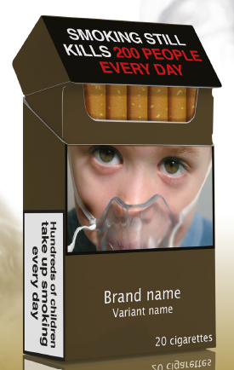
The context
SMOKING STILL KILLS
> 7 million adults in Great Britain still smoke
96,000 deaths a year due to smoking
Half of all smokers die from smoking-related diseases
Notes:
Although smoking prevalence has halved in the UK in the last 35 years, >7 million people still smoke – around 1/6 of the UK population.
Every year, 96000 people in the UK die from smoking-related illnesses – more than from obesity alcohol, road traffic accidents, illegal drugs and HIV infection combined - and overall, half of all smokers will die from their disease.
Smoking also exacerbates adult and child poverty: smoking is twice as common in unskilled and manual occupations than in professional and managerial groups, and is much higher in the unemployed, homeless, prisoners and those with mental illness, contributing to social inequalities.
So, while we can celebrate many of the interventions that have helped save lives by reducing smoking prevalence – bans on advertising, bans on smoking in public places, funding of smoking cessation services, and future interventions like plain packaging and smoking in cars – there are still millions of adults that smoke.
Sources:
ASH (2018) Fact Sheet: Smoking statistics
Britton (2015) Electronic cigarettes: pro. Thorax; doi:10.1136/thoraxjnl-2015-206935
Doll et al (1994) Mortality in relation to smoking: 50 years’ observations on male British doctors. BMJ. 309(6959):901-11.. doi:10.1136/bmj.38142.554479.AE
Jha et al (2013) 21st century hazards of smoking and benefits of cessation on the United States. NEJM. 368:341-50
Image from ASH (2015) – Smoking Still Kills

Slide 6
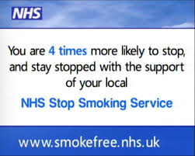
Stopping smoking works
Stopping smoking reduces mortality and increases life expectancy
NHS Stop Smoking Services have been a big success
BUT not all smokers access these services
Notes:
We know that stopping smoking works – stopping before age 30 reduces mortality risk to that of a non-smoker, and quitting at any age increases life expectancy.
UK NHS stop smoking services have helped thousands of smokers to quit since being established in the early 2000s. Unfortunately, less than 10% of smokers use these services to quit, and therefore we need to do more to target these people, as well as continuing to discourage young people from starting in the first place.
- Routine clinic data support findings from randomised controlled trials that smokers receiving stop-smoking support from specialist clinics, treatment in groups and varenicline or combination NRT are more likely to succeed than those receiving treatment in primary care, one-to-one and single NRT (Brose L, West R, McDermott M, Fidler J, Croghan E, McEwen A (2011) What makes for an effective stop-smoking service? Thorax. 66(10), 924-6. Doi:10.1136/thoraxjnl-2011-200251)
Sources:
- West R, May S, West M, Croghan E, McEwen A (2013) Performance of English stop smoking services in first 10 years: analysis of service monitoring data. British Medical Journal, 47:f4921
Britton (2015) Electronic cigarettes: pro. Thorax; doi:10.1136/thoraxjnl-2015-206935
Doll et al (1994) Mortality in relation to smoking: 50 years’ observations on male British doctors. BMJ. 309(6959):901-11.. doi:10.1136/bmj.38142.554479.AE
Taylor et al (2002) Benefits of Smoking Cessation for Longevity. Am J Public Health. 92:990-996
National Centre for Smoking Cessation Training website – www.ncsct.co.uk.
Image:
- http://smoking-quit.info/nhs-is-offering-stop-smoking-services

Slide 7
What about electronic cigarettes?
…A solution that could lead to the end of tobacco?
Or
…A huge gamble that will harm health and lead young people to smoking?
Notes:
What is the role of e-cigarettes in trying to reduce the huge unquestionable harm from tobacco?
On the one hand, as a popular method of nicotine delivery free of tobacco, could they be the means of harm reduction that appeals to smokers who want to quit but don’t access current NHS Stop Smoking Services?
On the other hand, is this enthusiasm misplaced, and could the promotion of e-cigarettes backfire with unknown long-term harms to health and a new gateway for young smokers?
Sources:
Britton (2015) Electronic cigarettes: pro. Thorax; doi:10.1136/thoraxjnl-2015-206935
Furber (2015) Electronic cigarettes: reasons to be cautious. Thorax; doi:10.1136/thoraxjnl-2014-206735
Chapman (2014) E-cigarettes: the best and worst case scenarios for public health. 349:g5512

Slide 8
What are electronic cigarettes?
Also known as:
  - E-cigarettes
  - Electronic nicotine delivery systems’ (ENDS)
  Vapourisers
Battery-operated devices that deliver nicotine via vapour – inhaled similar to cigarettes
Do not contain tobacco or generate CO (‘vaping’ rather than ‘smoking’)
Notes:
Originated in China in 2003-04, and have spread through Europe from late 2006 and on to North America.
Awareness has increased significantly over the last 5 years: in a 2010-11 survey of just over 1000 people in the UK, 54% of current and former smokers had heard of e-cigarettes, but a more recent survey from 2019 showed 94% of smokers and 93% of non-smokers were aware of them.
Sources:
Adkison (2013) Am J Prev Med. Electronic nicotine delivery systems: International Tobacco Control Four Country Survey.
ASH 2019 factsheet, ‘Use of electronic cigarettes (vapourisers) among adults in Great Britain’, https://ash.org.uk/wp-content/uploads/2019/09/Use-of-e-cigarettes-among-adults-2019.pdf

Slide 9
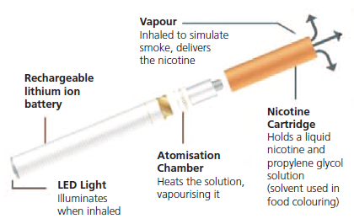
Evolution of electronic cigarettes
Notes:
The first e-cigarettes looked like real cigarettes.
Also known as cig-a-likes, Mini E-Cigs, or 1st generation e-cigarettes.
3 components: a battery, a cartridge that holds a solution of e-liquid, usually nicotine suspended in propylene glycol and glycerine, and an ‘atomizer’ that heats the solution to form a vapour. Some devices have a light at the end that glows on inhalation to mimic a real lit cigarette.
Initially either disposable, or could replace pre-filled cartridges.
Image from NCSCT electronic cigarettes briefing: www.ncsct.co.uk/usr/pub/e-cigarette_briefing.pdf

Slide 10
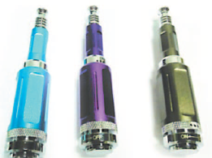
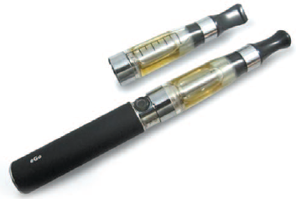

Evolution of electronic cigarettes
Notes:
1st generation e-cigarettes looked familiar to smokers so perhaps encouraged switching, but newer ‘2nd generation’ devices are now more popular.
Also known as E-pens, vapourisers or ‘tank systems’, these have a higher battery life so last longer, and increasing flexibility with ability to vary e-liquids, flavourings, etc. Cheaper to ‘top up’ e-liquid container than buy pre-filled versions. Now a huge market selling flavoured e-liquids.
3rd generation e-cigarettes, also known as modified e-cigarettes, ‘mods’, or ‘variable power e-cigarettes’, are even more complex and can look completely different – some have display screens, plug into computers, and have controls to vary power and ‘hit’ of the device…
The huge variety in devices has helped drive the enthusiasm of ‘vapers’ and there is now a huge community of advocates for their use.
Images from NCSCT electronic cigarettes briefing: www.ncsct.co.uk/usr/pub/e-cigarette_briefing.pdf

Slide 11

Use of e-cigarettes in the UK
Over
1 in 2
are ex-smokers
3.6 million current adult users
(ASH, 2019)
2 in 5
are current
smokers
Source: ASH, 2019
Notes:
Action on Smoking and Health (ASH) estimate there are currently 3.6 million adults in Great Britain using e-cigarettes (approx 7.1% of the population) – just under 2 million are ex-smokers, 1.4 million are current smokers and 200,000 are never smokers.
Regular use amongst never users is very low.
Source:
ASH (2019) ‘Use of electronic cigarettes (vapourisers) among adults in Great Britain’, www.ash.org.uk.

Slide 12
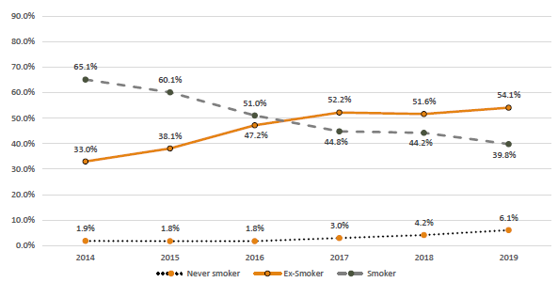
Use of electronic cigarettes in the UK by smoking status
Notes:
This graph shows the proportion of e-cigarette users by smoking status
The proportion of e-cigarette users who also smoke has steadily fallen whilst the proportion of ex-smokers has been rising. Never smokers make up about 6% of e-cigarette users
Taken from ASH (2019) - ‘Use of electronic cigarettes (vapourisers) among adults in Great Britain’, www.ash.org.uk.

Slide 13
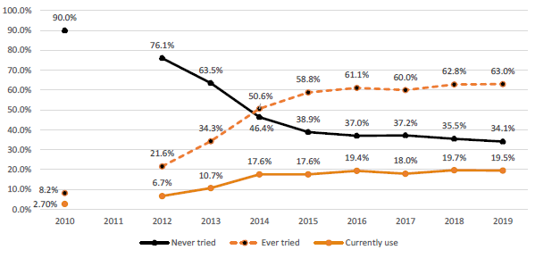
Use of electronic cigarettes in the UK amongst current smokers
Notes:
Looking at current smokers who have ever tried e-cigarettes: the proportion increased rapidly from 2010 to 2014 but plateaued at around 60% since. Notably over a third of current smokers havent tried vaping (2019).
For ex-smokers, 13.3% have tried vaping but no longer vape compared to 11.7% of ex-smokers who currently vape
Taken from ASH (2019) - ‘Use of electronic cigarettes (vapourisers) among adults in Great Britain’, www.ash.org.uk.

Slide 14
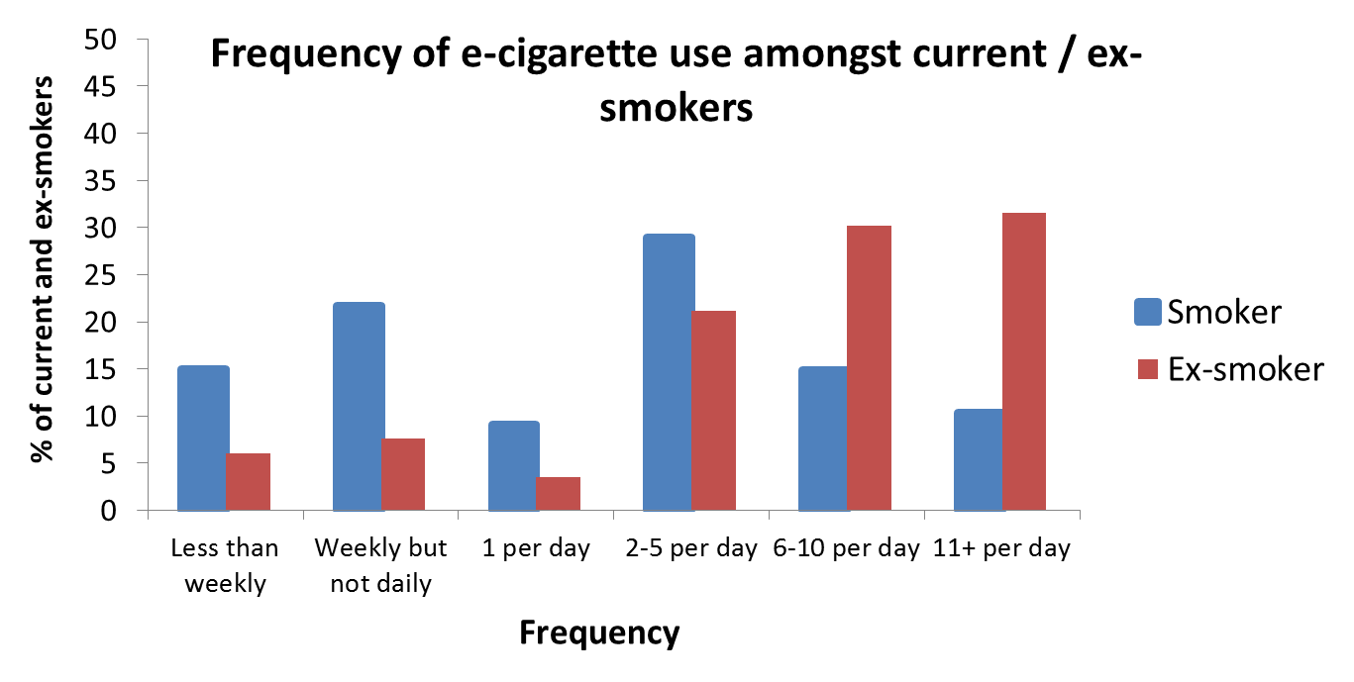
Use of electronic cigarettes in the UK
Notes:
According to the Smoking Toolkit Survey, e-cigarette use is more frequent in ex-smokers than current smokers
Source:
Smoking Toolkit Study: Trends in electronic cigarette use in England. Oct 2019 update. www.smokinginengland.info/latest-statistics

Slide 15
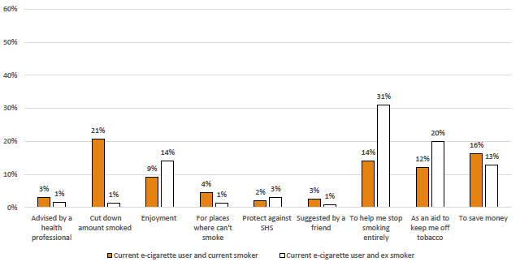
Main reasons for electronic cigarettes in the UK
Notes:
In the ASH 2019 survey, current vapers were asked their reasons for using an e-cigarette: most wanted to stop smoking or reduce their tobacco intake. Other reasons included being able to smoke in non-smoking environment (mainly current smokers), saving money, and to stop exposing others to the risks of second-hand smoke.

Slide 16

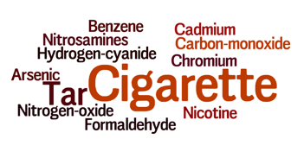
What are the benefits?
Less harmful than conventional cigarettes
Far fewer harmful components
Notes:
Smoking causes 96,000 deaths per year – half of all smokers die as a result of their smoking.
Conventional cigarettes contain tobacco, which, when smoked, produces tar, which contributes to most of the adverse health effects. Nicotine is the component of cigarettes that causes addiction, but is relatively harmless.
E-cigarettes contain predominantly nicotine, and while there are safety concerns related to other components, particularly with a lack of regulation and long-term data regarding health effects, they are considerably less harmful than conventional cigarettes.
Sources:
ASH factsheet (2019): Smoking statistics
Doll et al (1994) BMJ: Mortality in relation to smoking: 50 years’ observations on male British doctors.
Word clouds from www.wordle.net

Slide 17
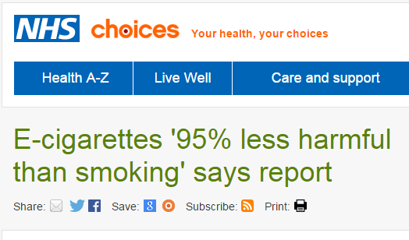

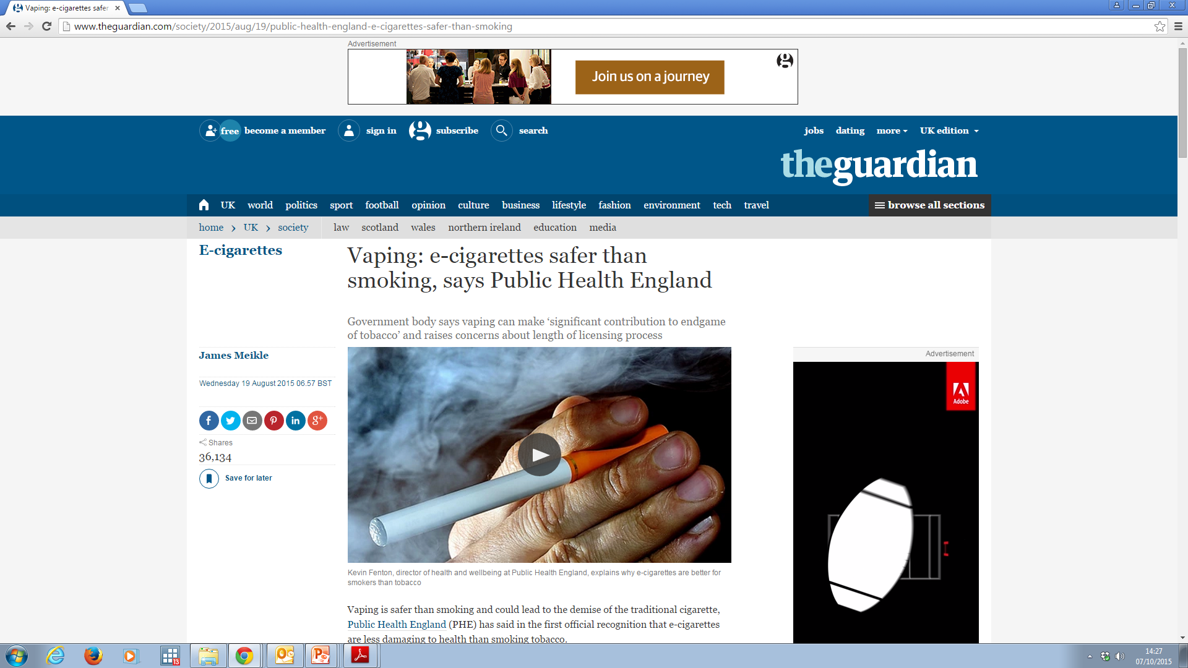
What are the benefits?
Notes:
A report by Public Health England I 2015 and updated in 2018 reported the harm from e-cigarettes to be expected to be 95% less than that of smoking tobacco cigarettes. This received widespread press coverage. A similar figure was stated in a report for the UK Parliament.
Sources:
McNeil et al (2015, 2018) E-cigarettes: an evidence update. A report commissioned by Public Health England. https://www.gov.uk/government/uploads/system/uploads/attachment_data/file/454516/Ecigarettes_an_evidence_update_A_report_commissioned_by_Public_Health_England.pdf AND: 2018 update: https://assets.publishing.service.gov.uk/government/uploads/system/uploads/attachment_data/file/684963/Evidence_review_of_e-cigarettes_and_heated_tobacco_products_2018.pdf
West et al (2014) Electronic cigarettes: what we know so far. A report to UK All-Party Parliamentary Groups.
Screenshots from NHS Choices, Public Health England, The Guardian.

Slide 18
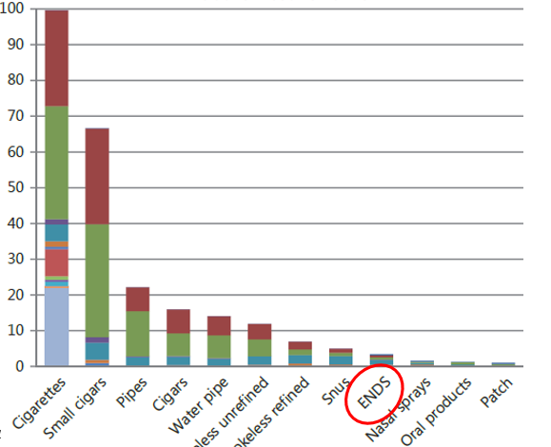
Relative nicotine harms
Notes:
There has been some discussion in both the medical journals and the media about where this ‘95% less harmful’ statistic comes from, and this is worth discussing.
The source was a paper by David Nutt and colleagues, where 12 international experts were convened to assess the harm from various nicotine containing products, by ‘scoring’ them using published methodology (the MCDA approach). The graph above shows the relative harms of these products, both in terms of morbidity and mortality related to the product itself (large green and red areas) as well as issues such as crime and economic costs.
This demonstrates the considerable reduced harm from e-cigarettes (classed as ENDS; electronic nicotine delivery systems) compared to conventional cigarettes.
The authors acknowledged that their assessment was limited by a lack of data on harm from e-cigarettes, and that some of ‘harm’ for conventional cigarettes was related to how widespread they were used. They also acknowledged that their was no formal selection criteria for group members.
Some correspondents have raised concerns that this was the only source used, and also about possible conflicts of interest in group members.
Subsequent correspondence from the PHE report authors has referred to the much lower levels of toxins in e-cigarette vapour. Others have added that while it is difficult to give a precise estimate, the evidence consistently shows e-cigarettes to be substantially less harmful than conventional cigarettes, which should be the key message to the public.
Sources:
Nutt (2014) Estimating the harms of nicotine-containing products using the MCDA approach. Eur Addict Res. 20:218-225
E-cigarettes: Public Health England’s evidence-based confusion. 2015. The Lancet. 386(9996): p829. doi: http://dx.doi.org/10.1016/S0140-6736(15)00042-2
McKee and Capewell (2015) Evidence about electronic cigarettes: a foundation built on rock or sand? BMJ. 351:h4863. doi: 10.1136/bmj.h4863
McNeil and Hajek (2015). Underpinning evidence for the estimate that e-cigarette use is around 95% safer than smoking: authors’ note. https://www.gov.uk/government/uploads/system/uploads/attachment_data/file/456704/McNeill-Hajek_report_authors_note_on_evidence_for_95_estimate.pdf
(Nutt article is Open Access therefore acceptable to use above figure for non-commercial use.)

Slide 19
Use of nicotine products in recent ex-smokers
Notes:
[this slide text behind the graph]
E-cigarettes have become popular and accepted by smokers, to a greater extent than traditional nicotine replacement therapy – this may be due to the wide range of products, the fact they have been promoted as a new lifestyle product rather than a medicine, and the fact that they more closely replicate the experience of smoking. They are also cheaper than smoking for regular use.
Increase in use of e-cigarettes has reversed a decline in use of nicotine amongst recent ex-smokers.
Sources:
Smoking Toolkit Study: Trends in electronic cigarette use in England. 2019 update. www.smokinginengland.info/latest-statistics – quarterly data from source graph averaged to create above graph.

Slide 20
Aids used by smokers in most recent stop attempt
Notes:
E-cigarettes are currently the most popular aid to quitting, based on a survey of adult smokers who either stopped or tried to stop in the past year – more than nicotine replacement therapy (either over the counter or via prescription), varenicline (Champix) or behavioural support (NB answers coded as ‘any’ use, not exclusive use.
E-cigarettes results in blood nicotine levels similar to those seen with oral NRT products, but achieved significantly faster.
Sources:
Smoking Toolkit Study: Trends in electronic cigarette use in England. June 2019 update. www.smokinginengland.info/latest-statistics – quarterly data from source graph averaged to create above graph.
McRobbie (2014) Electronic Cigarettes – National Centre for Smoking Cessation and Training briefing.

Slide 21
What are the benefits?
Less harmful than conventional cigarettes
Acceptable to smokers
May help smokers quit
Notes:
But do e-cigarettes actually work as a smoking cessation aid?
Whether e-cigarettes help smokers quit is one of the more debated issues – in part due to a lack of clear evidence, but also the wide range of products available.
Online forums and surveys of users support the concept that e-cigarettes help people quit, but clearly these are self-selected groups and not representative of the wider population.
See next slides
Source:
McRobbie (2014) Electronic Cigarettes – National Centre for Smoking Cessation and Training briefing.

Slide 22


Can e-cigarettes help people to stop smoking?
Cochrane Review 2016 update
Compared e-cigarettes with and without nicotine
One compared e-cigarette to nicotine patch
RCTs judged at low risk of bias
Notes:
Overall there is some limited evidence that e-cigarettes can be of benefit in helping smokers to quit.
A Cochrane review from 2014 and updated in 2016 identified only two randomized controlled trials (and 21 cohort studies) comparing e-cigarettes with and without nicotine. In one study users wanted to quit, in the other they did not. They looked at whether people had quit for at least 6 months.
The Bullen study from NZ, published in the Lancet looked at smokers who wanted to quit, and showed higher abstinence rates in the intervention group, although not statistically significant. They did note good acceptability and low side effects, and also similar efficacy to nicotine patches, so concluded they were moderately effective and comparable to other NRT.
The Caponnetto study from Italy, published in PLOS One, featured smokers who didn’t want to quit, who were offered the opportunity to test ‘a healthier alternative’ that they could use as often as they wanted. Both nicotine and placebo e-cigs lead to significant reductions in e-cig use and exhaled CO levels.
The Cochrane review pooled the results comparing abstinence rates in nicotine vs placebo EC groups (662 patients)
Italy map from www.wikihow.com
New Zealand map from www.vectorportal.com

Slide 23
Can e-cigarettes help people to stop smoking?
Overall:
Participants using EC: 9% chance of quitting at 6/12
Participants using placebo: 4% chance of quitting at 6/12
RR 2.29, 95% CI 1.05-4.96
No significant difference: e-cigarette vs patch
RR 1.26, 95% CI 0.68-2.34
Bottom line:
E-cigarettes better than placebo
but
Quality of evidence rated ‘low’ due to small number of trials
Notes:
The Cochrane review found that use of a nicotine-containing EC was associated with higher abstinence rates than placebo EC but not a nicotine patch
The studies were judged to be at low risk of bias, but the overall quality of evidence was graded as ‘low’ due to the limited number of studies.
Of note, both studies used ‘1st generation’ ‘cig-a-like’ products, that were widely available at the time, but have both now been surpassed by newer models – difficult to make conclusions for alternative models, let alone the newer ‘2nd generation’ devices.
Source:
McRobbie et al (2016) – Electronic cigarettes for smoking cessation and reduction (Cochrane Review).

Slide 24
Can e-cigarettes help people to stop smoking?
Cross-sectional survey (2014) – Brown, 2014
Monthly surveys of adults from 2009-2014
Part of Smoking Toolkit Study
Face-to-face computer-assisted survey with trained interviewers
5,863 English smokers making at least 1 quit attempt
E-cigarette users around
50% more likely to remain abstinent for at least a few months than those buying NRT or trying to quit unaided
But probably less than those attending specialist stop smoking services…
Notes:
What about other data? RCTs limited by trial conditions, products often ‘superseded’ in market by end of trial, and trials do not reflect ‘real world’ issues reflecting uptake of e-cigs, such as attractiveness, price, and social network influences.
A ‘real-world’ cross-sectional study using the Smoking Toolkit Study data looked at smokers making at least one quit attempt in the previous year.
It found that e-cigarette users were around 50% more likely to remain abstinent for at least a few months than those buying NRT from a store or those trying to quit unaided, but probably less than those attending specialist stop smoking services.
Sources:
Brown et al (2014) Addiction – Real-world effectiveness of e-cigarettes when used to aid smoking cessation: a cross-sectional population study.
West et al (2014) Electronic cigarettes: what we know so far. A report to UK All-Party Parliamentary Groups.

Slide 25

Can e-cigarettes help people to stop smoking?
United States less convinced:
Smaller survey (Grana, 2014)
US survey of 949 smokers
No link between baseline e-cigarette use and self-reported quitting at 1 year
Limited by low numbers of e-cigarette users (n=88)
US Preventative Services Task Force report (2015):
‘Not enough evidence to recommend ENDS for tobacco cessation’
Notes:
In contrast, a US survey of 949 smokers found no link between baseline e-cigarette use and self-reported quitting 1 year later.
This study was limited by low numbers of e-cigarette users (n=88), particularly those who quit smoking (n=9).
The US seems on the whole a lot more sceptical about the role of e-cigs, and in 2015, the US Preventative Services Task Force concluded that there was not enough evidence to recommend ENDS for tobacco cessation, suggesting clinicians direct smokers to other cessation interventions with established effectiveness and safety.
Clearly more studies needed to firm up evidence base.
Sources:
McRobbie et al (2014) – Electronic cigarettes for smoking cessation and reduction (Cochrane Review).
Grana (2014) JAMA Internal Medicine – A longitudinal analysis of electronic cigarette use and smoking cessation.
Torjesen (2015) BMJ – Evidence is insufficient to recommend e-cigarettes for quitting, US committee concludes. BMJ 2015:350:h2488
US flag from www.clipartbest.com

Slide 26
Can e-cigarettes help people to stop smoking?
Overall:
Probably yes – but limited evidence.
Need more research, with newer products.
Guideline bodies can only recommend licenced products.
Increasing e-cigarette use associated with increased population smoking cessation rates
Notes:
In England, increasing e-cigarette use has been associated with an increase in the population smoking cessation rate, although this may be due to other factors.
Source:
West et al (2014) Electronic cigarettes: what we know so far. A report to UK All-Party Parliamentary Groups.

Slide 27
What are the risks of e-cigarettes?
Direct harms to users
Due to inhalation of vapour
Presence of contaminants (lack of regulation)
Other harms using products
Indirect harms to others
Passive exposure to vapour
Inappropriate use of products
Encouraging children to vape / smoke
Encouraging others to smoke (re-normalizing smoking?)
Notes:
A number of concerns have been raised about the use of e-cigarettes – the main concerns being:
Safety during ‘normal’ use, by inhalation of vapour
Lack of regulation leading to harmful contaminants
Safety in other situations, eg burns from concentrated liquid, fires from incorrect chargers
Passive exposure of others to vapour
Encouraging young people to take up vaping and/or smoking
‘Re-normalizing smoking’ so that current smokers are less likely to stop, and ex-smokers re-start

Slide 28
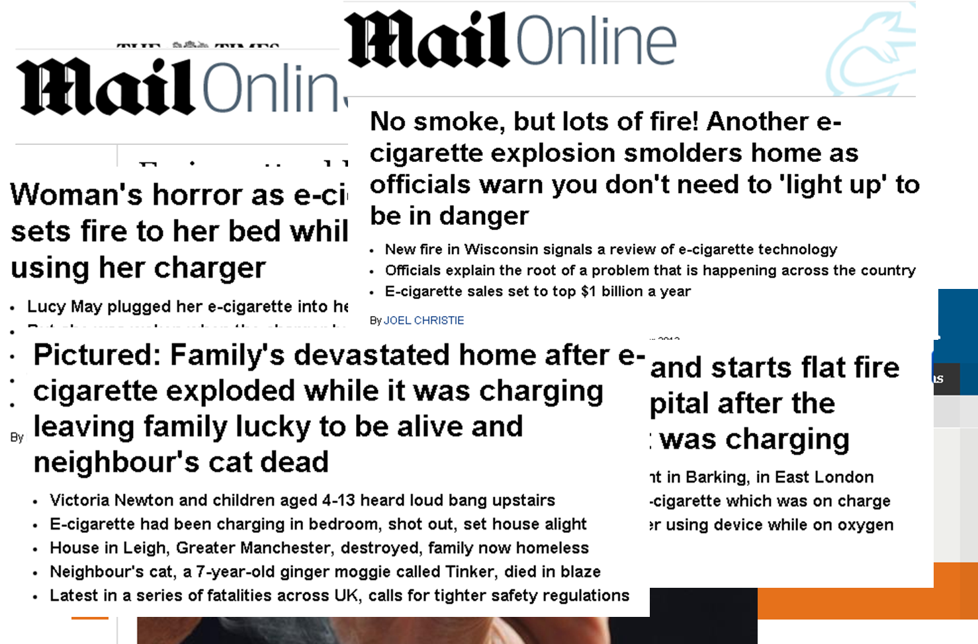
Notes:
Are e-cigarettes safe?
Countless news stories:
- An early BBC News story 2011 reporting a case of a patient dying from lipoid pneumonia, presumed secondary to vegetable ‘oils’ in an e-cigarette. More recently an outbreak in the united states linked to cannabis oils and a concern about increasing cases in the UK
Guardian opinion piece highlighting the various contaminants reported to be found in e-cigarettes.
News article from The Times highlighting the risk of fires due to dodgy chargers – a story hugely popular with the Daily Mail – see headlines (four).
Screenshots from online newspaper pages

Slide 29
Are e-cigarettes safe?
During normal use by vapers - inhalation:
Nicotine
Propylene Glycol
Glycerine
Flavourings
Contaminants
Notes:
During normal vaping, the main substances inhaled are nicotine, propylene glycol and/or glycerine, plus possibly flavourings and the potential for unspecified ‘contaminants’ – see next slides.
Propylene glycol and glycerine are the most commonly used vaporising solvents
Most side-effects reported by users in studies and in user groups have been minor, such as throat irritation or dry cough.
Glycerine (UK) = glycerin (US) = glycerol

Slide 30
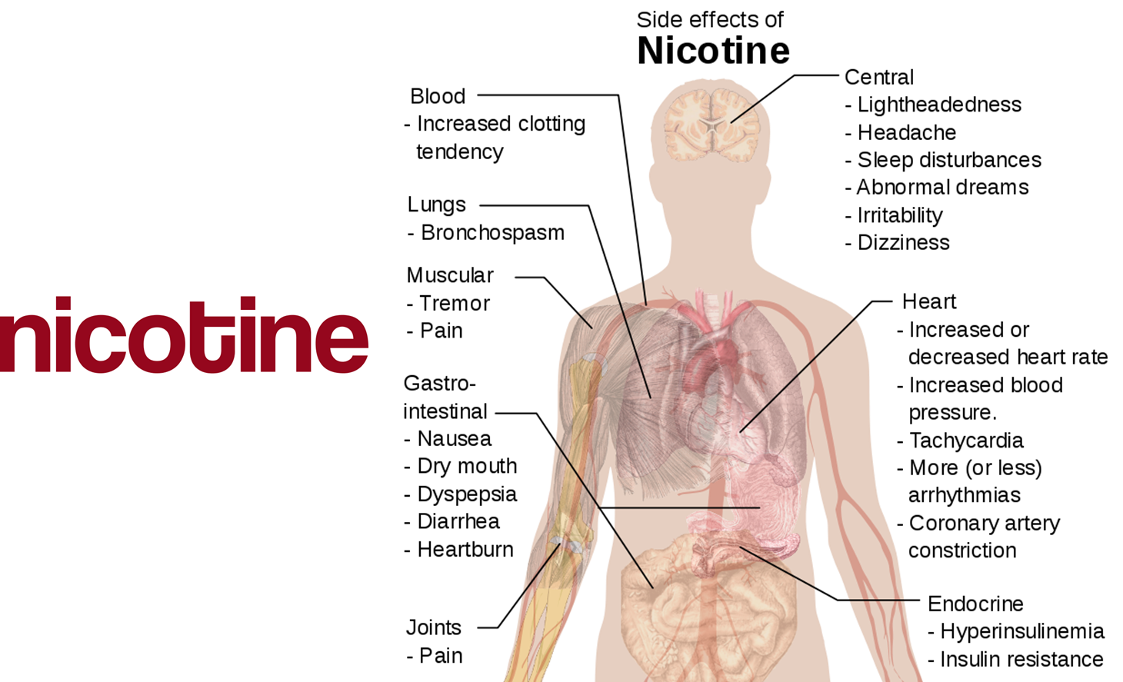
Are e-cigarettes safe?
Notes:
Nicotine is the substance that causes addiction to tobacco, but otherwise is perceived to be relatively harmless – hence why NRT is available on prescription.
It can cause irritant effects locally, for example oesophagitis and bronchospasm, and GI side-effects such as nausea and vomiting are common. The BNF lists other side effects such as chest pain and palpitations.
Use of nicotine usually leads to withdrawal symptoms after use, including headache, depression, irritability, anxiety, weight gain and impaired concentration.
However, it has not been associated with increased risk of cardiovascular events – an epidemiological study using primary care data showed no increased risk of myocardial infarction, stroke or death.
There are some data suggesting nicotine may have a role in the biology of cancer development, but the International Agency for Research on Cancer doesn’t currently consider it a carcinogen.
Nicotine probably has adverse effects on fetal development.
Nicotine levels in e-cigarettes vary depending on quantity specified, but delivery to the user also depends on how they use the device, eg duration and frequency of puffs. There are instances of mislabelling quantities in some studies, but mostly these devices contained less than that declared rather than more.
Sources:
British National Formulary
Hubbard et al (2005) Tobacco Control. Use of nicotine replacement therapy and the risk of myocardial infarction, stroke and death. 14:416.
Grando (2014) Nature Reviews Cancer. Connections of Nicotine to Cancer. 14: 419
IARC monograph (2012): A Review of Human Carcinogens: Personal Habits and Indoor Combustions. http://monographs.iarc.fr/ENG/Monographs/vol100E/mono100E.pdf.
McNeil et al (2015) E-cigarettes: an evidence update. A report commissioned by Public Health England.
Image from Wikipedia:
"Side effects of nicotine" by Mikael Häggström - All used images are in public domain. Licensed under Public Domain via Wikimedia Commons - https://commons.wikimedia.org/wiki/File:Side_effects_of_nicotine.svg#/media/File:Side_effects_of_nicotine.svg

Slide 31

Are e-cigarettes safe?
No evidence of harm – but limited evidence
Papers reporting animal testing from 1940s described no adverse effects
Notes:
No evidence of harm. Used in other products eg food and cosmetics.
The US Environmental Protection Agency studied propylene glycol around 10 years ago and reported no evidence of toxicity, after a limited array of testing.
US scientists back in the 1940s subjected monkeys and rats to continuous high concentrations of propylene glycol vapour for periods of 12 to 18 months, and found them to be no different to control animals, including after extensive lung examination on autopsy.
Clearly limited data from humans, but seems ‘safe’ so far.
Sources:
US Environmental Protection Agency (2006). Registration eligibility decision for propylene glycol and dipropylene glycol - http://www.epa.gov/oppsrrd1/reregistration/REDs/propylene_glycol_red.pdf
Robertson et al (1947) Tests of the chronic toxicity of propylene glycol and triethylene glycol on monkeys and rats by vapour inhalation and oral administration. J Pharmacol Exp Ther. 91: 52
McRobbie (2014) Electronic Cigarettes – National Centre for Smoking Cessation and Training briefing.

Slide 32


Are e-cigarettes safe?
Case reports of lipoid pneumonia
Notes:
Whilst there has been a recent reported ‘outbreak’ of Lipoid pneumonia declared in North Carolina, USA – this was amongst patients using electronic vaping pens/e-cigarettes that had refillable chambers or interchangeable cartridges with tetrahydrocannabinol (THC) vaping concentrates or oils. In the US, recent CDC laboratory testing of BAL samples from 29 of these cases identified the presence of Vitamin E acetate, an additive in some THC-containing products, in 82%. Whilst causality cannot yet be proven, It is likely that this compound is responsible in part for the vaping associated lung injury outbreak
There have been several case reports of lipoid pneumonia related to (non-THC) e-cigarette use – this is a rare chronic inflammatory response to lipid substances in the lungs. Most patients are asymptomatic but symptoms can include cough, dyspnoea, fever, weight loss, chest pain and haemoptysis.
Vegetable glycerine (glycerin in American English, also known as glycerol) is an alternative e-liquid to propylene glycol – it is produced by heating palm or coconut oil, or from animal fat and soap by a fatty-acid splitting operation.
Sources:
McCauley (2012) Chest. An Unexpected Consequence of Electronic Cigarette Use. 141:1110.
BBC News report: http://www.bbc.co.uk/news/uk-england-12887335, accessed July 2015
CDC report 2019 (https://www.cdc.gov/mmwr/volumes/68/wr/mm6836e1.htm)
Viswam D, Trotter S, Burge PS, et al Respiratory failure caused by lipoid pneumonia from vaping e-cigarettes Case Reports 2018;2018:bcr-2018-224350.
CDC: https://www.cdc.gov/tobacco/basic_information/e-cigarettes/severe-lung-disease.html

Slide 33
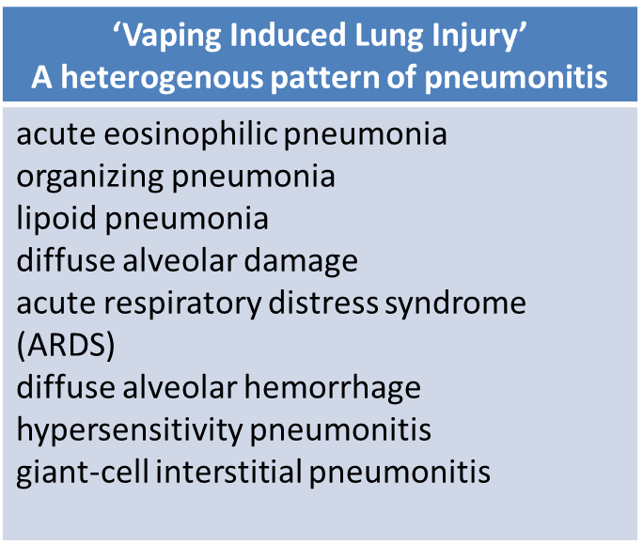
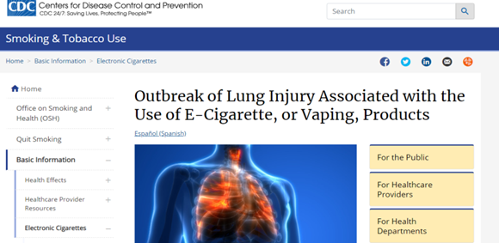
Are e-cigarettes safe?
As of Nov 2019:
2051 cases of e-cigarette associated lung injury reported in US
39 deaths
Sources: Christiani (2019); CDC
Notes:
The Centres for Disease Control and Prevention reported in Nov 2019 at least 2015 cases of e-cigarette associated lung injury and 39 deaths. These cases all demonstrate a heterogenous pattern of pneumonitis including
acute eosinophilic pneumonia , organizing pneumonia, lipoid pneumonia. diffuse alveolar damage ,acute respiratory distress syndrome (ARDS) , diffuse alveolar hemorrhage . hypersensitivity pneumonitis, giant-cell interstitial pneumonitis
The precise mechanism of vaping induced lung injury is diverse and yet to be fully characterised but it is worth noting again that the majority of those cases reported in the US related to persons vaping both nicotine and THC containing products
Sources:
CDC https://www.cdc.gov/tobacco/basic_information/e-cigarettes/severe-lung-disease.html
Christiani DM (2019), Vaping Induced Lung Injury. NEJM [Epub ahead of print] available at: https://www.nejm.org/doi/full/10.1056/NEJMe1912032

Slide 34

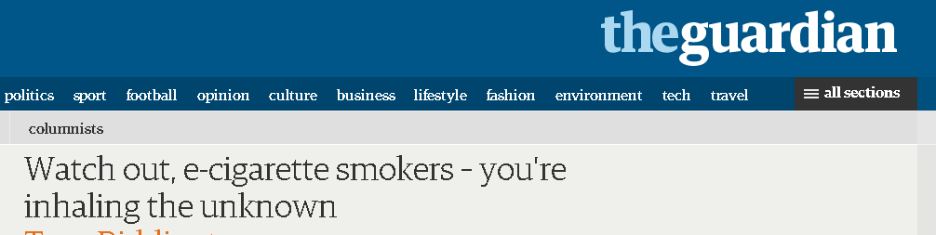
Are e-cigarettes safe?
Contaminants are most significant concern
Lack of regulation means uncertainty as to content – variability between devices / brands
Notes:
Toxins have been found in a number of studies of e-cigarettes
These include formaldehyde, acetaldehyde and nitrosamines, which are carcinogenic, as well as toxic metals such as cadmium, nickel and lead.
Screenshot from www.theguardian.co.uk

Slide 35
Are e-cigarettes safe?
Levels of tobacco-specific nitrosamines in various products
(ng/g, except for gum/patch – ng/patch or ng/piece)
Product | NNN | NNK | NAT | NAB | Total
Nicorette 4mg gum | 2.00 | ND | ND | ND | 2.00
NicoDerm CQ 4mg patch | ND | 8.00 | ND | ND | 8.00
Electronic cigarette | 3.87 | 1.46 | 2.16 | 0.69 | 8.18
Marlboro (ultralight) | 2900 | 750 | 1100 | 58 | 4808
Marlboro (full) | 2900 | 960 | 2300 | 100 | 6260
Adapted from: Cahn, 2011, J Public Health Policy
Notes:
Tobacco-specific nitrosamines have been detected in e-cigarettes, but levels are orders of magnitude lower than in tobacco cigarettes, and similar to levels in nicotine replacement therapy.
Diethylene glycol (DEG) is another potential health hazard found in e-cigarettes in one study , but not in 15 other studies.
Source:
Cahn and Siegel (2011) Journal of Public Health Policy. Electronic cigarettes as a harm reduction strategy for tobacco control: A step forward or a repeat of past mistakes? 32: 16-31.

Slide 36
Are e-cigarettes safe?
Levels of selected toxins in conventional vs electronic cigarettes (microgram in mainstream smoke / per 15 puffs)
Toxic compound | Conventional cigarette | Electronic cigarette | Average ratio
Formaldehyde | 1.6-52 | 0.20-5.61 | 9
Acetaldehyde | 52-140 | 0.11-1.36 | 450
Acrolein | 2.4-62 | 0.07-4.19 | 15
Toluene | 8.3-70 | 0.02-0.63 | 120
Adapted from: Goniewicz, 2014, Tobacco Control
Notes:
The data is messier for toxins like formaldehyde, which have been reported as causing cancer.
A study from Poland in 2013 evaluated 12 brands of e-cigarettes and a nicotine inhalator as a reference product.
Carbonyl compounds such as formaldehyde were found in most e-cigarettes but 9 – 450 times less than in conventional cigarettes.
Trace amounts of some substances were also found in the inhalator.
Volatile organic compounds, tobacco-specific nitrosamines and metals were found in most devices.
The PHE report addressed some studies reporting higher levels of aldehydes in e-cigarettes – the authors argue that these studies involved ‘overheated’ e-liquid.
This can occasionally occur in normal use if the level of e-liquid was too low or the power too high, but if it occurs, it causes a distinctive unpleasant taste to vapers (known as ‘dry puff’) and therefore users would avoid inhaling.
PHE concluded that with normal vaping, aldehyde levels posed no risk to health.
A recent report from the US ‘Center for Environmental Health’ raised concerns about ‘cancer-causing chemicals’ in e-cigarettes
It noted that of 97 products tested in an independent laboratory, around half produced levels of formaldehyde above the California state safety level.
The report did not give details of its methodology and was written with a strong stance against e-cigarettes, so a follow-up publication in the peer-reviewed literature would be useful, in particular to assess whether the ‘dry-puff’ phenomenon detailed in the PHE report was responsible.
Sources:
Goniewicz et al (2014) Tobacco Control. Levels of selected carcinogens and toxicants in vapour from electronic cigarettes. 23: 133
McNeil et al (2015) E-cigarettes: an evidence update. A report commissioned by Public Health England.
Cox (2015) A Smoking Gun: Cancer-causing chemicals in e-cigarettes. Center for Environmental Health. September 2015. http://www.ceh.org/wp-content/uploads/CEH-2015-report_A-Smoking-Gun_-Cancer-Causing-Chemicals-in-E-Cigarettes.pdf

Slide 37
Are e-cigarettes safe?
Levels of selected metals in conventional vs electronic cigarettes (microgram per 10 puffs)
Metal | Conventional cigarette | Electronic cigarette
Iron | 0.04 | 0.52
Aluminium | 0.22 | 0.39
Copper | 0.19 | 0.20
Tin | - | 0.04
Clinical significance?
Adapted from: Williams, 2013, PLoS One
Notes:
This further US study looked at levels of various metals in e-cigarettes, by analyzing cartomizers (cartridge-atomizer components) which contain metal.
Researchers were able to detect metals such as tin, silver, iron, nickel and aluminium in aerosols, often at higher levels than conventional cigarettes.
However, the clinical significance of these levels was unclear, and levels may be well below that ‘allowed’ in inhalational drugs, for example, one American standards document specified a limit of 100 micrograms/day of copper in inhalational medicinal products, suggesting that the 0.2 micrograms per 10 puffs specified here should be of no concern. Farsalinos and colleagues conducted a review comparing levels of metals from studies in the literature to published guidance and concluded levels of metals would not be a significant health concern for smokers switching to electronic cigarettes, but could be an unnecessary source of exposure for never smokers, and called for more research. They also noted variation between products, and suggested quality standard implementation could further reduce unnecessary exposure.
A systematic review by Burstyn converted values reported from other papers into levels in a ‘personal breathing zone’ and compared these to occupational exposure limits: the author concluded that contamination by metals was at ‘trivial levels that posed no health risks’. This report was funded by the US Consumer Advocates for Smoke-free Alternatives Association, of which the author is a Director.
Sources:
Williams et al (2013). PLoS ONE. Metal and silicate particles including nanoparticles are present in electronic cigarette cartomizer fluid and aerosol. 8: e57987
US Pharmacopeial Convention Elemental Limits – see http://www.usp.org/sites/default/files/usp_pdf/EN/USPNF/key-issues/c232_final.pdf
Farsalinos et al (2015) Are metals emitted from electronic cigarettes a reason for health concern? A risk assessment analysis of currently available literature. International Journal of Environmental Research and Public Health. 12:5215-5232.
Burstyn (2014) Peering through the mist: systematic review of what the chemistry of contaminants in electronic cigarettes tells us about health risks. BMC Public Health. 14:18

Slide 38

Are e-cigarettes safe?
Mouse model:
Reduced pulmonary anti-microbial defences
Tigger inflammatory responses and alter lung mechanics
? relevance in humans
Image: George Shuklin
Notes:
A study where mice were exposed to vapour from e-cigarettes was widely reported in early 2015.
After exposure, mice were infected with either bacteria (Strep pneumoniae) or viruses (Influenza A), and monitored for markers of inflammation.
Mice exposed to e-cigarette vapour had more problems than those that had not had the vapour exposure. Bacterial-exposed mice had increased bacterial burden in bronchoalveolar lavage fluid, and viral-exposed mice had increased viral titres. The viral-exposed mice also lost more weight than their counterparts who had not been exposed to e-cig vaper, and 2 of 10 died vs none of the non-vaping ones.
The authors concluded that e-cigarettes could impair pulmonary clearance of infections.
Criticisms of this study include: 1) can’t assume mouse model would apply to humans, 2) no comparison to tobacco, which would likely have been more harmful, 3) ‘stress’ of vapour exposure process, including nicotine poisoning, may have been responsible.
Public Health England reviewed this study in their recent report and concluded it had little relevance for estimating human risk and raised no new safety concerns.
Another study, 2017, reported increased BALF cellularity and mucin production in mice exposed to vapour from e-cigarettes; furthermore the levels of BALF protein and oxidative stress were equal to or more pronounced than mice exposed to cigarette smoke. Tissue elasticity, static compliance and airway resistence were all adversely affected following short-term exposure to e-cigarette vapour but after more prolonged exposure, this effect of pulmonary mechanics disappeared (whereas there was a sustained effect in those mice exposed to cigarette smoke)
Source:
Sussan, T.E., et al., Exposure to Electronic Cigarettes Impairs Pulmonary Anti-Bacterial and Anti-Viral Defenses in a Mouse Model. PLoS One, 2015. 10(2): p. e0116861.
McNeil et al (2015) E-cigarettes: an evidence update. A report commissioned by Public Health England.
Glynos, C. et al. Comparison of the effects of e-cigarette vapor with cigarette smoke on lung function and inflammation in mice. American Journal of Physiology-Lung Cellular and Molecular Physiology 2018 315:5, L662-L672
Image source:
"Мышь 2" by George Shuklin - Own work. Licensed under CC BY-SA 1.0 via Commons - https://commons.wikimedia.org/wiki/File:%D0%9C%D1%8B%D1%88%D1%8C_2.jpg#/media/File:%D0%9C%D1%8B%D1%88%D1%8C_2.jpg. From Wikipedia.

Slide 39
Are e-cigarettes safe?
Other harms to users:
Damage from inappropriate nicotine exposure
Fires when charging
Image: George Shuklin
Notes:
wo other concerns to users from e-cigarettes are the risk of damage from over-exposure to e-liquid (either oral consumption, or topical to skin) and fires (mainly when charging devices).

Slide 40
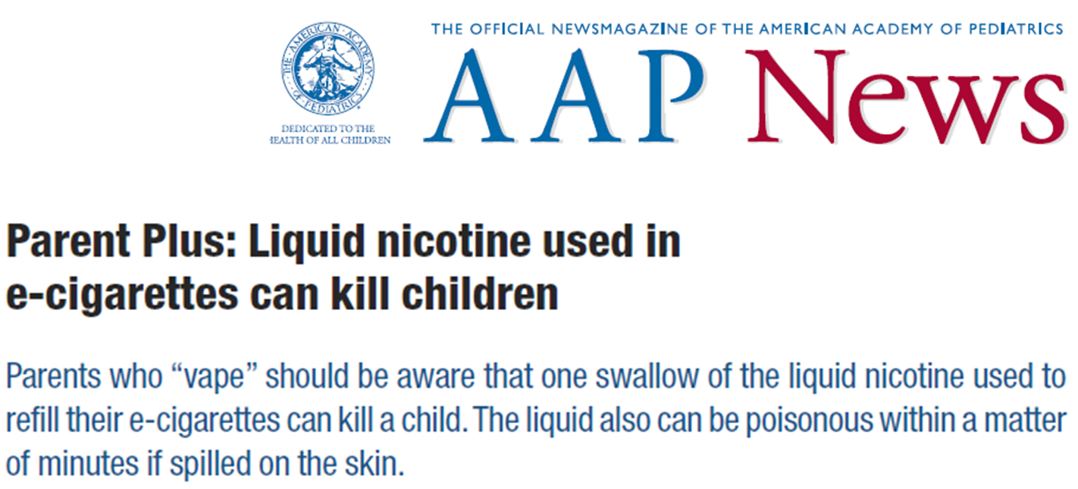
Are e-cigarettes safe?
Damage from inappropriate nicotine exposure
Image: George Shuklin
Notes:
There are media reports of people drinking e-liquid, either in intentional overdoses or by accident – clearly this could be harmful and potentially fatal, especially for young children.
There are at least two reports of deaths of children, one in Israel and one in the USA
The US Centers for Disease Control and Prevention and UK National Poisons Information Service have reported increasing numbers of calls to poison centres across the country in recent years – in the UK there were 262 calls in 2018/9 – 40% of which involved children <5 years, although for context there were over 1000 calls relating to ingestion of dishwasher tablets.
Aside from ingestion, there are also reports of toxicity through accidental spillage of e-liquid on skin.
The risk of fatal nicotine poisoning is however extremely rare. Low doses tend to cause nausea and vomiting, which prevents further intake.
Clearly childproof packaging is important to prevent harms to children.
Sources:
American Academy of Pediatrics News article (December 2014) http://aapnews.aappublications.org/content/early/2014/12/17/aapnews.20141217-1.full.pdf+html
Various news reports including Times Union, http://www.timesunion.com/news/article/Case-closed-in-Fort-Plain-liquid-nicotine-death-6195411.php
Kloosterman (2013) Electronic cigarette kills toddler in Israel. Green Prophet. 29.
CDC Morbidity and Mortality Weekly Report - Notes from the Field: Calls to Poison Centers for Exposures to Electronic Cigarettes — United States, September 2010–February 2014 http://www.cdc.gov/mmwr/preview/mmwrhtml/mm6313a4.htm?s_cid=mm6313a4_w
McNeil et al (2015) E-cigarettes: an evidence update. A report commissioned by Public Health England.

Slide 41
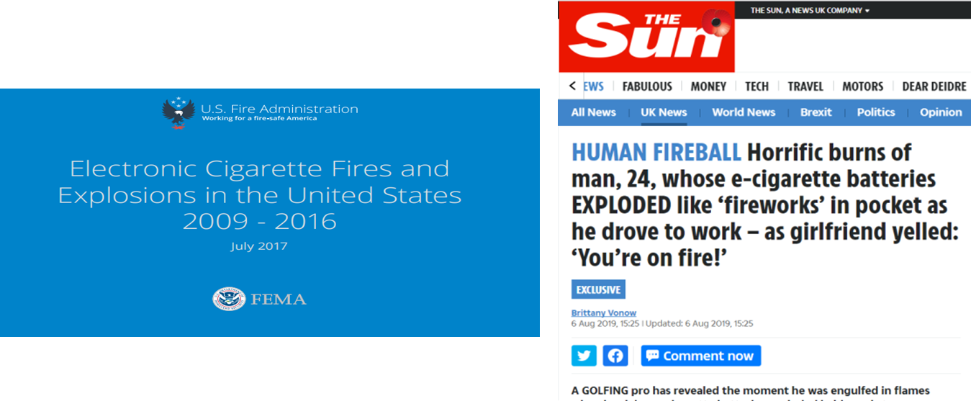
Are e-cigarettes safe?
195 separate incidents of fires or explosions in US over 7 years linked to e-cigarettes
38 severe injuries
Image: George Shuklin
Notes:
The US Fire Administration reported an analysis of media reports in 2017 concerning the risks of fires and explosions with e-cigarettes
At least 195 incidents were identified from 2009-2016, with at least 38 severe injuries reported. There were no deaths, although the authors did note a report of a death from the UK where a fire from an e-cigarette ignited nearby oxygen equipment.
In two cases where the e-cigarette was being used, vapers suffered severe burns to the mouth.
In the UK, in 2016, there were 67 fires attributed to e-cigarettes, 11 casualties and zero fatalities (source: PHE)
Source:
US Fire Administration Report (October 2014) – Electronic Cigarette Fires and Explosions. https://www.usfa.fema.gov/downloads/pdf/publications/electronic_cigarettes.pdf
US Fire Administration Report (July 2017) - https://www.usfa.fema.gov/downloads/pdf/publications/electronic_cigarettes.pdf
Public Health England, Evidence review of e-cigarettes and heated tobacco products 2018: executive summary. 2018
McNeil et al (2015) E-cigarettes: an evidence update. A report commissioned by Public Health England.

Slide 42
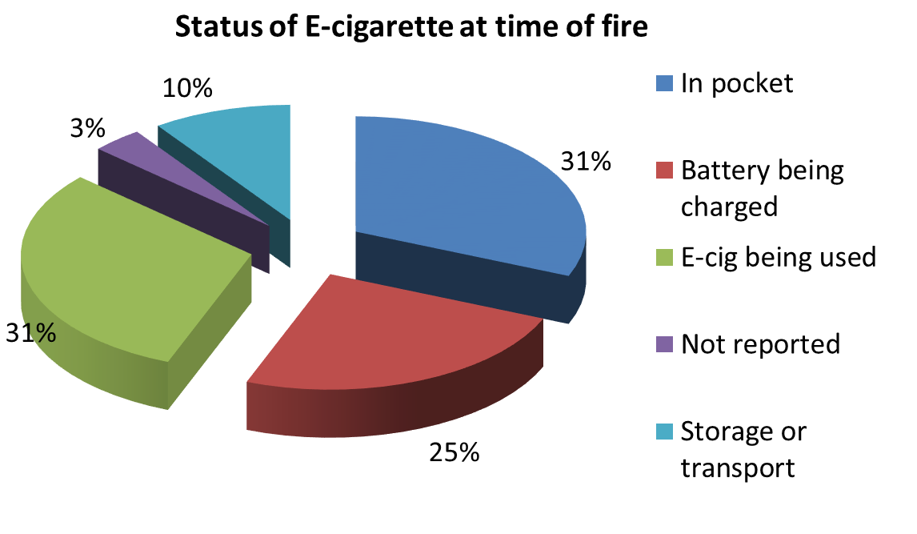
Are e-cigarettes safe?
Source: US Fire Administration Report: 2017
Notes:
Based on the US report:
Most fires occurred during use or whilst In pocket and have been attributed to the use of Lithium Ion batteries presenting a known explosion hazard. Fires during charging mostly occurred with devices that were connected to generic USB ports. The report emphasized that devices should generally only be charged using chargers supplied by the manufacturer.
The report noted that fires had also been reported with lithium ion batteries in mobile phones and laptops, and descriptions of fires and explosions in the media from e-cigarettes matched the same pattern. However, Lithium ion batteries in these larger appliances are usually more rigidly encased and arguably are not brought in as close proximity to vital areas of the body
The report concluded that the relative infrequency of e-cigarettes fires compared to use suggested current precautions by manufacturers to prevent battery fires have been largely successful, but there was scope for education of users on safe charging practice, including eliminating USB connections, and ensuring all manufacturers include protective circuits as part of devices.
Source:
US Fire Administration Report (October 2017) – Electronic Cigarette Fires and Explosions. https://www.usfa.fema.gov/downloads/pdf/publications/electronic_cigarettes.pdf

Slide 43
Are e-cigarettes safe?
Overall:
Nicotine – generally low risk of harm
Propylene glycol – seems safe
Glycerine – increasing reports of lipoid pneumonia moreso associated with THC
Contaminants – potentially harmful but low amounts if used correctly?
Risk of fire – increasing with use of Li-ion batteries
E-liquids can cause toxicity with overexposure

Slide 44
Are e-cigarettes safe?
Need long term data
Need effective regulation
Overall less harmful than tobacco
Public education re: safety

Slide 45
Are e-cigarettes harmful to others?
No smoke from e-cigarettes – therefore no ‘passive smoke’ exposure
Vaping may expose others to exhaled vapour
Notes:
Vapour is not ‘smoke’, so there isn’t passive smoke exposure
E-cigarettes don’t produce sidestream vapour between puffs, but users will exhale some of the mainstream vapour

Slide 46

Levels of nicotine and aerosol particles produced by e-cigarettes compared to baseline/tobacco cigarettes
Notes:
One study assessed the level of nicotine and other constituents in a closed room after volunteers first used e-cigarettes and then used conventional cigarettes. Levels of nicotine were around 10x higher with tobacco cigarettes, and levels of aerosol particles (PM_{2.5}) were 7x higher.
E-cigarettes did not produce carbon monoxide.
Both tobacco smoke and e-cigarette vapour contained toluene but for e-cigarettes this was not significantly different than baseline values. Tobacco cigarettes had 3.5x higher amounts. There were no other volatile organic compounds produced by e-cigarettes.
Source:
Czogala (2013) Secondhand exposure to vapors from electronic cigarettes. Nicotine & Tobacco Research. 16(6):655-62. doi: 10.1093/ntr/ntt203
Permission obtained for above and subsequent image from OUP: license number 3765391229757, Dec 2015 – to use in Slide Kit for British Thoracic Society.

Slide 47
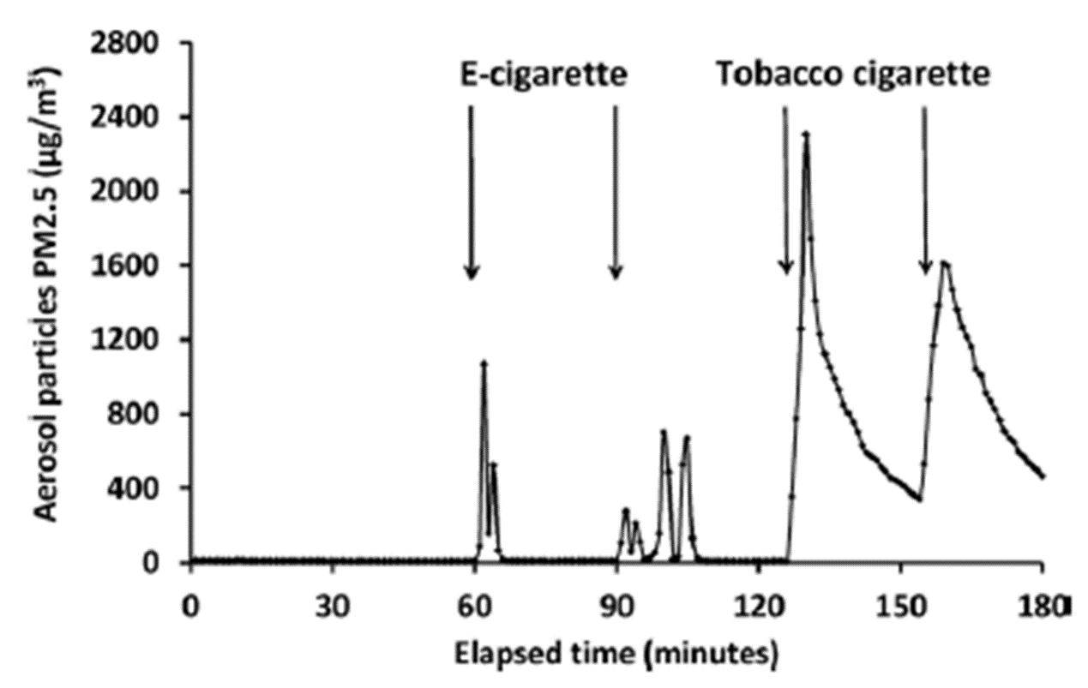

Levels of aerosol particles produced in experiment by e-cigarettes, then tobacco cigarettes
Notes:
The above study did not assess the presence of carbonyl compounds such as formaldehyde, or heavy metals.
Another study (Long 2014) reported that e-cigarette aerosol did not increase bystander exposure to carbonyl compounds above levels in exhaled breaths of air. Note author employed by Lorillard Tobacco, who own the e-cigarettes that were tested in the paper...
Source:
Czogala (2013) Nicotine & Tobacco Research. Secondhand exposure to vapors from electronic cigarettes.
Long (2014) Comparison of Select Analytes in Exhaled Aerosol from E-cigarettes with exhaled smoke from a conventional cigarette and exhaled breaths. Int J Environ Research Pub Health. 11, 11177-11191

Slide 48
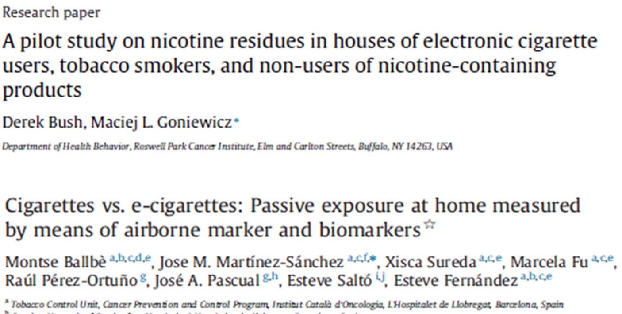
Are e-cigarettes harmful to others?
Notes:
A study examining nicotine residue on surfaces in homes found levels 169x lower in e-cigarette users homes than smokers homes, and with no difference between e-cigarette users and non-users (Bush 2015).
Another study from Spain (Ballbe 2014) looked at salivary and urinary cotinine levels of non-smokers living with smokers, vapers or controls, and actually noted statistically similar biomarker levels in the smoker and vaper homes, suggesting similar exposure. There were small numbers (only 5 participants living with vapers) and users may inadvertently have had exposure out of the home. Overall levels were low however: Public Health England’s 2015 report loosely compared them to that obtained by eating a tomato.
Source:
Bush (2015) A pilot study on nicotine residues in houses of electronic cigarette users, tobacco smokers, and non-users of nicotine-containing products. Int Journal of Drug Policy. 26. 609-611.
Ballbe (2014) Cigarettes vs e-cigarettes: Passive exposure at home measured by means of airborne marker and biomarkers. Environmental Research. 135: 76-80
McNeil et al (2015) E-cigarettes: an evidence update. A report commissioned by Public Health England.

Slide 49
Are e-cigarettes harmful to others?
E-cigarettes don’t produce smoke
Vapour contains low levels of nicotine and aerosol particles but no CO/VOCs
Possibility of other compounds?
  Less harmful than tobacco
  Likely to be low risk
Notes:
Overall, Public Health England concluded that ‘the health risks of passive exposure to electronic cigarette vapour are therefore likely to be extremely low’ (2014 report).
Source:
Britton and Bogdanovica (2014) Electronic Cigarettes: A report commissioned by Public Health England.

Slide 50

Will e-cigarettes encourage children to start smoking?
Source: www.thealchemistscupboard.co.uk
Notes:
A major concern about e-cigarettes is that they will appeal more to children – thereby encouraging children to start vaping.
This could then lead to them moving onto tobacco (most worrying) or at the very least result in a large generation of young people addicted to nicotine and experiencing potentially future harms from long-term vaping.
Part of the concern stems from the wide variety of child-friendly flavours available, and marketing potentially targeted at children.
A counter to this would be that these flavours help smokers to switch to vaping. Some vapers feel tobacco-flavoured liquids are unpalatable once they get their taste buds back after stopping smoking.
Image: screenshot from www.thealchemistscupboard.co.uk – note that this website does state users have to be over 18

Slide 51
Will e-cigarettes encourage children to start smoking?
Most UK children have heard of e-cigarettes
In one 2019 survey by ASH:
15.4% of 11-18 year olds had tried them at least once
1.6% had used them regularly (once a week or more)
Source: ASH, 2019
Notes:
Awareness of e-cigarettes amongst young people has risen significantly from 2013, when 67% of 11-18 year olds were aware of e-cigarettes, and 2015 when it reached 93%, and it has remained at this level since then. Whilst increasing, regular use amongst 11-18 year olds continues to be rare
Source:
ASH factsheet – Use of electronic cigarettes amongst young people in Great Britain. June 2019
Source:
Britton and Bogdanovica (2014) Electronic Cigarettes: A report commissioned by Public Health England.

Slide 52
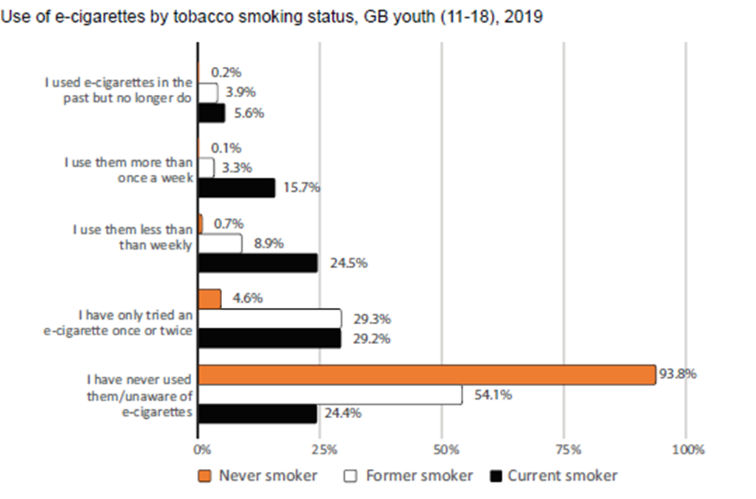
Will e-cigarettes encourage children to start smoking?
Source: ASH 2019
Notes:
Most of those who had tried electronic cigarettes were current or former smokers, or those who had tried cigarette smoking.
Of those who had never smoked a tobacco cigarette, 93.8% were not aware or had never used an e-cigarette
Frequent use of e-cigarettes by children was confined almost entirely to ex-smokers and daily smokers. 15.7% of current smokers surveyed used e-cigarettes more than once a week
So e-cigarettes are mainly used by those who have already been tempted by smoking.
Source:
ASH factsheet – Use of electronic cigarettes among young people in Great Britain. June 2019.

Slide 53

Will e-cigarettes encourage children to start smoking?
9 longitudinal studies
16,621 adolescents and young adults
Age ranges 14-30
Compared cigarette smoking initiation between:
ever e-cigarette users at baseline and
never e-cigarette users
Notes:
A meta-analysis published in 2017 in Jama Paediatrics included 9 longitudinal US based studies comprising a total of 16,621 adolescents and young adults aged between 14 and 30 which reported odds ratios for cigarette smoking initiation associated with ever use of e-cigarettes or past 30-day cigarette smoking associated with past 30-day e-cigarette use.

Slide 54
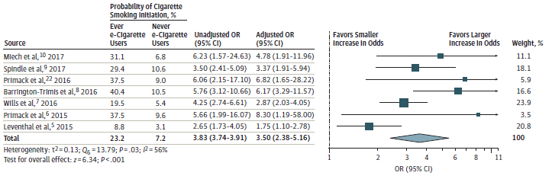
Will e-cigarettes encourage children to start smoking?
Pooled adjusted OR for subsequent smoking for adolescent based studies = 3.03 for ever vs never e-cigarette users
Source: Soneji et al (2017)
Notes:
A meta-analysis published in 2017 in Jama Paediatrics included 9 longitudinal US based studies comprising a total of 16,621 adolescents and young adults aged between 14 and 30 which reported odds ratios for cigarette smoking initiation associated with ever use of e-cigarettes or past 30-day cigarette smoking associated with past 30-day e-cigarette use.
Pooling of data from 7 studies specifically assessing probability of cigarette smoking initiation revealed that the probability of cigarette smoking initiation was 23.3% for baseline ever e-cigarette users and 7.2% for baseline never e-cigarette users – giving a pooled adjusted odds ratio for subsequent cigarette smoking of 3.5 (95% CI, 2.38-5.16) for baseline ever e-cigarette users compared with baseline never e-cigarette users. The pooled adjusted odds ratio for adolescent only studies (age <18) was 3.03 (1.65 – 5.55)
This data would suggest that e-cigarette use is associated with an increased risk of future cigarette smoking initiation
However:
- adolescent based studies exhibited considerable heterogeneity
Many of the included studies reported significant loss to follow-up (>20%)
Source:
- Soneji S, Barrington-Trimis JL, Wills TA, et al. Association Between Initial Use of e-Cigarettes and Subsequent Cigarette Smoking Among Adolescents and Young Adults: A Systematic Review and Meta-analysis [published correction appears in JAMA Pediatr. 2018 Jan 1;172(1):92-93] [published correction appears in JAMA Pediatr. 2018 Jan 1;172(1):98]. JAMA Pediatr. 2017;171(8):788–797. doi:10.1001/jamapediatrics.2017.1488

Slide 55
Will e-cigarettes encourage children to start smoking?
In a Welsh survey of 10-11 year olds (2014):
- 5.3% of never smokers had used an e-cigarette
In a Welsh survey of 11-16 year olds (2014):
- 0.3% of never smokers reported regular use of e-cigarettes (at least once a month)
Current weekly smokers 100x more likely than non-smokers to report regular e-cigarette use
Source: Moore 2014/15
Notes:
In a Welsh study of year 6 pupils (10-11 year olds), a similar percentage of 5.3% of never smokers had used an e-cigarette at least once.
Use of e-cigarettes among never smokers was associated with parental use of e-cigarettes, tobacco or both, and greatest if both mother and father figures were users. There was also an association with friends who smoked.
In a survey of 11-16 year olds, 1.5% reported regular use (at least once a month), including 0.3% of never smokers.
Current smoking was strongly associated with e-cigarette use (smokers 100x more likely than non-smokers to be regular vapers).
Source:
Moore (2014) E-cigarette use and intentions to smoke among 10-11 year old never smokers in Wales. Tobacco Control; 0:1-6
Moore (2015) Electronic cigarette use among young people in Wales: evidence from two cross-sectional surveys. BMJ Open; 5:e007072

Slide 56
Will e-cigarettes encourage children to start smoking?
Paris, France:
6.4% of 12-14 year olds had ever tried e-cigs (19% of 17 year olds)
4.4% of non-smokers had tried e-cigs
As smoking is rare in 12-14 year olds, 64.4% of all those experimenting are non-smokers
Source: Dautzenberg (2013)
Notes:
In a French survey from Paris, 6.4% of 12-14 year olds had ever tried e-cigarettes, rising to 19% in 17 year olds.
By smoking status, 4.4% of non-smokers had tried e-cigarettes, vs 16.4% of occasional smokers, 19.6% of ex-smokers and 33.4% of regular smokers.
As smoking is rare in young teenagers (12-14 year olds), a majority of those experimenting are non-smokers
Numbers are fairly similar in France (slightly higher, which may reflect society’s attitudes to smoking, the demographic of users, and the urban environment in Paris). The study makes the point that non-smokers are still experimenting with e-cigarettes in reasonable numbers, although makes no comment about regular use.
Source:
Dautzenberg (2013) E-cigarette: A new tobacco product for schoolchildren in Paris. Open Journal of Respiratory Diseases. 3, 21-24

Slide 57
Will e-cigarettes encourage children to start smoking?
California, USA:
2,530 high school never smokers
Baseline use of electronic cigarettes associated with 6 and 12 month tobacco use…
BUT are these young people who would have smoked anyway?
Source: Leventhal (2015)
Notes:
In a US survey from Los Angeles, California, never smokers were surveyed on whether they ever used e-cigarettes, and whether they used tobacco products at 6 or 12 month follow-up.
Electronic cigarette users at baseline were more likely to be smokers at 6 and 12 months – 30.7% of baseline vapers used tobacco at 6 months, vs 8.1% of non-vapers.
But: no distinction between level of tobacco use – try out vs regular?
And: are these the same people who would have started smoking anyway? i.e. simply attracted to vaping prior to tobacco? Likely that experimentation with e-cigarettes is most likely in the same group that currently experiment with tobacco.
This study is longitudinal, but it would be useful to know what the baseline smoking rates were in previous years.
Source:
Leventhal (2015) Association of Electronic Cigarette Use With Initiation of Combustible Tobacco Product Smoking Early Adolescence. JAMA. 314(7):700-707

Slide 58
Will e-cigarettes encourage children to start smoking?
Source: www.smokinginengland.info
Notes:
Current data from England suggests smoking prevalence is decreasing, which would go against electronic cigarettes acting as a gateway.
Source:
Smoking Toolkit Study: Trends in electronic cigarette use in England. www.smokinginengland.info/latest-statistics

Slide 59
Will e-cigarettes encourage children to start smoking?
Should we ban access to e-cigarettes for young people?
In one US study, state bans on e-cigarette sales to minors lead to an increase in smoking in 12-17 year olds, relative to states without such bans.
Reducing access may worsen smoking rates
Source: Friedman (2015)
Notes:
In this study by Friedman in the USA, comparisons were made between states banning sales of e-cigarettes to young people (minors) and smoking rates. Although the study was not able to assess e-cigarette use, there was a clear association between reduced access to e-cigarettes and smoking rates.
Over the 8 years preceding the first bans, smoking in the 12-17 year age group fell an average of 1.3 percentage points per two year period, but there was an estimated 0.9 percentage point rise in adolescent smoking in those states instituting bans.
Source:
Friedman (2015) How does electronic cigarette access affect adolescent smoking? Journal of Health Economics. http://dx.doi.org/10.1016/j.jhealeco.2015.10.003

Slide 60
Will e-cigarettes encourage children to start smoking?
Overall:
Regular vaping is not common in never smokers
Vapers may be more likely to smoke tobacco but may have become smokers anyway
Smoking prevalence in the young has remained constant – not increased
Notes:
In summary, studies suggest electronic cigarettes are mainly used by children who are already smoking or who have tried smoking.
There is some data to suggest that never smokers who vape may go on to use tobacco products, but could these people may have become smokers anyway?
Tellingly there is currently no rise in smoking prevalence in young people as would have been expected if electronic cigarettes were attracting new smokers. However, clearly continued surveillance is important to monitor for any changes.

Slide 61
Will e-cigarettes ‘re-normalise’ smoking?
Encourage those who have stopped due to smokefree rules to start up again?
Make ‘smoking behaviour’ more visible to children who might no longer see it?
vs
Different to cigarettes – more likely to lead to normalisation of vaping therefore supports smokefree policies?
Notes:
2 schools of thought:
Widespread use of e-cigarettes will make smoking behaviour more visible and acceptable, encouraging those who’ve stopped to either start up again, or to start vaping and subsequently return to tobacco use after going back to nicotine. Children will witness smoking-like behaviour more and see it as a more normal thing to do, whereas currently smoking has disappeared from view in many situations.
Widespread use of e-cigarettes will normalise vaping and encourage more people to switch to less harmful products, thereby reducing the prevalence of tobacco use.
Source:
Britton and Bogdanovica (2014) Electronic Cigarettes: A report commissioned by Public Health England.

Slide 62

Will e-cigarettes ‘re-normalise’ smoking?
Notes:
One concern is the similarity between advertising for e-cigarettes and that used previously by the tobacco companies – adverts are often targeted to young people, feature celebrity endorsements, or give the impression that vaping is ‘cool’.
Source:
Britton and Bogdanovica (2014) Electronic Cigarettes: A report commissioned by Public Health England.
Image from Stanford University Research into the Impact of Tobacco Advertising webpage: tobacco.stanford.edu

Slide 63

Will e-cigarettes ‘re-normalise’ smoking?
Celebrities pictured using e-cigarettes
Promotions at festivals
Sponsorship of sports teams and events
Television advertising
Image: tobacco.standford.edu
Notes:
Advertising and marketing of e-cigarettes has caused concern regarding the nature and visibility of promotions, which may entice young people to start vaping, and may undermine ‘quitting’ messages.
E-cigarettes have been used by celebrities such as Leonardo DiCaprio, Lily Allen, Kevin Spacey and Britney Spears, either attending events such as the BRIT awards, or in television series and music videos.
E-cigarettes have been sold en route to music events such as Glastonbury, and companies are seeking sponsorship of sports teams. The presence of tobacco sponsorship at sports events in the UK has been absent since it was banned over 10 years ago in 2003.
The first e-cigarette TV advert on a national mainstream British channel was broadcast in January 2013, although it was later banned for its likely appeal to children. A later advert for another e-cigarette company was banned before the watershed after receiving over 1000 complaints for it’s sexually provocative nature.
Advertising rules were published in October 2014 placing an emphasis on protection of young people – ads must not be likely appeal to people under 18, those using e-cigarettes must not seem to be under 25, and ads must not encourage non-smokers to use them.
One additional yet controversial thought about ‘re-normalisation’ is whether the ‘de-normalisation’ of smoking has in fact been a good thing. It has been argued that de-normalisation in some groups has led to stigmatisation of smokers, making them less likely to seek help and therefore quit, with consequent widening social inequalities. The re-normalisation debate is therefore not simple.
Sources:
Bauld et al (2013) E-cigarette update and marketing. A report commissioned by Public Health England. May 2014.
UK Committees on Advertising Practice (2014). New UK advertising rules for e-cigarettes. https://www.cap.org.uk/News-reports/Media-Centre/2014/New-ecig-ad-rules.aspx#.VeWa1_lVhBc
Voight (2015) Smoking norms and the regulation of e-cigarettes. Am Journal Public Health. 105(10): 1967-1972.
Image from Stanford University Research into the Impact of Tobacco Advertising webpage: tobacco.stanford.edu

Slide 64
Should we fear the tobacco companies?
BIG TOBACCO
British American Tobacco
Imperial Tobacco
Altria (Phillip Morris)
Japan Tobacco International
All major tobacco companies are purchasing or developing electronic cigarette companies – should we question their motives?
Notes:
slide features images of tobacco products under text box with animation]
A major source of unease amongst those opposed to e-cigarettes is the involvement of major tobacco companies in the products.
Some have described the tobacco companies as fearful of a ‘Kodak scenario’, referring to the large American photographic company that filed for bankruptcy after being sidelined by the rise of digital photography.
To ‘keep in the game’, all major tobacco companies have either purchased smaller e-cigarette companies, developed their own ventures, or both.
British American Tobacco has obtained MHRA licensing for a ‘nicotine inhaler’, Voke, through it’s subsidiary Nicoventures, that could theoretically be prescribable by doctors... The company has also announced plans for a hybrid product called iFuse that will pass nicotine-infused vapour through tobacco in a ‘heat not burn’ approach.
Accepting e-cigarettes as ‘a good thing’ in terms of harm reduction therefore indicates tacit approval of an industry that has long been criticized by health campaigners, for countless issues including interfering with tobacco control legislation, misleading claims about lower risk products, tempting young people to start smoking, and continuing to promote a product that kills millions of people worldwide every year. In essence, the tobacco industry cannot be trusted and so their intentions cannot be supported by those promoting public health.
Clearly the focus of tobacco companies lies with maximizing profits, and their business depends on a continuing supply of smokers – so many would argue that they are not going to be content on making an alternative product or quitting aid for current smokers, but instead will try to gain new converts, particularly among young people.
Some proponents of e-cigarettes have acknowledged that the tobacco industry involvement is a concern, but counter that ‘the primary target of tobacco control is to prevent smoking. If the tobacco industry produces products that are an effective harm reduction option, we should be prepared to use them’ (Britton, Thorax, 2015).
Most e-cigarettes owned by the major tobacco companies are of the ‘ciga-like’ 1st generation variety, which are less common in the UK today.
Sources:
http://www.tobaccotactics.org/
Akam (2015) Big Tobacco fights back: how the cigarette kings bought the vaping industry. Newsweek, May 2015.
Britton (2015) Electronic cigarettes: pro. Thorax; doi:10.1136/thoraxjnl-2015-206935
McNeil et al (2015) E-cigarettes: an evidence update. A report commissioned by Public Health England. https://www.gov.uk/government/uploads/system/uploads/attachment_data/file/454516/Ecigarettes_an_evidence_update_A_report_commissioned_by_Public_Health_England.pdf
Gornall (2015) British American Tobacco puts tobacco in new e-cigarette. BMJ. 351:h6314
Image sources:
www.nicocig.co.uk
www.e-lites.co.uk
www.blu.co.uk
www.govype.com

Slide 65


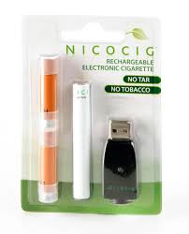


Should we fear the tobacco companies?
BIG TOBACCO
British American Tobacco
Imperial Tobacco
Altria (Phillip Morris)
Japan Tobacco International
All major tobacco companies are purchasing or developing electronic cigarette companies – should we question their motives?
Notes:
[slide features images of tobacco products under text box with animation]
A major source of unease amongst those opposed to e-cigarettes is the involvement of major tobacco companies in the products.
Some have described the tobacco companies as fearful of a ‘Kodak scenario’, referring to the large American photographic company that filed for bankruptcy after being sidelined by the rise of digital photography.
To ‘keep in the game’, all major tobacco companies have either purchased smaller e-cigarette companies, developed their own ventures, or both.
British American Tobacco has obtained MHRA licensing for a ‘nicotine inhaler’, Voke, through it’s subsidiary Nicoventures, that could theoretically be prescribable by doctors... The company has also announced plans for a hybrid product called iFuse that will pass nicotine-infused vapour through tobacco in a ‘heat not burn’ approach.
Accepting e-cigarettes as ‘a good thing’ in terms of harm reduction therefore indicates tacit approval of an industry that has long been criticized by health campaigners, for countless issues including interfering with tobacco control legislation, misleading claims about lower risk products, tempting young people to start smoking, and continuing to promote a product that kills millions of people worldwide every year. In essence, the tobacco industry cannot be trusted and so their intentions cannot be supported by those promoting public health.
Clearly the focus of tobacco companies lies with maximizing profits, and their business depends on a continuing supply of smokers – so many would argue that they are not going to be content on making an alternative product or quitting aid for current smokers, but instead will try to gain new converts, particularly among young people.
Some proponents of e-cigarettes have acknowledged that the tobacco industry involvement is a concern, but counter that ‘the primary target of tobacco control is to prevent smoking. If the tobacco industry produces products that are an effective harm reduction option, we should be prepared to use them’ (Britton, Thorax, 2015).
Most e-cigarettes owned by the major tobacco companies are of the ‘ciga-like’ 1st generation variety, which are less common in the UK today.
Sources:
http://www.tobaccotactics.org/
Akam (2015) Big Tobacco fights back: how the cigarette kings bought the vaping industry. Newsweek, May 2015.
Britton (2015) Electronic cigarettes: pro. Thorax; doi:10.1136/thoraxjnl-2015-206935
McNeil et al (2015) E-cigarettes: an evidence update. A report commissioned by Public Health England. https://www.gov.uk/government/uploads/system/uploads/attachment_data/file/454516/Ecigarettes_an_evidence_update_A_report_commissioned_by_Public_Health_England.pdf
Gornall (2015) British American Tobacco puts tobacco in new e-cigarette. BMJ. 351:h6314
Image sources:
www.nicocig.co.uk
www.e-lites.co.uk
www.blu.co.uk
www.govype.com

Slide 66

Regulation – will it work?
EU Tobacco vs Products Directive
Nicotine limits
Health warnings
Toxicology data
May inhibit innovation and restrict choice
Like NRT
Prescribable
Complex and costly
Favours tobacco companies
Notes:
Currently e-cigarettes are governed by general product safety regulations.
New proposals describe two scenarios. Manufacturers can also apply for a medicinal license from the MHRA, which would bring e-cigs in line with NRT, meaning appropriate advertising controls and allowing prescription on the NHS
This process is complex and would be costly for companies – currently there are no licensed products and the only ones in the pipeline are from tobacco companies (does this route favour larger companies?)
Since 2016 all products not licensed by the MHRA come under the EU tobacco products directive (TPD) – extensive regulations including nicotine limits, additive restrictions, childproofing, health warnings, advertising restrictions, and reporting of information such as ingredients, toxicological data and sales statistics.
Regulation may control the market and enhance safety, but some argue could inhibit innovation and restrict choice for smokers (eg restrictions on nicotine limits might be a disadvantage for heavier smokers).
Some tobacco researchers think the proposals (both) are too restrictive and favour tobacco companies. Others argue that they offer the opportunity to protect consumers and guarantee product safety.
Source:
https://www.gov.uk/guidance/e-cigarettes-regulations-for-consumer-products

Slide 67
What do the experts say?
Two camps:
Supporters
E-cigarettes offer a harm reduction approach to tobacco control
Less harmful than conventional cigarettes for smokers
Opposers
Take population view: e-cigarettes could ‘re-normalise’ smoking and reverse and reverse years of progress
Suspicious of tobacco industry motives
Notes:
There are experts on either side of the debate who have strong views one way or the other. The debate has been heated as both sides see the others arguments as counter-productive: for example, the views of ‘opposers’ on potential harms may be confusing the public about safety and preventing smokers from switching; similarly the enthusiasm of some ‘supporters’ may be encouraging the public to use e-cigarettes more and more, thereby increasing exposure to non-smokers who may not have been aware...
Jonathan Gornall, writing in the BMJ, characterised ‘pragmatists’ and ‘idealists’: the former often clinicians who had witnessed countless patients suffering from tobacco-related ailments and felt this could be prevented with a less harmful alternative, and the latter often public health workers who were fearful of the explosion of interest in vaping and the potential impossible-to-know impact on the wider population. Clearly this is a generalization, in that some clinicians remain strongly opposed to e-cigarettes, whereas the recent Public Health England document endorses them.
Simon Chapman, Professor of Public Health in Sydney, considered best and worst case scenarios in the BMJ in 2014. The ‘best’ scenario was a rapid switch of smokers to e-cigarettes, with vaping being a gateway out of smoking rather than gateway into it, and no long-term harms from vaping in follow-up studies – essentially, e-cigarettes leading to the end of tobacco. The ‘worst’ scenario was that vaping would take off hugely and become a common population behaviour, attracting many who would never have smoked, with the talk of low risk meaning that it was acceptable despite longer-term studies showing harms and many switching over to tobacco due to the greater nicotine ‘hit’. Like many, Chapman worried that the huge progress in reducing population cessation rates could be at risk by the role of e-cigarettes.
Sources:
Gornall (2015) Why e-cigarettes are dividing the public health community. BMJ. 350:h3317
Chapman (2014) E-cigarettes: the best and worst case scenarios for public health. 349:g5512

Slide 68

What do the experts say?
Notes:
Not ‘for’ and ‘against’, more ‘proponents’ who feel e-cigarettes should be widely adopted, and those who are more cautious and feel we should await more research.
US organisations (including ATS and ALA) have tended to be more opposed. The Federation of International Respiratory Societies (FIRS) has also released a statement erring on the side of caution. The European Respiratory Society (ERS) is a member of FIRS and similarly cautious. The British Medical Association and World Health Organization have a similar view.
Action on Smoking and Health and the Royal College of Physicians have been proponents. Most academics from the UK Centre for Tobacco and Alcohol Studies, a collaboration of 13 universities, are supportive of e-cigarettes.
Public Health England has previously been cautious but recent reports (authored by UKCTAS academics) have been more supportive.
The BTS currently adopts a neutral position.
Source: position statements and commentaries from the above organizations, although these may clearly be reviewed and changed from the time of writing.

Slide 69
What is everyone else doing?
Australia – e-cigarette sales banned
New York City – use prohibited where smoking is prohibited – eg restaurants, parks, beaches
Wales – a proposed bill to ban use in enclosed public spaces collapsed
Notes:
Various countries, regions and cities have taken different approaches to regulation of e-cigarettes. One issue concerns use in public places, and whether e-cigarettes should be classified alongside tobacco (and therefore prohibited) or welcomed and permitted.
Australia has a strong record of anti-smoking legislation and has adopted a hard-line approach with a ban on the sale of nicotine-containing electronic cigarettes. (although non-nicotine containing e-cigarettes can be bought)
New York City had banned e-cigarette use in public places, and has more recently implemented a ban on sales of flavoured e-liquids
A bill to ban use of e-cigarettes within enclosed spaces by the Welsh government In 2016 collapsed.
Is this over-the-top legislation, considering the lack of evidence of harm from passive vaping, or a brave move to prevent children being exposed to and tempted by smoking-like behaviour?
Different areas are likely to continue to adopt different practices over time.
Sources:
McNeil et al (2015) E-cigarettes: an evidence update. A report commissioned by Public Health England.
Electronic Cigarettes Law: http://www1.nyc.gov/nyc-resources/service/1591/electronic-cigarettes-law

Slide 70
The future
Regulation: MHRA vs EU TPD
E-cigarettes in Stop Smoking services?
More research
- Long-term effects of vaping
- Trends in vaping and smoking in young people
- Impact of newer products
Notes:
Leicester has become the first Stop Smoking service to support e-cigarettes – the argument being that smokers are choosing e-cigs to help them quit, and it seems counterproductive for the NHS to not support them – this approach is likely to expand to elsewhere, so that those choosing e-cigs can get the behavioural support available to others.

Slide 71
What should we tell patients?
E-cigarettes are not harm-free, but likely to be considerably less harmful than tobacco
They may help you stop smoking, although most evidence is currently with licensed products and behavioural support offered by the NHS
The best thing you can do for your health is stop smoking: if e-cigarettes can help you do this, then we would encourage this.
Notes:
The NCSCT (National Centre for Smoking Cessation and Training) advises that practitioners should be open to e-cigarette use in people keen to try them, especially those who have tried, but not succeeded, in stopping with licensed products such as NRT.
Providing advice and information on e-cigarettes is important. It may be useful to explain that there are a wide range of products available and people may need to try various brands or flavourings to find one that suits them, or that the vaping behaviour is slightly different to smoking, and users may need to learn how to use e-cigs effectively – for example, longer ‘drags’, short puffs at the start to activate the device, etc.
The best quit rates are with NHS stop smoking services, but e-cigs are the most popular means of quitting – so it makes sense for NHS services to support e-cig use.
Leicester has become the first Stop Smoking service to support e-cigarettes – this approach is likely to expand to elsewhere, so that those choosing e-cigs can get the behavioural support available to others.
Source:
McRobbie (2014) Electronic Cigarettes – National Centre for Smoking Cessation and Training briefing.

Slide 72
Summary
E-cigarettes are increasing in popularity
Conflicting views on their role in smoking cessation but likely to be helpful
Much less harmful than conventional cigarettes
May form part of harm reduction programmes
Issues around regulation, advertising and promotion will continue to be debated.
Notes:
This slide set was produced by BTS for use as a teaching aid. We have tried to adopt a balanced approach to this contentious subject, but welcome any feedback.

Slide 73
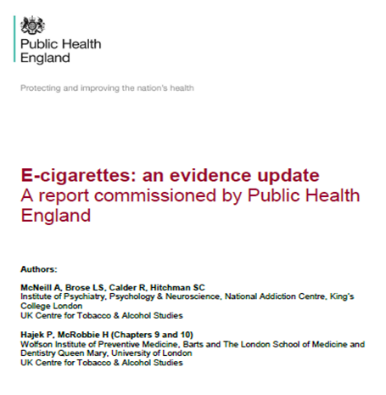
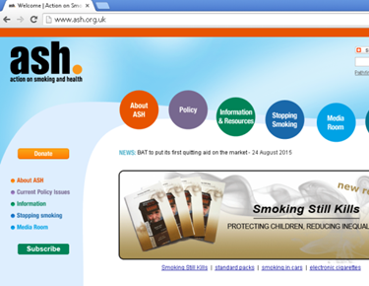
Further reading
Public Health England reports
ASH reports / surveys
Smoking Toolkit Study surveys
Further references available in slide notes
BTS Position Statement on Tobacco and Smoking
https://www.brit-thoracic.org.uk/document-library/governance-and-policy-documents/position-statements/tobacco-and-smoking-january-2018/
Notes:
This slide set was produced by BTS for use as a teaching aid. We have tried to adopt a balanced approach to this contentious subject, but welcome any feedback.
Selected references:
McNeil et al (2015) E-cigarettes: an evidence update. A report commissioned by Public Health England. https://www.gov.uk/government/uploads/system/uploads/attachment_data/file/454516/Ecigarettes_an_evidence_update_A_report_commissioned_by_Public_Health_England.pdf
Britton and Bogdanovica (2014) Electronic Cigarettes: A report commissioned by Public Health England. https://www.gov.uk/government/uploads/system/uploads/attachment_data/file/311887/Ecigarettes_report.pdf
McRobbie (2014) Electronic Cigarettes – National Centre for Smoking Cessation and Training briefing. http://www.ncsct.co.uk/usr/pub/e-cigarette_briefing.pdf
ASH factsheets
West et al (2014) Electronic cigarettes: what we know so far. A report to UK All-Party Parliamentary Groups. www.smokinginengland.info/downloadfile/?type=report&src=6
McRobbie et al (2014) – Electronic cigarettes for smoking cessation and reduction (Cochrane Review). http://onlinelibrary.wiley.com/doi/10.1002/14651858.CD010216.pub2/epdf/abstract
Britton (2015) Electronic cigarettes: pro. Thorax; doi:10.1136/thoraxjnl-2015-206935
Furber (2015) Electronic cigarettes: reasons to be cautious. Thorax; doi:10.1136/thoraxjnl-2014-206735

Slide 74
End of slides
Due for review mid 2020

