Slide 1

British Thoracic Society Guidelines
Management of
NTM-Pulmonary Disease
BTS NTM Guideline Development Group

Slide 2
Why are NTM guidelines needed?
Survey of NTM Diagnosis and Treatment in the EU
446 physicians, 1012 patients with NTM-Pulmonary Disease
France 206, Germany 211, Italy 210, Spain 230, UK 155
Pulmonologists 29%, Internal Medicine 21%, GP 30%
MAC 79%, M. abscessus 20%
68% received antibiotic treatment
Proportion of patients with MAC-PD that received > 6 months of Rifampicin / Ethambutol / Macrolide?
EU 9% (UK 18%, Spain 8%, France 8%, Germany 4%)
van Ingen Eur Res J 2016

Slide 3
NTM epidemiology – prevalence of NTM-PD in USA
Adjemian AJRCCM 2012

Slide 4
NTM epidemiology
Possible causes for increasing prevalence:
Enhanced awareness and improved detection
Reduced incidence of TB
Exposure: showers, reduced hot water temperatures, soil
Antibiotic exposure creating a favourable niche
Impaired host immunity: aging, lung disease, drugs
Person-to-person transmission

Slide 5
Definition of NTM-Pulmonary disease
To determine the clinical relevance of NTM positive cultures it is essential to distinguish transient or persistent colonisation from infection
Use of the ATS / IDSA 2007 definition of NTM-PD is recommended
Griffith AJRCCM 2007

Slide 6
Definition of NTM-Pulmonary disease
Clinical and microbiological criteria for diagnosing non-tuberculous mycobacterial lung disease
Clinical (both required) 1) Pulmonary symptoms, nodular or cavitary opacities on chest radiograph, or a high-resolution CT scan that shows multifocal bronchiectasis with multiple small nodules. and 2) Appropriate exclusion of other diagnoses Microbiological 1) Positive cultures results from at least two separate expectorated sputum samples. If the results are non-diagnostic, consider repeat sputum AFB smears and cultures. or 2) Positive culture result from at least one bronchial wash or lavage. or 3) Transbronchial or other lung biopsy with mycobacterial histopathological features (granulomatous inflammation or AFB) and positive culture for NTM or biopsy showing mycobacterial histopathological features (granulomatous inflammation or AFB) and one or more sputum or bronchial washings that are culture positive for NTM.
Griffith AJRCCM 2007

Slide 7
Microbiological sampling for NTM-PD
Sputum, induced sputum, bronchial washings, bronchoalveolar lavage or transbronchial biopsy samples can be used to evaluate individuals suspected of having NTM-PD
Whenever possible, less invasive sampling should be attempted first to minimise procedural risks
BTS Guidelines 2017

Slide 8
Mycobacterial culture
All respiratory samples should be stained using auramine-phenol after liquefaction and concentration and then examined by microscopy
Respiratory tract samples should be cultured (following decontamination) on solid and liquid media in a ISO15189 accredited clinical laboratory for 8 weeks extending to 12 weeks if necessary.
BTS Guidelines 2017

Slide 9
Drug susceptibility testing
For M. avium complex (MAC), clarithromycin and amikacin susceptibility testing should be performed on an isolate taken prior to initiation of treatment and on subsequent isolates if the patient fails to respond to treatment or recultures MAC after culture conversion
BTS Guidelines 2017

Slide 10
Drug susceptibility testing
For M. kansasii, rifampicin susceptibility testing should be performed on an isolate prior to initiation of treatment and on subsequent isolates if the patient fails to respond to treatment or recultures M. kansasii after culture conversion
BTS Guidelines 2017

Slide 11
Drug susceptibility testing
Susceptibility testing for M. abscessus should include at least clarithromycin, cefoxitin and amikacin (and preferably also tigecycline, imipenem, minocycline, doxycycline, moxifloxacin, linezolid, cotrimoxazole and clofazimine if a validated method is available) to guide, but not dictate, treatment regimens.
BTS Guidelines 2017

Slide 12
Investigations for NTM-PD: microbiological
A minimum of two sputum samples collected on separate days should be sent for mycobacterial culture when investigating an individual suspected of having NTM-pulmonary disease
Individuals suspected of having NTM-pulmonary disease whose sputum samples are consistently mycobacterial culture negative should have CT-directed bronchial washings sent for mycobacterial culture.
BTS Guidelines 2017

Slide 13
Investigations for NTM-PD: microbiological
Individuals suspected of having NTM-pulmonary disease who are unable to expectorate sputum should have CT-directed bronchial washings sent for mycobacterial culture.
Transbronchial biopsies should not be performed routinely in individuals suspected of having NTM-pulmonary disease.
BTS Guidelines 2017

Slide 14
Investigations for NTM-PD: microbiological
Sputum induction resulting in a positive culture may avoid the need for CT-directed bronchial washings in individuals who are unable to spontaneously expectorate sputum.
Sputum induction should be considered in individuals suspected of having NTM-pulmonary disease who are unable to spontaneously expectorate sputum and in whom CT-directed bronchial washings are considered inappropriate.
BTS Guidelines 2017

Slide 15
Investigations for NTM-PD: radiology
A CT scan should be performed in individuals suspected of having NTM-pulmonary disease.
BTS Guidelines 2017

Slide 16
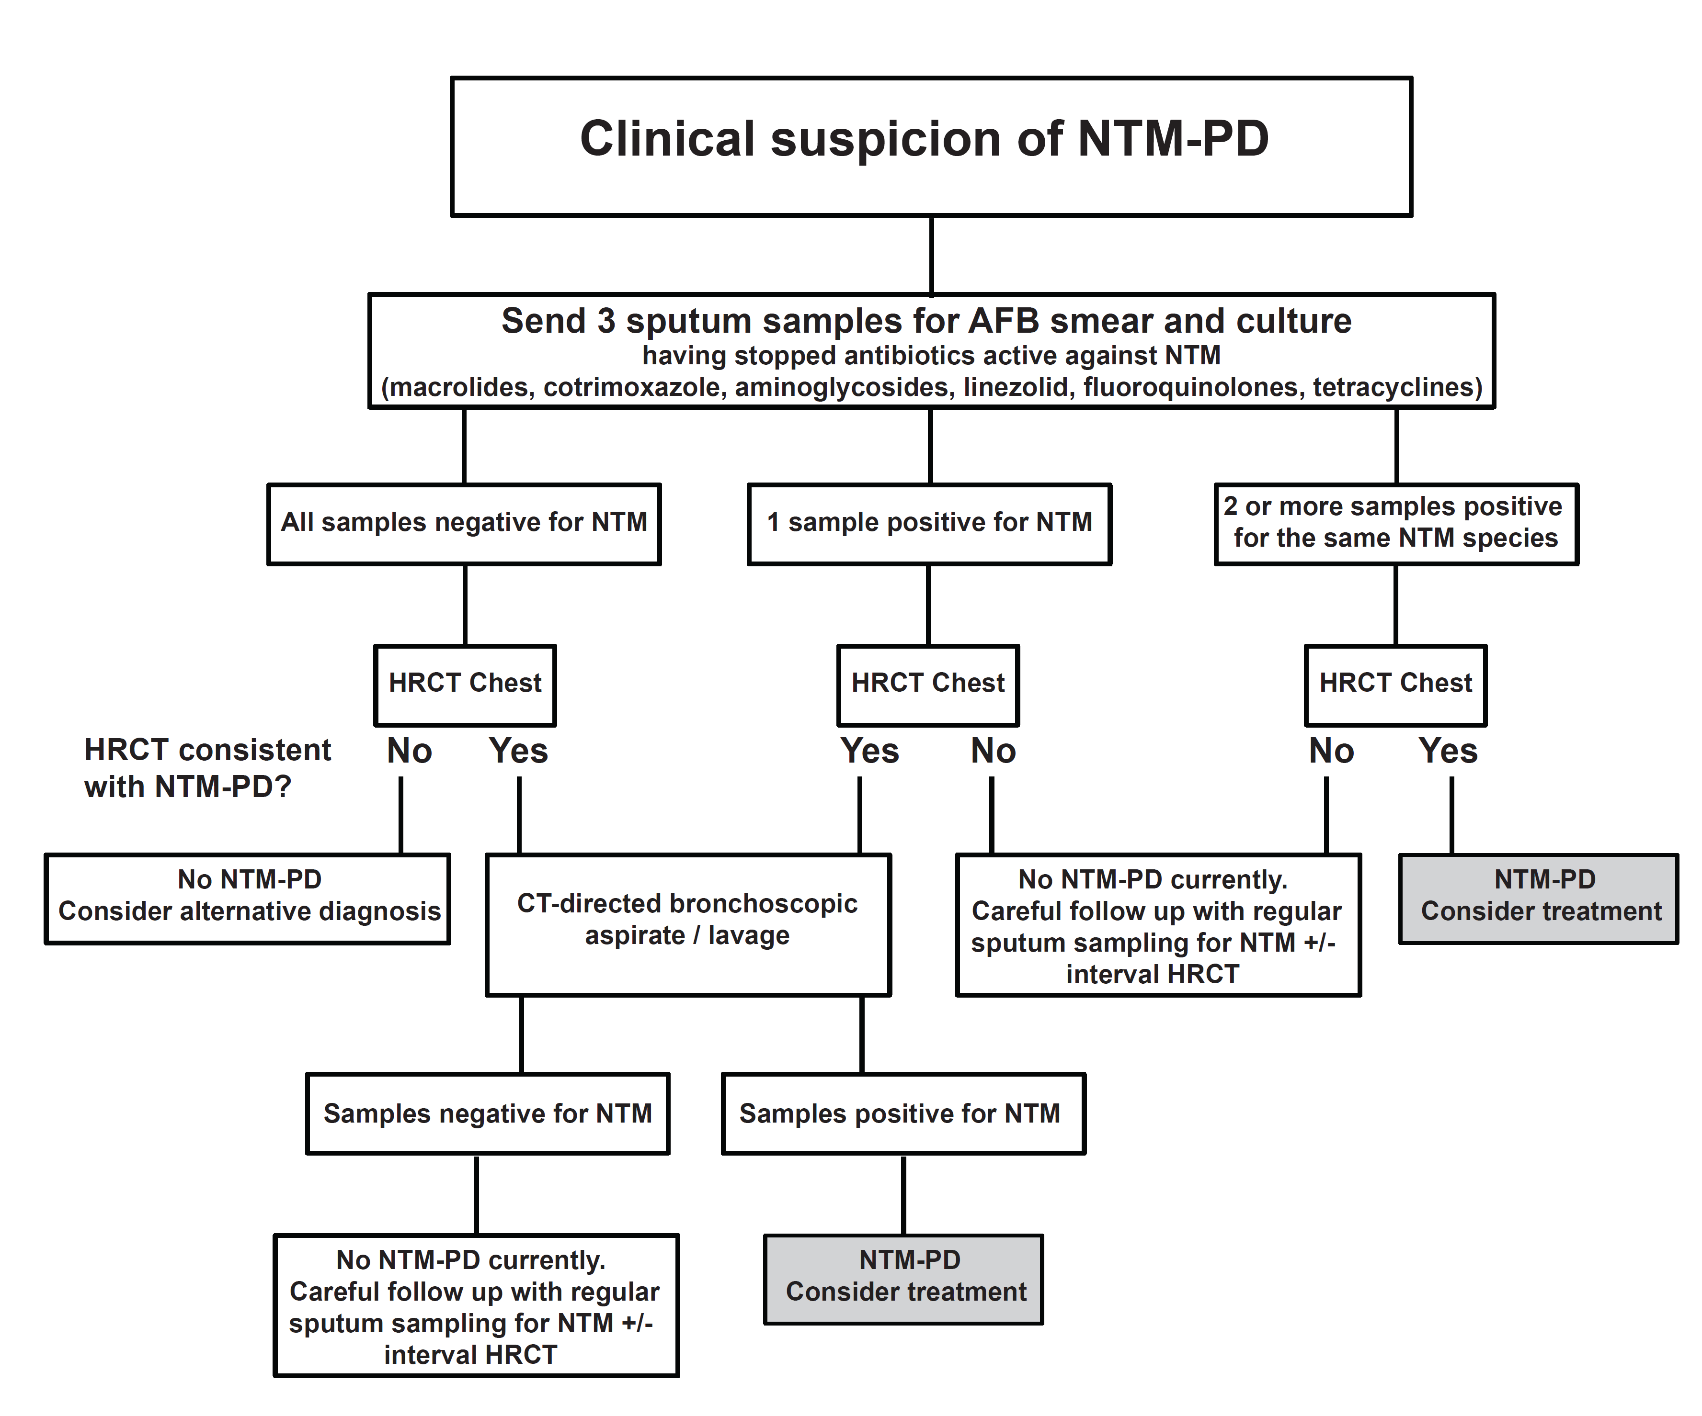
Algorithm for investigation of NTM-PD
BTS Guidelines 2017

Slide 17
Decision to treat
The decision to start treatment should be influenced by the severity of NTM-pulmonary disease, the risk of progressive NTM-pulmonary disease, the presence of comorbidity and the goals of treatment.
Individuals may require a period of longitudinal assessment (symptoms, radiological change and mycobacterial culture results) to inform NTM treatment decisions.
BTS Guidelines 2017

Slide 18
Decision to treat
The views of the affected individual should be sought on the potential risks and benefits of starting NTM treatment versus observation (i.e. longitudinal assessment of symptoms, radiological change and mycobacterial culture results).
BTS Guidelines 2017

Slide 19
Relevant NTM in the UK
Scottish mycobacterial reference laboratory
Episodes (n=933) meeting ATS microbiology criteria 2000/10
M. avium complex 45%
M. malmoense 22%
M. abscessus 14%
M. xenopi 5%
M. kansasii 4%
M. chelonae 2.6%, M. simiae 1.8%, M. fortuitum 1.8%
Russel Thorax 2014

Slide 20
Treatment: M. avium complex-pulmonary disease
Non-severe MAC-pulmonary disease: | Antibiotic regimen:
AFB smear negative No radiological evidence of cavitation / severe infection Mild-moderate symptoms No signs of systemic illness | Rifampicin 600mg 3x per week and Ethambutol 25mg/kg 3x per week and Azithromycin 500mg 3x per week or Clarithromycin 1g in two divided doses 3x per week Antibiotic treatment should continue for a minimum of 12 months after culture conversion
BTS Guidelines 2017

Slide 21
Treatment: M. avium complex-pulmonary disease
Severe MAC-pulmonary disease: | Antibiotic regimen:
AFB smear positive Radiological evidence of cavitation / severe infection Severe symptoms Signs of systemic illness | Rifampicin 600mg daily and Ethambutol 15mg/kg daily and Azithromycin 250mg daily or Clarithromycin 500mg twice daily And consider intravenous amikacin for up to 3 months or nebulised amikacin Antibiotic treatment should continue for a minimum of 12 months after culture conversion
BTS Guidelines 2017

Slide 22
Treatment: M. avium complex-pulmonary disease
Clarithromycin resistant MAC-PD: | Antibiotic regimen:
 | Rifampicin 600mg daily and Ethambutol 15mg/kg daily and Isoniazid 300mg (+ pyridoxine 10mg) daily or Moxifloxacin 400mg daily And consider intravenous amikacin for up to 3 months or nebulised amikacin Antibiotic treatment should continue for a minimum of 12 months after culture conversion
BTS Guidelines 2017

Slide 23
Treatment: M. kansasii-pulmonary disease
M. kansasii-pulmonary disease: | Antibiotic regimen:
Rifampicin-sensitive M. kansasii-PD | Rifampicin 600mg daily and Ethambutol 15mg/kg daily and Isoniazid 300mg (with pyridoxine 10mg) daily or Azithromycin 250mg daily or Clarithromycin 500mg twice daily Antibiotic treatment should continue for a minimum of 12 months after culture conversion
BTS Guidelines 2017

Slide 24
Treatment: M. malmoense-pulmonary disease
Non-severe M. malmoense-PD: | Antibiotic regimen:
AFB smear negative No radiological evidence of cavitation / severe infection Mild-moderate symptoms No signs of systemic illness | Rifampicin 600mg daily and Ethambutol 15mg/kg daily and Azithromycin 250mg daily or Clarithromycin 500mg twice daily Antibiotic treatment should continue for a minimum of 12 months after culture conversion
BTS Guidelines 2017

Slide 25
Treatment: M. malmoense-pulmonary disease
Severe M. malmoense-PD: | Antibiotic regimen:
AFB smear positive Radiological evidence of cavitation / severe infection Severe symptoms Signs of systemic illness | Rifampicin 600mg daily and Ethambutol 15mg/kg daily and Azithromycin 250mg daily or Clarithromycin 500mg twice daily and consider intravenous amikacin for up to 3 months or nebulised amikacin Antibiotic treatment should continue for a minimum of 12 months after culture conversion
BTS Guidelines 2017

Slide 26
Treatment: M. xenopi-pulmonary disease
Non-severe M. xenopi-PD: | Antibiotic regimen:
AFB smear negative No radiological evidence of cavitation / severe infection Mild-moderate symptoms No signs of systemic illness | Rifampicin 600mg daily and Ethambutol 15mg/kg daily and Azithromycin 250mg daily or Clarithromycin 500mg twice daily and Moxifloxacin 400mg daily or Isoniazid 300mg (+pyridoxine 10mg) daily Antibiotic treatment should continue for a minimum of 12 months after culture conversion
BTS Guidelines 2017

Slide 27
Treatment: M. xenopi-pulmonary disease
Severe M. xenopi-PD: | Antibiotic regimen:
AFB smear positive Radiological evidence of cavitation / severe infection Severe symptoms Signs of systemic illness | Rifampicin 600mg daily and Ethambutol 15mg/kg daily and Azithromycin 250mg daily or Clarithromycin 500mg twice daily and Moxifloxacin 400mg daily or Isoniazid 300mg (+pyridoxine 10mg) daily And consider intravenous amikacin for up to 3 months or nebulised amikacin Antibiotic treatment should continue for a minimum of 12 months after culture conversion
BTS Guidelines 2017

Slide 28
Interpretation of clarithromycin susceptibility results for M. abscessus
Clarithromycin susceptibility day 3-5 | Clarithromycin susceptibility day 14 | Genetic implication | M. abscessus sub species | Macrolide susceptibility phenotype
Susceptible | Susceptible | Dysfunctional erm(41) gene | M. a. massiliense | Macrolide susceptible
Susceptible | Resistant | Functional erm(41) gene | M. a. abscessus M. a. bolletti | Inducible macrolide resistance
Resistant | Resistant | 23S ribosomal RNA point mutation | Any | High level constitutive macrolide resistance
BTS Guidelines 2017

Slide 29
Treatment: M. abscessus-pulmonary disease
M. abscessus-pulmonary disease: | Antibiotic regimen:
Clarithromycin susceptible isolates or Inducible macrolide resistant isolates Key: ªpatients with clarithromycin resistant isolates may benefit from longer duration iv antibiotic treatment ^{b}substitute iv / nebulised amikacin for an alternative antibiotic if M. abscessus is resistant to amikacin (MIC >64mg/L or known to have a 16S rRNA gene mutation) | Initial phase: ≥ 1 monthª iv amikacin 15mg/kg daily or 3x per week^{b} and iv tigecycline 50mg twice daily and where tolerated iv imipenem 1g twice daily and where tolerated oral clarithromycin 500mg twice daily or oral azithromycin 250-500mg daily Continuation phase: nebulised amikacin^{b} and oral clarithromycin 500mg twice daily or oral azithromycin 250-500mg daily and 1-3 of the following guided by drug susceptibility and patient tolerance: oral clofazimine, linezolid, minocycline, moxifloxacin, cotrimoxazole
BTS guidelines 2017

Slide 30
Treatment: M. abscessus-pulmonary disease
M. abscessus-pulmonary disease: | Antibiotic regimen:
Constitutive macrolide resistant isolates Key: ªpatients with clarithromycin resistant isolates may benefit from longer duration iv antibiotic treatment ^{b}substitute iv / nebulised amikacin for an alternative antibiotic if M. abscessus is resistant to amikacin (MIC >64mg/L or known to have a 16S rRNA gene mutation) | Initial phase: ≥ 1 monthª iv amikacin 15mg/kg daily or 3x per week^{b} and iv tigecycline 50mg twice daily and where tolerated iv imipenem 1g twice daily Continuation phase: nebulised amikacin^{b} and 2-4 of the following guided by drug susceptibility and patient tolerance: oral clofazimine, linezolid, minocycline, moxifloxacin, cotrimoxazole
BTS guidelines 2017

Slide 31
Assessing the microbiological response to treatment
Sputum samples should be sent for mycobacterial culture every 4 - 12 weeks during treatment and for 12 months after completing treatment to assess the microbiological response.
If there is doubt about persisting NTM infection despite negative sputum cultures, a CT-directed bronchial wash should be performed to assess the microbiological response to treatment.
BTS Guidelines 2017

Slide 32
Assessing the microbiological response to treatment
In individuals who are unable to expectorate sputum, a CT scan followed by a CT-directed bronchial wash after 6 and 12 months treatment can be used to assess the microbiological response to treatment.
BTS Guidelines 2017

Slide 33
Assessing the microbiological response to treatment
Definitions for Microbiological Outcomes
Culture conversion: three consecutive negative mycobacterial sputum cultures collected over a minimum of three months, with the time of conversion being the date of the first of the three negative mycobacterial cultures. In patients unable to expectorate sputum, a single negative mycobacterial culture of a CT-directed bronchial wash is indicative of culture conversion.
Recurrence: two positive mycobacterial cultures following culture conversion. If available, genotyping may help distinguish relapse from reinfection.
Refractory disease: failure to culture convert after twelve months of NTM treatment.
BTS Guidelines 2017

Slide 34
Assessing the radiological response to treatment
A CT scan should be performed shortly before starting NTM treatment and at the end of NTM treatment to document the radiological response to treatment.
BTS Guidelines 2017

Slide 35
Assessing the clinical response to treatment
A detailed assessment of pulmonary and systemic symptoms should be recorded at each clinical review.
BTS Guidelines 2017

Slide 36
Therapeutic drug monitoring
Therapeutic drug monitoring (other than for aminoglycosides) should not be performed routinely in individuals’ prescribed antibiotic therapy for NTM-pulmonary disease.
When aminoglycosides are administered, serum levels and the serum creatinine must be monitored and aminoglycoside dosing adjusted according to local policies.
BTS Guidelines 2017

Slide 37
Therapeutic drug monitoring
Therapeutic drug monitoring can be considered in individuals in whom gastrointestinal malabsorption, drug-drug interactions or suboptimal adherence may be adversely affecting treatment response.
BTS Guidelines 2017

Slide 38
Toxicity monitoring
The frequency / type of toxicity monitoring required during NTM treatment is dependent on the drug regimen. Treatment-related adverse events and suggested toxicity monitoring protocols are outlined in the NTM antibiotic treatment monograph.
BTS Guidelines 2017

Slide 39
Role of Thoracic Surgery
The role of lung resection surgery in the management of NTM-pulmonary disease should be considered at the time of diagnosis and revisited in individuals who develop refractory disease.
Lung resection surgery for NTM-pulmonary disease may be indicated in individuals with localised areas of severe disease.
BTS Guidelines 2017

Slide 40
Role of Thoracic Surgery
Lung resection surgery for NTM-pulmonary disease should only be performed following expert multidisciplinary assessment in a centre experienced in managing individuals with NTM-pulmonary disease.
Individuals with NTM-pulmonary disease should be established on antibiotic treatment prior to lung resection surgery and should continue treatment for 12 months after culture conversion.
BTS Guidelines 2017

Slide 41
Role of Thoracic Surgery
Following resection of a solitary NTM nodule in an individual with no other features of NTM-pulmonary disease, antibiotic treatment is not usually required.
Individuals with NTM-pulmonary disease in whom lung resection surgery is being considered should have a comprehensive assessment of cardiopulmonary status in line with current guidance for lung cancer resection.
BTS Guidelines 2017

Slide 42
Lung Transplantation
Individuals being considered for lung transplantation referral should be assessed for evidence of NTM-pulmonary disease.
Isolation of NTM organisms including M. abscessus in potential lung transplant candidates should not preclude referral and assessment for lung transplantation.
BTS Guidelines 2017

Slide 43
Lung Transplantation
Potential lung transplant candidates with evidence of NTM-pulmonary disease should be treated whenever possible prior to listing to either eradicate the organism or lower bacterial load.
Individuals with previous or current M. abscessus infection or disease who are listed for lung transplantation should be counselled about the high post-operative risk of developing invasive and disseminated NTM disease which causes significant morbidity and necessitates prolonged treatment with a multidrug antibiotic regimen.
BTS Guidelines 2017

Slide 44
Lung Transplantation
Individuals with NTM-pulmonary disease should demonstrate an ability to tolerate optimal antibiotic therapy before listing for lung transplantation.
Progressive NTM-pulmonary disease despite optimal antibiotic therapy is likely to be a contraindication to listing for lung transplantation.
BTS Guidelines 2017

Slide 45
NTM Drug Monograph
The NTM drug monograph is provided to facilitate antibiotic prescribing in people with NTM-PD, but it should only be used in conjunction with, and not as a substitute for, local / national prescribing formularies.
To facilitate the prescription of the correct drugs at the correct doses, and aid awareness of potential drug-drug interactions and the most appropriate toxicity monitoring.
BTS Guidelines 2017

Slide 46
NTM Drug Monograph
The NTM drug monograph includes information on the following medications:
Amikacin - iv
Amikacin – nebulised
Azithromycin
Bedaquiline
Cefoxitin
Ciprofloxacin
Clarithromycin
Clofazimine
Cotrimoxazole
Doxycycline
Ethambutol
Imipenem
Isoniazid
Linezolid
Minocycline
Moxifloxacin
Rifabutin
Rifampicin
Streptomycin
Tigecycline
BTS Guidelines 2017

Slide 47
NTM Guideline: Patient information
Patient information has been developed as part of the BTS NTM guideline and is available on the BTS website.
Clinicians and other health care professionals are invited to use this information in their local practice and it can be adapted for local use, but please acknowledge the “BTS Guideline for the management of NTM-PD” as the source.

Slide 48
Useful Links
Full guideline
  www.brit-thoracic.org.uk/standards-of-care/guidelines/bts-guidelines-for-non-tuberculous-mycobacteria/
Thorax editorial http://thorax.bmj.com/content/72/11/969
Summary of recommendations
http://bmjopenrespres.bmj.com/content/4/1/e000242
Patient information
  www.brit-thoracic.org.uk/standards-of-care/guidelines/bts-guidelines-for-non-tuberculous-mycobacteria/

Slide 49
BTS Guidelines for the Management of NTM-PD
Acknowledgements:
Dr Charles Haworth (co-chair)
Professor Andres Floto (co-chair) Professor Ian Campbell
Dr J Banks Dr M Ruddy
Dr T Capstick
Professor A Fisher Sally Welham
Dr T Gorsuch
Dr I Laurenson
Dr A Leitch
Dr M Loebinger
Professor H Milburn
Mr M Nightingale
Professor P Ormerod
Dr D Shingadia
Dr D Smith
Ms N Whitehead
Professor R Wilson

