Slide 1
The BTS/NICE/SIGN Joint Guideline on Asthma: diagnosis, management and chronic asthma management
Summary slide set

Slide 2
Introduction to the guideline
Published in November 2024 (linked here) – produced jointly by BTS, NICE and SIGN.
Covers diagnosis, monitoring and management of chronic asthma in adults and children and young people
Updates and replaces NICE guideline 80 (2017) and parts of BTS/SIGN British guideline SIGN 158 (2019)
Joint Asthma Pathway also launched with range of resources on asthma care including aspects out of scope of guideline (e.g. difficult or severe asthma, asthma in pregnancy, etc). Available from NICE here and Right Decision Service Scotland here

Slide 3
Diagnosis of chronic asthma in all patients – key points
Code as suspected asthma until diagnosis confirmed through a suggestive clinical history and a supporting objective test
Clinical history should check for:
- Recurrent symptoms with diurnal variation (reported wheeze, noisy breathing,
cough, breathlessness etc)
- Triggers that make symptoms worse e.g. allergies, environment, exercise
- Family history of asthma or allergic rhinitis
- Lack of symptoms to suggest an alternative diagnosis

Slide 4
Initial treatment and objective tests for acute presentation (adult & CYP patients)
  Treat people immediately if they are acutely unwell or highly symptomatic at presentation
  and
  perform objective tests that may help support a diagnosis of asthma e.g. eosinophil count, fractional exhaled nitric oxide [FeNO], spirometry or peak expiratory flow [PEF] before and after bronchodilator) if the equipment is available
  if objective tests cannot be done immediately, carry them out when acute symptoms have been controlled, and advise people to contact their healthcare professional immediately if they become unwell while waiting for tests

Slide 5
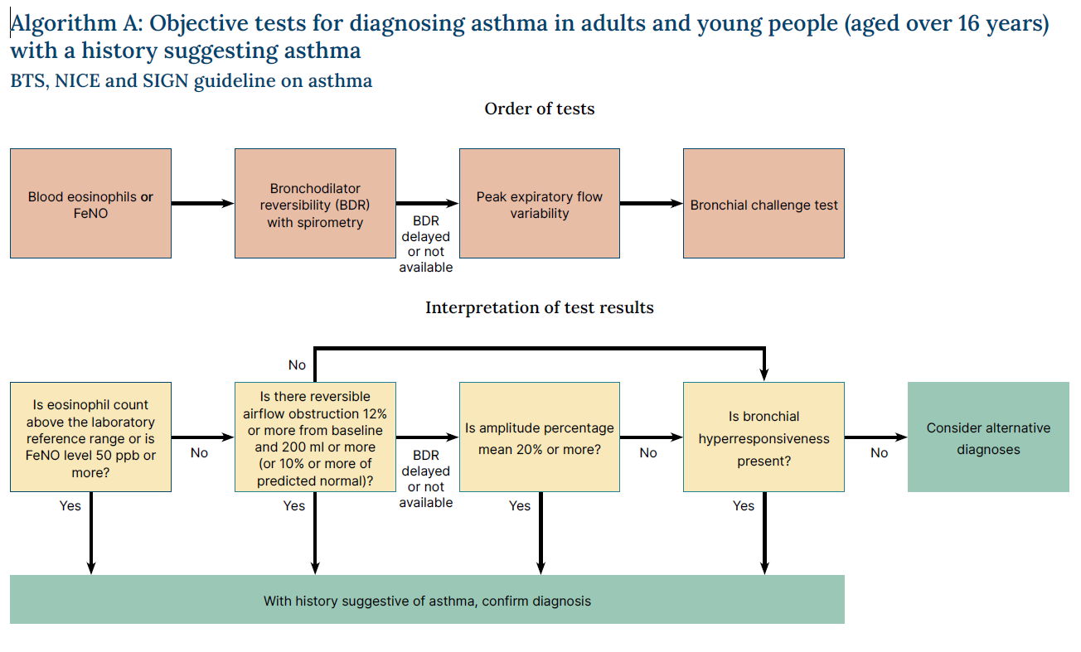
Objective tests for diagnosing patient (16 years>)
*
n.b. if blood eosinophils/FENO delayed and treatment needs to be started then can do 2 weeks PEF variability testing

Slide 6
Diagnosis of chronic asthma in children under 5
For children under 5 with suspected asthma, treat with inhaled corticosteroids in line with advice on slides 14 & 15, and review the child on a regular basis.
If they still have symptoms when they reach 5 years, attempt objective tests
If a child is unable to perform objective tests when they are aged 5:
- try doing the tests again every 6 to 12 months until satisfactory results are obtained
- refer for specialist assessment if the child's asthma is not responding to treatment.
Any preschool child with an admission to hospital, or 2 or more admissions, to an emergency department, with wheeze in a 12-month period should be referred to a respiratory paediatrician

Slide 7
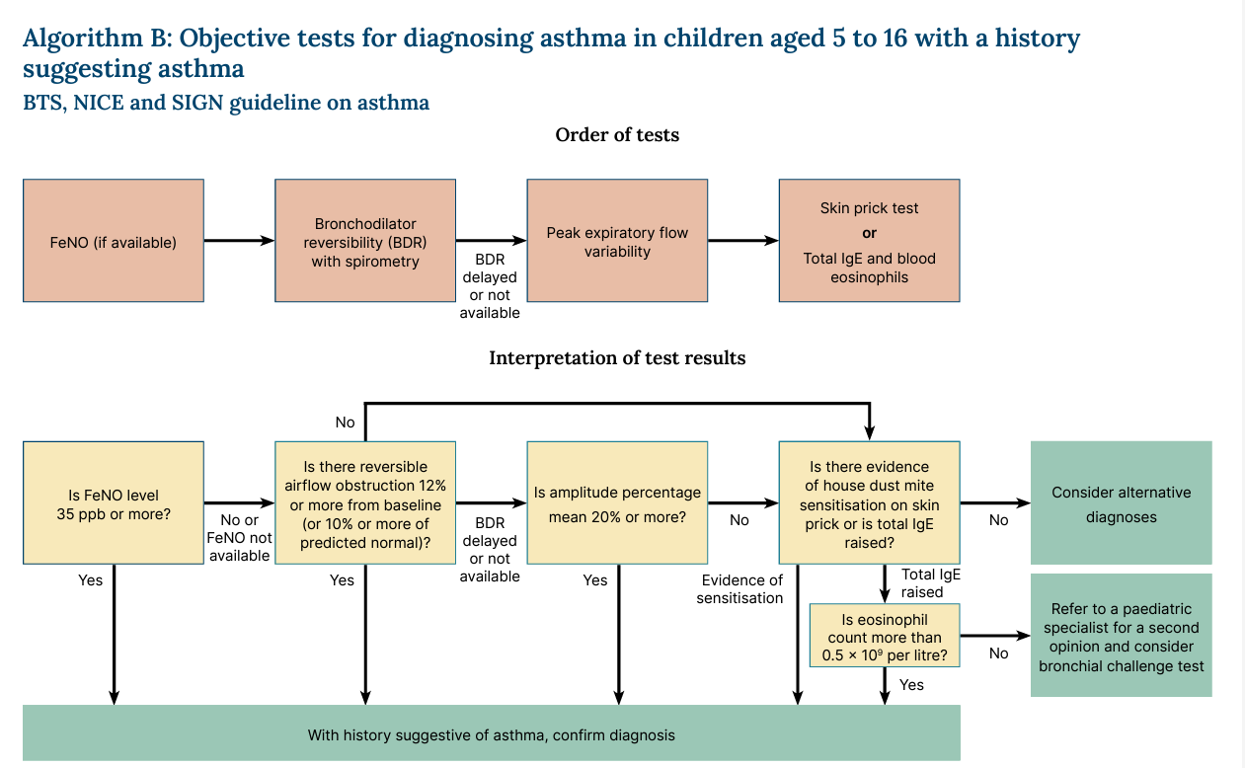
Objective tests for diagnosing children aged 5 -16

Slide 8
Monitoring asthma control
For all adult and CYP patients, asthma control should be monitored at every review
Check symptoms and also:
- time off work or school due to asthma
- amount of reliever inhaler used, including a check of the prescription record
- number of courses of oral corticosteroids
- any hospital admissions or ED attendance due to asthma
A validated symptom questionnaire should be used at any asthma review
For adults, FeNO monitoring should be undertaken at their regular review, and before and after changing their asthma therapy

Slide 9
Uncontrolled asthma
Possible reasons for uncontrolled asthma to consider before commencing/changing treatment:
  Alternative or additional diagnoses
  Poor adherence
  Suboptimal inhaler technique
  Smoking (active and passive) and vaping
  Occupational exposures
  Psychosocial factors (anxiety, depression, relationships)
  Seasonal factors
  Environmental factors

Slide 10
Treatment of chronic asthma (12> years)
  No new adolescents/adults (>12yrs) should be given salbutamol
  Anyone presenting uncontrolled / exacerbating on old pathway: change to MART (Maintenance and Reliever Therapy)
  If failing: adherence, diagnosis, refer quickly to asthma specialist
  Asthma specialist is a healthcare professional with:
  - higher training in respiratory medicine
  - proficiency in the management of asthma
  - access to resources to deliver pathways described

Slide 11
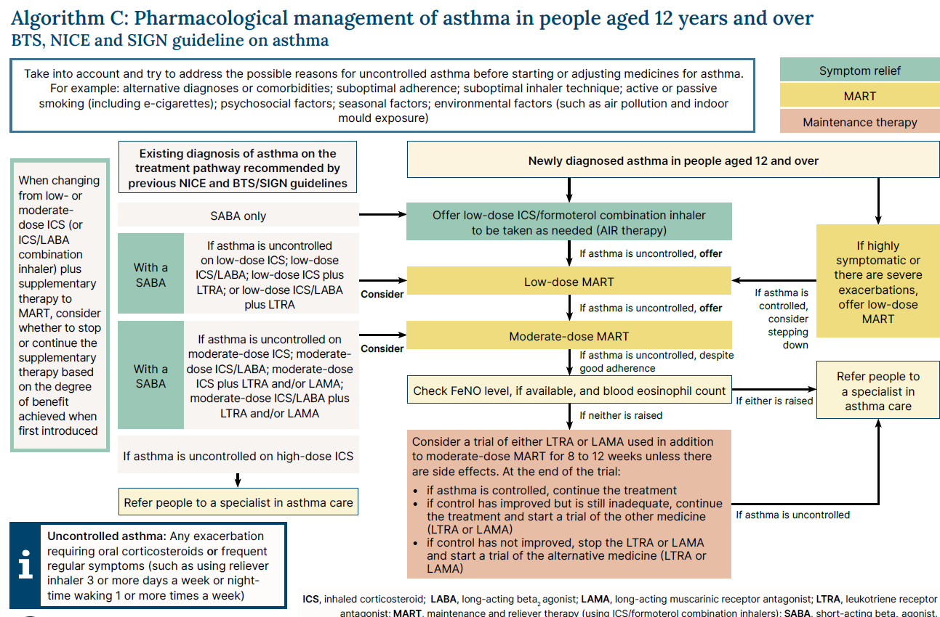
Treatment pathway (12> years)

Slide 12
Treatment of chronic asthma – children 5 - 11
  Initial treatment of newly diagnosed 5 to 11 year-olds: twice-daily paediatric low-dose inhaled corticosteroid (ICS), with a short-acting beta₂ agonist (SABA) as needed
  If asthma uncontrolled, consider either MART pathway (if able to manage MART), or conventional pathway:
  MART pathway - paediatric low-dose MART. If still uncontrolled, consider increasing to paediatric moderate-dose MART
  Conventional pathway – add leukotriene receptor antagonist (LTRA) to twice daily paediatric low-dose ICS plus SABA (for 8-12 weeks). If still uncontrolled - twice daily paediatric low-dose ICS/LABA (long-acting beta₂ agonist) combination inhaler plus SABA as needed (with or without LTRA). If still uncontrolled - progress to moderate-dose
  Refer to asthma specialist if patient not responding to moderate-dose MART or moderate-dose ICS/LABA combination

Slide 13
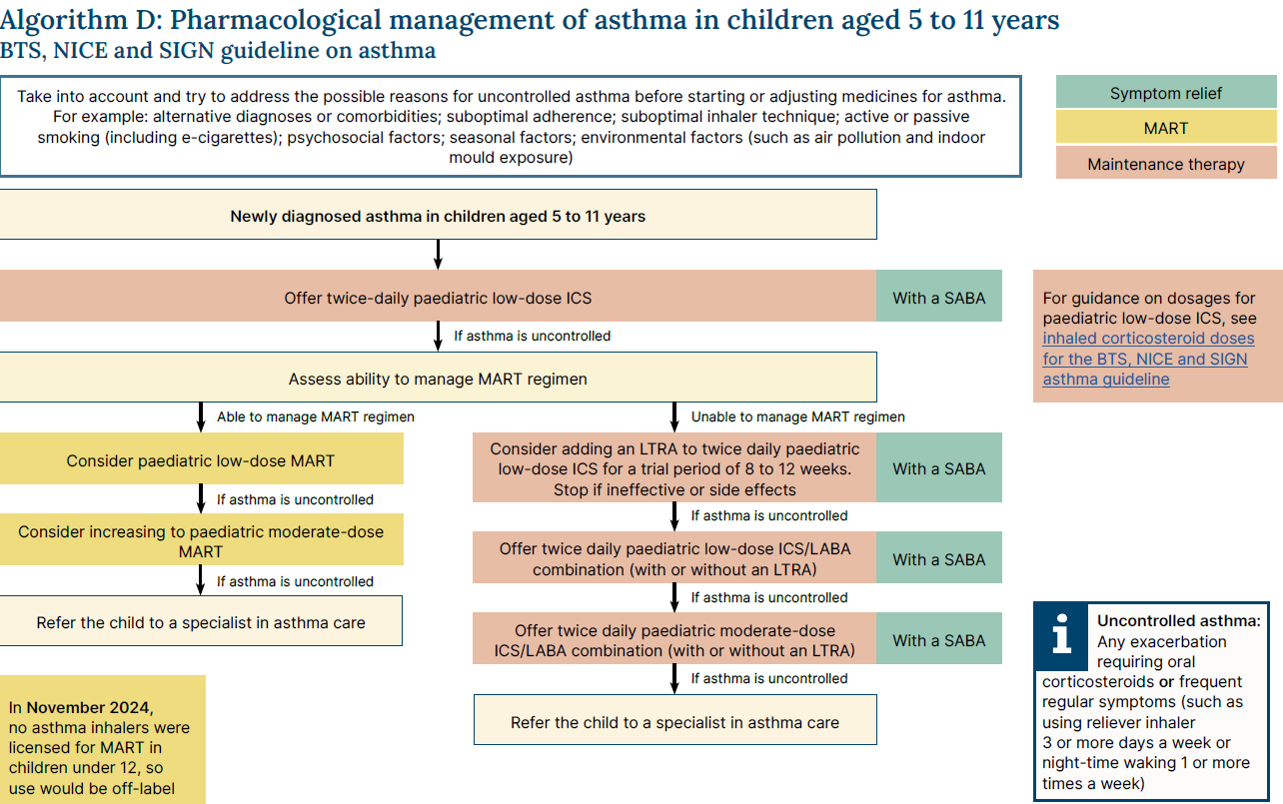
Treatment pathway: children 5 - 11

Slide 14
Treatment of chronic asthma in children under 5
8-12 week trial of twice-daily paediatric low-dose inhaled corticosteroid (ICS), as maintenance therapy (with a short-acting beta₂ agonist [SABA] for reliever therapy)
Look for symptomatic improvement
If no improvement check adherence, inhaler technique, persistent triggers and consider specialist referral
If symptoms improve consider stopping ICS and review at 3 months from start or sooner if needed. If symptoms recur restart ICS

Slide 15
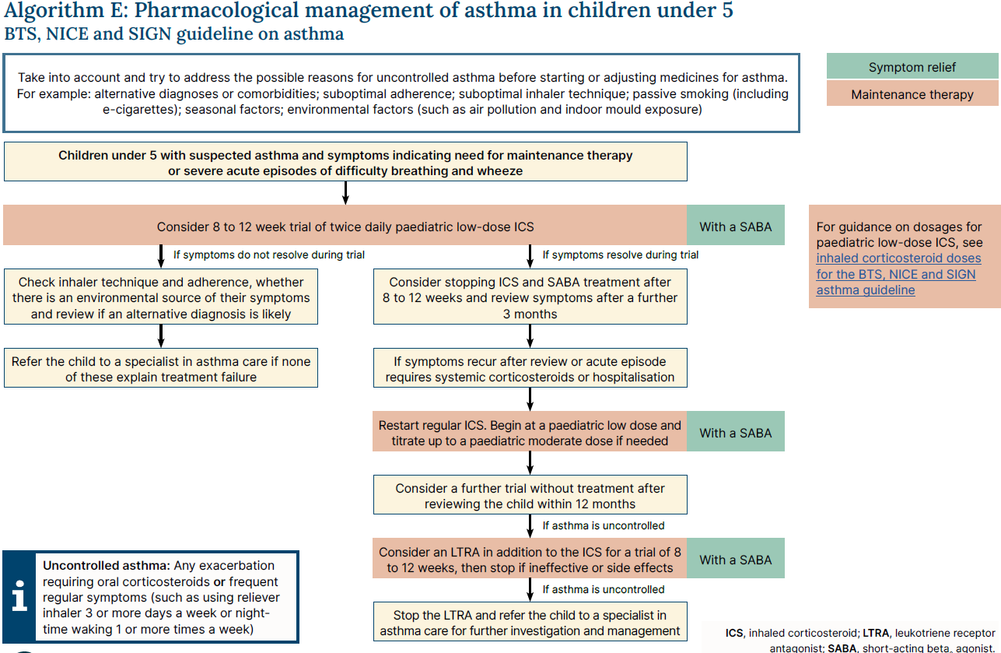
Treatment pathway: children under 5

Slide 16
Find out more
Further information on asthma resources can be found here:
Guideline
BTS/NICE/SIGN Joint Guideline on Asthma: diagnosis, management and chronic asthma management (NG245)
Asthma Pathway – signposting to range of resources in asthma
Joint Asthma Pathway (NG244) on NICE website
Joint Asthma Pathway (SIGN 244) on Right Decision Service Scotland website
BTS Webinars on new guideline
BTS hosted two webinars (one on managing adult patients, the other on children) offering practical insights on new guideline. Accessed via this link BTS Asthma Webinars
For queries, contact asthmaenquiries@nice.org.uk

